Slide 1

EXTREME HEAT EVENTS
2017
HEALTH AND CLIMATE CHANGE TRAINING MODULE SERIES
Minnesota Climate & Health Program | Environmental Impacts Analysis Unit
Notes:
This Extreme Heat Events & Health climate change training module is one of six one-hour introductions to the health effects of climate changes in Minnesota. The other training modules are:
Climate Change & Health 101
Agriculture & Food Security
Air Quality & Health
Water Quality and Quantity & Health
Well-being & Health
These modules have been designed for public health professionals, as well as others concerned about climate change, to provide a basic level of information about the observed climate changes in Minnesota and their health impacts.
The training modules generally focus on climate adaptation (preparing for and adjusting to new conditions to reduce harm or risk of negative health outcomes), and includes some references to climate mitigation (reducing harmful greenhouse gas emissions) as well.

Slide 2
NOTICE
The Minnesota Department of Health (MDH) developed this presentation based on scientific research published in peer-reviewed journals. References for information can be found in the relevant slides and/or at the end of the presentation.
Notes:
The Minnesota Department of Health (MDH) developed this presentation based on scientific research published in peer-reviewed journals. References for information can be found in the relevant slides and/or at the end of the presentation.

Slide 3
OUTLINE
Climate changes in Minnesota
Extreme heat and climate change
Urban heat island effect
Human health impacts of extreme heat and vulnerable populations
Strategy: Public health professionals
Strategy: Individuals
Notes:
The training module will review the following topic areas:
Climate changes in Minnesota
Extreme heat events and the relationship with climate change
Urban heat island effect
Human health impacts of extreme heat and vulnerable populations
Strategies: Public Health Professionals and Individuals
The first section covers Climate changes in Minnesota.

Slide 4
WEATHER VERSUS CLIMATE
Weather:
conditions of the atmosphere over a short period of time
Climate:
conditions of the atmosphere over long periods of time
Notes:
Although related, the terms weather and climate are defined differently. Weather generally refers to conditions of the atmosphere over a short period of time (days or weeks), while climate refers to conditions of the atmosphere over long periods of time (30-year standard averaging period) (NASA, 2005).
Therefore, climate change refers to any significant change in the measures of climate lasting for an extended period of several decades (US EPA, 2016a).
Weather has always fascinated Minnesotans, perhaps because we have all kinds of it, but recently climate change has also become a leading topic of concern.
Source: NASA, 2005; US EPA, 2016a
Image source: Lightning bolt and sun – Microsoft Clip Art

Slide 5

DEFINITIONS
ADAPTATION:
efforts to anticipate and prepare for the effects of climate change, and thereby to reduce the associated health burden
MITIGATION:
efforts to slow, stabilize, or reverse climate change by reducing greenhouse gas emissions
Notes:
Actions to prevent the adverse health effects of climate change can be described as ‘adaptation efforts’ or ‘mitigation efforts.’
Adapting to climate change means anticipating and preparing for the effects of climate change and reducing the associated health burden.
Mitigating climate change means taking on or supporting efforts that slow, stabilize or reverse climate change by reducing greenhouse gas emissions.
Image: Microsoft Clip Art

Slide 6
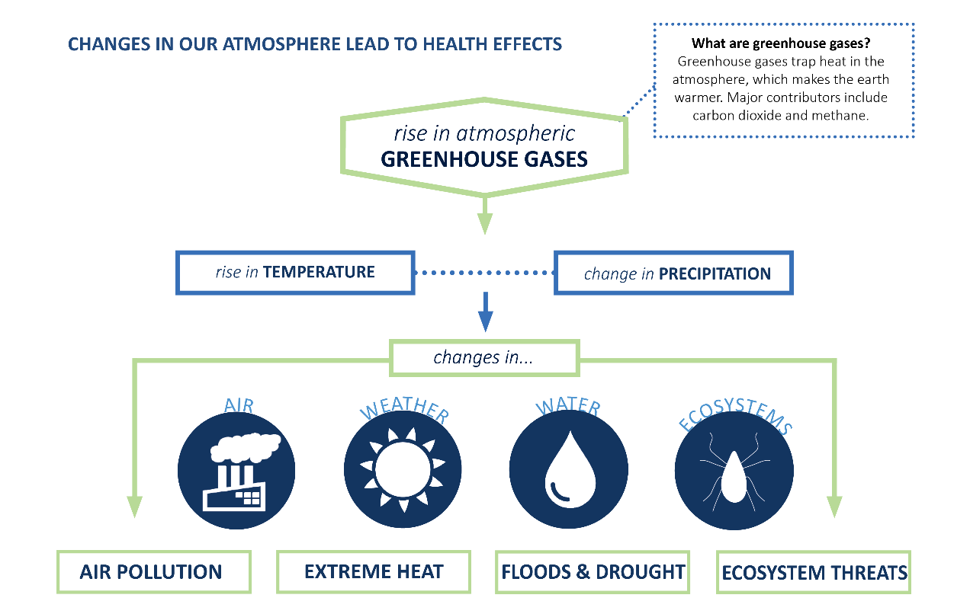
CLIMATE AND HEALTH ARE LINKED
Notes:
MDH’s MN Climate & Health Program is dedicated to understanding the links between climate changes and adverse health impacts and identifying opportunities for implementing adaptation measures in Minnesota communities.
Recent climate change is resulting in warmer temperatures and changing precipitation. Most climate scientists attribute these changes to burning of fossil fuels, like coal and oil, to produce energy for everyday use. This burning adds heat-trapping gases, such as carbon dioxide, into the air. These gases are called greenhouse gases (NASA, 2016).
As this graphic shows, the rise in greenhouse gases is leading to increases in temperature and changes in precipitation. These changes are causing changes in air quality, weather patterns, water quality and quantity, and ecosystems which, in turn, are leading to more air pollution, extreme heat, floods & drought, and ecosystem threats.
Source: EQB, 2015; MDH, 2015; NASA, 2016

Slide 7
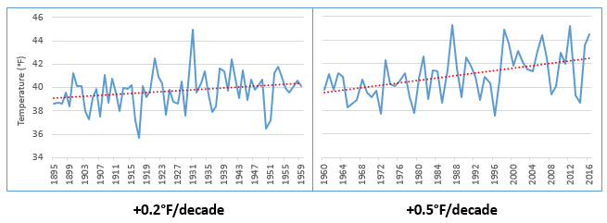
RISING TEMPERATURES
Minnesota Average Annual Temperature, 1895 -2016
Source: NOAA, 2017
Notes:
Minnesota has gotten noticeably warmer, especially over the last few decades. Since the beginning of the data record (1895) through 1959, Minnesota’s annual average temperature increased by nearly 0.2°F per decade, which is equivalent to over 2°F per century. This is shown in the graph to the left. This warming effect has accelerated over the last 50+ years. Data from 1960-2016 show that the recent rate of warming for Minnesota has sped up substantially to over 0.5°F per decade, which is equivalent to 5.0°F per century. This is shown in the graph to the right.
Source: National Oceanic and Atmospheric Administration (NOAA). 2017a. NOAA National Centers for Environmental information, Climate at a Glance: U.S. Time Series, Average Temperature, published February 2017, retrieved on February 9, 2017 from http://www.ncdc.noaa.gov/cag/

Slide 8
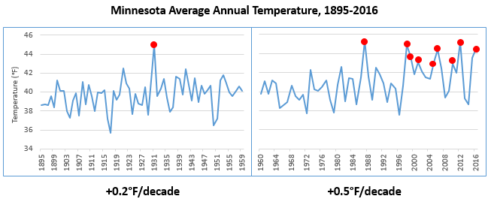
RISING TEMPERATURES
Minnesota Average Annual Temperature, 1895 -2016
Source: NOAA, 2017
Notes:
The increase in temperature trend is driving changes in the environment, affecting ice cover, soil moisture, bird migrations, insect behavior, and forest and plant growth. Some of these changes will impact the health of Minnesotans. For example, finding ways to cope with recent summer heat waves has made climate change less of an abstract concept for many residents, especially those who struggle to acclimate or adjust to these events, and the challenge will likely increase. Based on more than a century of data, 9 of the top 10 warmest years for Minnesota, shown in the slide as the peaks with red points, have occurred just within the last three decades.
Source: National Oceanic and Atmospheric Administration (NOAA). 2017a. NOAA National Centers for Environmental information, Climate at a Glance: U.S. Time Series, Average Temperature, published February 2017, retrieved on February 9, 2017 from http://www.ncdc.noaa.gov/cag/

Slide 9
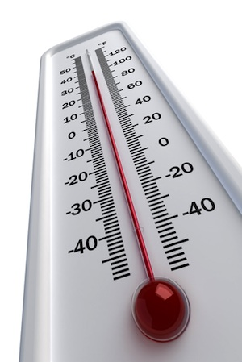
RISING TEMPERATURES
WINTER TEMPREATURES ARE RISING
ABOUT TWICE AS FAST AS ANNUAL AVERAGE TEMPERATURES
MINIMUM OR ‘OVERNIGHT LOW’
TEMPERATURES ARE RISING FASTER
THAN MAXIMUM OR ‘DAYTIME HIGH’ TEMPERATURES
NORTHERN MINNESOTA IS WARMING
FASTER THAN SOUTHERN MINNESOTA
Notes:
Within this overall annual warming pattern, there have been three significant observations in Minnesota.
First, winter temperatures are rising twice as fast as the annual average temperatures. We are now experiencing more warmer winter temps, less snow and more winter rain, and changes in the amount of ice.
Secondly, minimum temperatures, which are the overnight lows, have been rising faster than maximum temperatures, which are the daytime highs. In just the last 30 years, average annual overnight lows have been rising at a rate of 6 degrees Fahrenheit per 100-year period.
And lastly, the northern part of the state is warming faster than the southern part of the state. Over the last 50 years, there has been a distinct spread of warmer overnight lows into the northern part of Minnesota. This is consistent with patterns seen across the Northern Hemisphere, where climate changes are occurring more rapidly at these higher latitudes.
Source: Zandlo, 2008; NOAA, 2017a
Image: Clip Art Images

Slide 10
ENVIRONMENTAL CHANGES
Changing Plant Hardiness Zones
After USDA Plant Hardiness Zone Map, USDA Miscellaneous Publication No. 1475, Issued January 1990.
Arbor Day Foundation Plant Hardness Zone Map published in 2015.
Notes:
The change in temperature is already causing substantial shifts in the environment. Maps of USDA plant hardiness zones show what types of plants will survive well and where. This is the standard by which gardeners and growers determine the plants that are most likely to thrive at a location. Zones are based on the average annual minimum winter temperature over a 30-year period and each zone represents a 10-degree Fahrenheit increment of minimum temperatures (USDA Agricultural Research Service, 2012).
This image from the National Arbor Day Foundation compares two points in recent times. In 1990, Minnesota was predominantly zone 3 in the northern half of the state and zone 4 in the southern half of the state. In 2015, Minnesota was predominantly zone 4 across the majority of the state, with a smaller area of zone 3 in the far northern part of the state and zone 5 emerging in the far southern part of the state.
These shifts may stress native plant species and may make it easier for non-native plants, and the insects and pathogens that rely on them, to move into areas where they previously couldn’t survive.
Source: USDA Agricultural Research Service, 2012
Image source: Plant Hardiness Zones – Arbor Day Foundation, 2015

Slide 11
PRECIPITATION INCREASES
Minnesota Average Annual Precipitation, 1895-2016
-0.2”/decade
+0.5”/decade
Notes:
With a warming atmosphere, more evaporation occurs. Warmer air can also hold more water vapor than cool air. The water holding capacity of air increases by about 7% per 1°C warming.
The chart on this slide shows Minnesota's average annual precipitation from 1895 to 2016. The graph on the left highlights the trend for the early part of the last century, 1895-1959, while the graph on the right highlights the trend for the most recent half century, 1960-2016. For most of the first half of the 20th century, the trend in precipitation was slightly downward, at a loss of 0.2 inches per decade or the equivalent of -2 inches per century. This downward trend was influenced by the Dust Bowl years of the 1930s. However, the rate of precipitation across the state has increased by nearly 0.5 inches per decade or the equivalent of 5 inches per century over the last 50+ years.
Source: Trenberth, 2011; National Oceanic and Atmospheric Administration (NOAA). 2017. NOAA National Centers for Environmental information, Climate at a Glance: U.S. Time Series, Precipitation, published February 2017, retrieved on February 9, 2017 from http://www.ncdc.noaa.gov/cag

Slide 12




PRECIPITATION – MORE EXTREME EVENTS
1860s
1870s
1880s
1900s
1910s
1920s
1930s
1940s
1950s
1960s
1970s
1980s
1990s
2000s
2010s
2020s
1890s
1
1
1
2
3
3
4
7 OF THE 15
MINNESOTA MEGA-RAIN EVENTS HAVE
OCCURRED SINCE 2002
Notes:
Overall our average annual precipitation is slightly increasing and this increase is being driven by heavy precipitation events. This timeline captures the historic mega-rain events in Minnesota that have occurred since 1858. These events constitute a six-inch rainfall that covers more than 1,000 square miles, with the core of the event topping eight inches. 15 mega-rain events have been identified in Minnesota since 1858 and 7 of these events have occurred since 2002.
A recent study of precipitation in Minnesota found that storms with 3+ inches of rainfall has increased 104% in last 50 years.
[Reference] These seven mega-rain events since 2002 include:
June 2002 – where rainfall topped 12 inches over 48 hours in Roseau and Lake of the Woods Counties of Northern MN
September 2004 – with more than 10 inches of rain in a 36-hour period in Faribault and Freeborn Counties of Southern MN
August 2007 – in South East Minnesota, after 15.1 inches of rain fell in 24 hours
September 2010 – in South Central Minnesota, after 9.5 inches of rain fell in one day
June 2012 – in North East Minnesota, after over 10 inches of rain fell over 2 days, causing severe flash flooding and river flooding; the St. Louis River crested at over 16 feet after rising 10 feet in 24 hours
July 2016 – in Central Minnesota, especially Pine County, with a two-day total of 9.3 inches
August 2016 – in Central and South East Minnesota, with rainfall rates of two-three inches per hour.
Source: MDNR, 2016

Slide 13
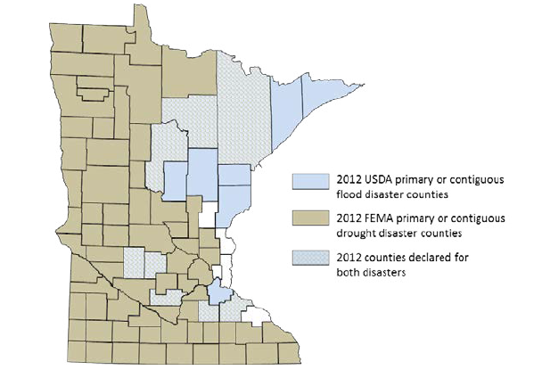
PRECIPITATION CHANGES
Blue counties were declared disaster areas due to flooding.
Brown counties were declared disaster areas due to drought.
Light blue, cross-hatched counties received both designations.
Notes:
However, more moisture in the atmosphere doesn’t necessarily mean a consistent rise in rain and snow. The character of precipitation in Minnesota is changing, increasing the potential for both extreme wet and dry spells. Minnesota is starting to experience increases in localized, heavy precipitation events. Observed trends have the potential to cause both increased flooding and drought, based on the localized nature of storms and their intensity, leaving some areas of the state drenched and other areas without any precipitation. For example, in 2012, 75 counties were declared primary or contiguous disaster areas for drought. However, in that same year 15 counties and three tribal reservations were declared disaster areas for flooding, with eight counties receiving disaster designation for both, underscoring the intensification of precipitation extremes in both directions.
Source: MDH, 2015

Slide 14
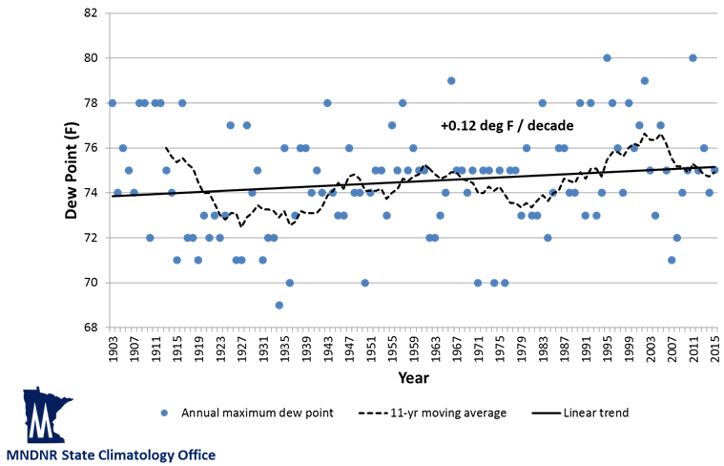
HUMIDITY CHANGES
Highest annual dew points at 6 p.m. CST
Minneapolis – St. Paul, 1903-2015
Notes:
Humidity levels are a function of both temperature and water levels in the atmosphere. Health professionals are particularly interested in humidity, since this affects the skin’s ability to evaporate moisture and cool the body. Dew point is a measure of water vapor in the air. Specifically, the dew point temperature is the temperature to which air must be cooled at constant pressure for it to become fully saturated with water. The higher the dew point is, the more uncomfortable and physically stressed a person feels. This is because people cool themselves by sweating, and if the dew point is high, it becomes more difficult for sweat to evaporate off the skin.
While many measures of dew point and humidity in Minnesota do not yet show evidence of increasing, the most extreme dew point values are becoming more frequent and more extreme over time. Based on historical data, annual maximum dew point temperatures (measured at 6pm CST) are increasing in Minnesota. This trend is modest but significant, about 0.12 degrees per decade. We are also experiencing an increase in the frequency of dew point readings at or above 75°F, a level that is extremely uncomfortable and oppressive. In fact, the frequency of these extreme dew point temperatures is 51% more common in the second half of Minnesota’s weather record (1960-2015) than in the first half (1903-1959).
Source: Trenberth, K.E., 2011; personal communication with Kenny Blumenfeld, Minnesota DNR State Climatology Office on August 9, 2016

Slide 15
OUTLINE
Climate changes in Minnesota
Extreme heat and climate change
Urban heat island effect
Human health impacts of extreme heat and vulnerable populations
Strategy: Public health professionals
Strategy: Individuals
Notes:
The next section covers extreme heat and climate change.

Slide 16
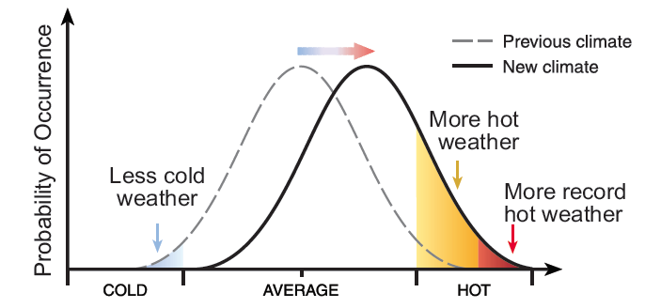
EXTREME HEAT
INCREASE IN AVERAGE TEMPERATURE
Climate change is causing a
shift in the probability of
both average and extreme temperatures.
Notes:
Climate change is causing a shift in the probability of both average and extreme temperatures. Scientists expect climate change to lead to longer, more severe and more frequent extreme heat events. Hot days and heat waves that once were considered rare and record-breaking may become much more commonplace.
Source: CDC, 2009

Slide 17

EXTREME HEAT
The experience of extreme heat is subjective and site-specific
No universal definition, but most refer to an extended period with unusually hot temperatures
Notes:
There is no universal definition of an extreme heat event. Criteria for what defines an extreme heat event differ given that the experience of heat is dependent on the level of acclimatization in the population. Summer temperatures considered commonplace in Phoenix, Arizona may seem extreme to people living in Northern Minnesota. In general, most definitions of an extreme heat event refer to an extended period of time with unusually hot weather conditions for that particular time of year.
Sources: Anderson and Bell, 2011; NWS, 2009a
Image: “Sunset” - https://www.pexels.com/photo/sunset-147465/

Slide 18
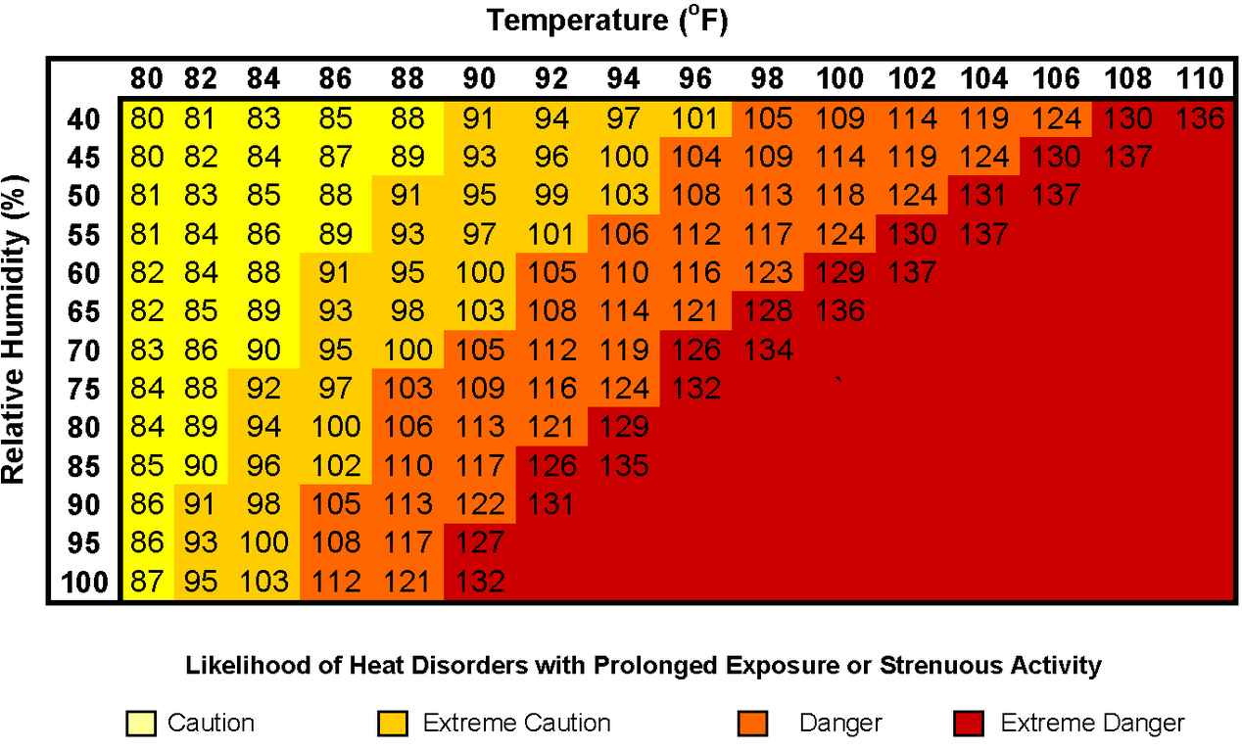
EXTREME HEAT
HEAT INDEX: A measure of how hot it really feels when relative humidity is factored in with the actual air temperature.
NOAA’s National Weather Service Heat Index
Notes:
Many weather stations rely on the calculation of the heat index to communication heat risk. The Heat Index (HI) is a measure of how hot it really feels when relative humidity is factored in with the actual air temperature.
For example, if the air temperature is 96°F and the relative humidity is 65%, the heat index…or rather, how hot it actually feels to the average person…is 121°F. The red area on the chart indicates extreme danger. Keep in mind that heat index values were devised for shady, light wind conditions. Exposure to full sunshine can increase heat index values approximately 15°F. Furthermore, strong winds, particularly with very hot, dry air, can be extremely hazardous.
Sources: NWS, 2009a; NWS, 2010a (and image)

Slide 19
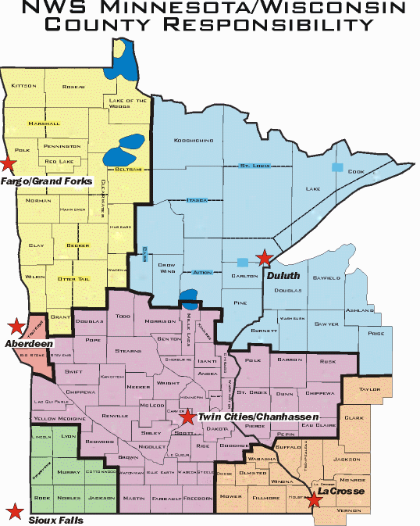
EXTREME HEAT
National Weather Service (NWS) stations release heat
advisories and warnings
Notes:
This map shows the service area for the six National Weather Service stations serving Minnesota. Each NWS station releases heat advisories and warnings depending on the weather in its service area.
Source: NWS, 2010b

Slide 20

EXTREME HEAT
NWS heat-related products
    Excessive heat outlook
    Excessive heat watch
    Heat advisory
    Excessive heat warning
Notes:
In general, the National Weather Service issues the following heat-related products as conditions warrant: Excessive heat outlooks, heat advisory, excessive heat watches, or excessive heat warnings.
Excessive Heat Outlooks are issued when the potential exists for an extreme heat event in the next 3-7 days.
Excessive heat watches are issued when conditions are favorable for an extreme heat event in the next 24 to 72 hours.
Heat advisories are issued within 12 hours of the onset of an extreme heat event. In general, an advisory is issued when the maximum heat index is expected to be 100° or higher for at least 2 days, and nighttime air temperatures are not expected to drop below 75°F.
Excessive heat warnings are issued within 12 hours of the onset of an extremely dangerous heat event. Generally, a warning is issued when the maximum heat index is expected to be 105° or higher for at least 2 days and nighttime air temperatures will not drop below 75°F. These criteria will vary, especially for areas not used to extreme heat conditions.
That advisories and warnings take into account the absence of nighttime cooling underscores how important this is. The drop in overnight temperatures offers important relief to people who lack air-conditioning or access to cool spaces. Elevated nighttime temperatures can continue to stress the body, prolonging they physiological strain and increasing risk for serious injury.
There are some indications that the relationship between high nighttime temperatures and mortality is more pronounced than the relationship for daytime temperatures.
Sources: NWS, 2009a; Medina-Ramón and Schwartz, 2007; Zhang, K., et al, 2012

Slide 21

EXTREME HEAT RECORDS
There were FIVE HEAT EPISODES in the summer of 2011
worthy of issuances of warnings or advisories
JUNE 6-7
JUNE 30 – JULY 1
JULY 16-20
JULY 23
AUGUST 1
Notes:
There were five heat episodes in summer 2011 worthy of issuing heat advisories or warnings:
June 6-7
June 30-July 1
July 16 – 20. This was the most prolonged extreme heat event by far, since late July of 2006 for Minnesota
July 23 (Minor event, with heat advisories only covering small portions of Minnesota)
August 1 (Minor event, with heat advisories only covering small portions of Minnesota)
Source: Friedlein, 2011

Slide 22
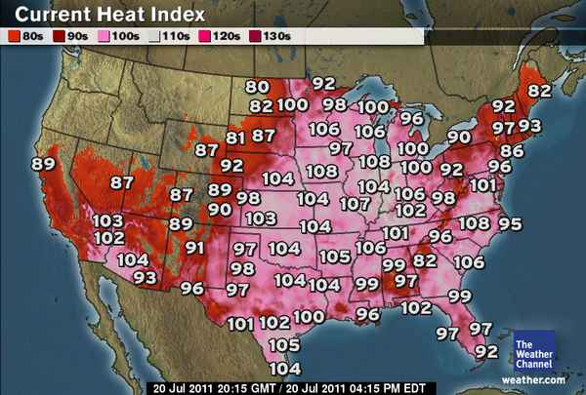
EXTREME HEAT RECORDS
JULY 19, 2011
Twin Cities
Heat Index of
119°F,
State Record
Heat Index of
130°F
Notes:
July 19, 2011 was an all-time heat index record for the Twin Cities. The air temperature reported at worst hour was 95°F and was paired with the 82°F dew point temperature for a heat index of 119°F.
That date also saw the state record dew point temperature of 88°F. With an air temperature of 93°F, the heat index reached 130°F. The record state dew-point temperature was recorded at Moorhead Municipal Airport from 7pm to 9pm.
Sources: Minnesota State Climatology Office, 2011a; Minnesota State Climatology Office, 2011b; NWS, 2011

Slide 23
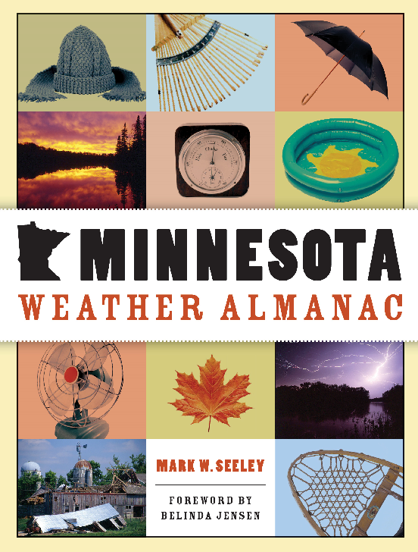
EXTREME HEAT EVENTS
1883, 1894, 1901, 1910, 1917, 1921, 1931, 1933, 1934, 1936, 1937, 1947, 1948, 1949, 1955, 1957, 1959, 1964, 1976, 1977, 1983, 1988, 1995,1999, 2001, 2005, 2006, 2007, 2010
*Purple denotes dew point driven
Notes:
The Minnesota Weather Almanac by Dr. Mark Seeley is the 200-year weather history of the state, including dramatic events and episodes of the 19th Century. The state has experienced many heat waves, as listed here on the slide. The ones noted in red font were driven by high dewpoints not high air temperatures. You can see an obvious trend of recent extreme heat events driven by high dew point whereas past extreme heat events were driven by high air temperatures. This trend is expected to continue. As you saw previously, dew points are rising.
Source: Seeley, 2011

Slide 24
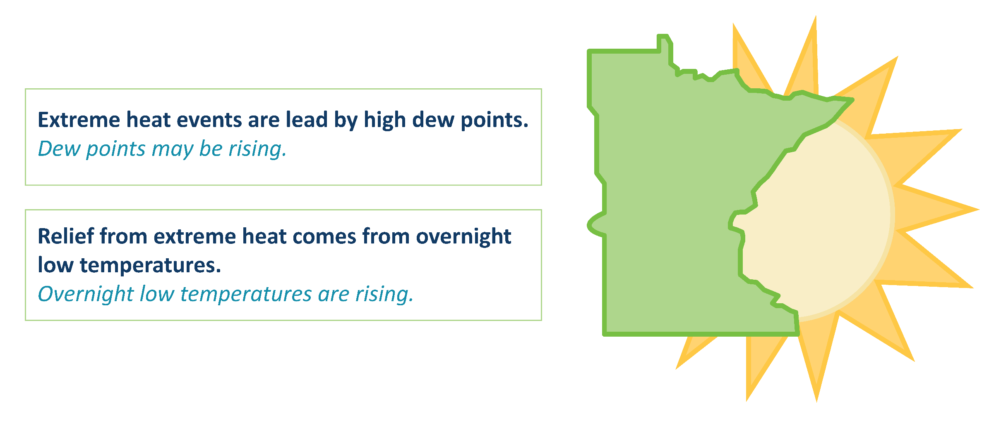
EXTREME HEAT EVENTS AND CLIMATE CHANGES
Notes:
The relationship of observed changes in Minnesota’s climate and Minnesota’s risk of extreme heat events can be summarized as follows:
In Minnesota more EHE are led by high dew points, and dew points may be rising
Relief from EHE comes from overnight low temperatures, and overnight low temperatures are rising
Therefore, Minnesota is at risk of more EHE

Slide 25
OUTLINE
Climate changes in Minnesota
Extreme heat and climate change
Urban heat island effect
Human health impacts of extreme heat and vulnerable populations
Strategy: Public health professionals
Strategy: Individuals
Notes:
The next section will define the urban heat island effect, which can make persons living in urban areas more at risk to extreme heat events.

Slide 26
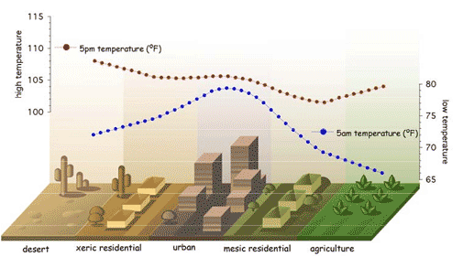
URBAN HEAT ISLANDS (UHI)
Urban heat island effect is a measurable increase in ambient urban air temperatures resulting primarily from the replacement of vegetation with buildings, roads, and other heat-absorbing infrastructure.
Notes:
The urban heat island effect is a measurable increase in ambient urban air temperatures resulting primarily from the replacement of vegetation with buildings, roads, and other heat-absorbing infrastructure. The heat island effect can result in significant temperature differences between rural and urban areas.
Causes:
Urbanization is associated with an increase in human and commercial traffic, air pollution from industries and cars, overcrowding and impervious surfaces such as large buildings and parking lots.
Reduced vegetation enhances the UHI because loss of evapotranspiration (evaporation and transpiration) cooling effect and shading
All these tend to produce the “urban heat island effect”, making urban areas warmer than rural areas.
The presence of tall buildings and emitted atmospheric pollutants in the cities prevents reflected radiation from escaping from the surface of the earth. Tall buildings and darker surfaces in the cities also absorb heat and radiation. Skyscrapers also obstruct free air flow in urban areas.
Similarly the increase energy consumption associated with cooling during extreme heat event also leads to the emission of more air pollutants that cause more trapping of heat.
Effects:
The effect is proportional to the size of the city – but all cities, large and small, have urban heat islands. On average, a city with 1 million people can have a 2-6 degree UHI. On clear, calm nights, this can be as high as 20 degree-plus fareinheit.
Sources: NWS, 2009b; Snyder, 2012

Slide 27
URBAN HEAT ISLANDS (UHI)
Year-Round Consequences
  Cost of cooling buildings
  Lack of low winter temps.
  Increased severe weather
  30% downwind precipitation increase
  Air pollutant production (ground-level ozone)
  Worse heat waves in urban areas
  Overall effect urban ecosystems
Notes:
The consequences of UHI can be positive and negative, especially in cooler climates like Minnesota’s. The chart on this slide shows that even a small increase in temperature during already peak periods can cost hundreds of millions of additional dollars in increased electricity costs for cooling. However, UHI in the winter can reduce the nighttime and extreme cooling and lower the costs of heating buildings. The UHI has also been shown to cause shifts in weather patterns, such as more severe weather and changes in precipitation from the urban area to rural regions downwind.
Sources: Snyder, 2012; U.S. EPA, 2008

Slide 28

MITIGATING URBAN HEAT ISLANDS
GREEN ROOFS
Vegetative layer grown on a rooftop
Reduces roof surface temperatures
COOL ROOFS
Highly reflective materials
Can remain 50-60° cooler than traditional materials
PERMEABLE PAVEMENTS
Pavement structure evaporates moisture as the surface heats, drawing heat out of the pavement, similar to evaporative cooling from vegetated land cover
Notes:
Three strategies to reduce the urban heat island effect are: green roofs, cool roofs/pavements and permeable pavements.
Green roofs: A green roof, or rooftop garden, is a vegetative layer grown on a rooftop. Green roofs provide shade and remove heat from the air through evapotranspiration, reducing temperatures of the roof surface and the surrounding air. On hot summer days, the surface temperature of a green roof can be cooler than the air temperature, whereas the surface of a conventional rooftop can be up to 90°F (50°C) warmer.
Cool roofs: Cool roofing products are made of highly reflective and emissive materials that can remain approximately 50 to 60°F (28-33°C) cooler than traditional materials during peak summer weather. A 2004 report summarized more than 25 articles about the cooling energy used by buildings with cool roofs and identified energy savings ranging from 2 to over 40 percent, with average savings of about 20 percent. Even when the wintertime heating penalty is accounted for, there are still significant energy savings during the summer. (winter sun is weaker and hours of daylight shorter; plus heating with natural gas can be cheaper than cooling with electricity.) A recent Stanford University study researched the impact of increased reflection on atmospheric warming if there was national implementation of cool (white) roofs. The study found that the increased reflection is absorbed into the atmosphere by dark particles and increases global warming. However, this is not a net-effect. It does not take into account the negative impact on global warming as a result of reduction in GHG emissions due to lower energy production because buildings are cooler with cool (white) roofs. It is unlikely that the increased reflection of the suns rays from a cool (white) roof would have a greater impact than the reduced GHG from lower energy production for cooling.
Cool pavements: Cool pavement materials reflect more solar energy and enhance water evaporation. Conventional paving materials can reach peak summertime temperatures of 120–150°F (48–67°C), transferring excess heat to the air above them and heating storm water as it runs off the pavement into local waterways. Researchers at Lawrence Berkeley National Laboratory have estimated that every 10 percent increase in solar reflectance could decrease surface temperatures by 7ºF (4ºC). Further, they predicted that if pavement reflectance throughout a city were increased from 10 percent to 35 percent, the air temperature could potentially be reduced by 1ºF (0.6ºC).
Permeable pavements: Although originally designed for storm-water control, permeable pavements are emerging as a potential cool pavement. These pavements allow air, water, and water vapor into the voids of the pavement. Permeable pavement technologies include porous asphalt applications, pervious concrete applications, permeable pavers, and grid pavements. When wet, these pavements can lower temperatures through evaporative cooling. The water passes through the voids and into the soil or supporting materials below. Moisture within the pavement structure evaporates as the surface heats, thus drawing heat out of the pavement, similar to evaporative cooling from vegetated land cover.
Source: U.S. EPA, 2008
Image source: The Kestrel Design Group

Slide 29
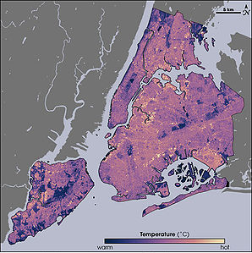

MITIGATING URBAN HEAT ISLANDS
Adding Trees and Vegetation
Thermal image of New York City
Vegetation in New York City
Notes:
The left image is a thermal image of New York City.
Yellow is the warmest,
Purple/Blue is the coolest area.
Compare that image with vegetation in NYC to the right, which shows the density of vegetation in NYC.
Where there is vegetation (see Central Park circles on both maps), the city is cooler.
Adding trees and vegetation: Trees and vegetation lower surface and air temperatures by providing shade which limits the amount of light (sun’s energy) that reaches the ground and through evapotranspiration. [Evapotranspiration is the combined movement of water vapor into the air as a result of plant transpiration (loss of water through leaf pores) and evaporation from soil, canopy interception and waterbodies.] Shaded surfaces, for example, may be 20–45°F (11–25°C) cooler than the peak temperatures of unshaded materials. Evapotranspiration, alone or in combination with shading, can help reduce peak summer temperatures by 2–9°F (1–5°C).
Sources: U.S. EPA, 2008; Scott, 2006
Image source: NASA

Slide 30
OUTLINE
Climate changes in Minnesota
Extreme heat and climate change
Urban heat island effect
Human health impacts of extreme heat and vulnerable populations
Strategy: Public health professionals
Strategy: Individuals
Notes:
The next section will describe the human health impacts of extreme heat events and identify those populations that are more vulnerable or have characteristics that make them more at risk to extreme heat events.

Slide 31
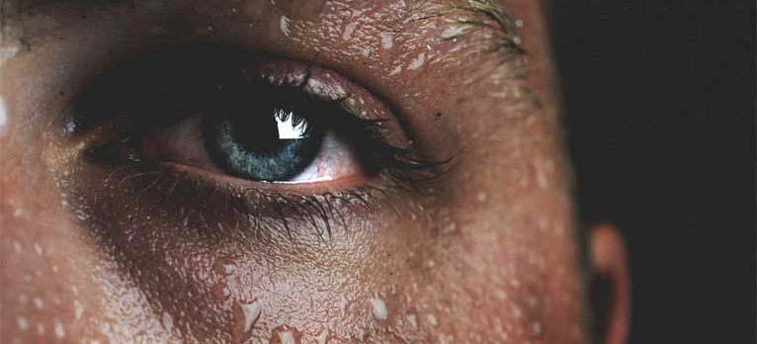
EXTREME HEAT EVENTS AND HUMAN HEALTH
Heat tetany (hyperventilation)
Heat rash
Heat cramps
Heat exhaustion
Heat edema (swelling)
Heat syncope (fainting)
Heat stroke
Death
Notes:
Heat stress and heat-related illness:
Physiologic mechanisms maintain the core body temperature (i.e., the operating temperature of vital organs in the head or trunk) in a narrow optimum range around 37° C (98.6° F). When core body temperature rises, the physiologic response is to sweat and circulate blood closer to the skin’s surface to increase cooling.
If heat exposure exceeds the physiologic capacity to cool, and core body heat rises, then a range of heat-related symptoms and conditions can develop – from relatively minor treatable conditions such as heat-related cramps (symptoms of excessive muscle spasms that occur with strenuous exercise during periods of extreme wave event), syncope (symptoms of dizziness and fainting that occur during heat wave period), and edema (symptoms of swelling in the ankles, feet and hands that occur in persons who are not used to hot climate during heat wave event), to more serious heat exhaustion (symptoms of profuse sweating, weakness, rapid breathing, dizziness, nausea, muscle cramps and headaches that occur during heat wave period) that results from extreme depletion of blood plasma volume and requires immediate treatment because if allowed to progress it can lead to heat stroke (life threatening and usually occurs when the body temperature is greater 105˚F), the most serious form of heat-related illness.
Heat stroke is an extreme medical emergency that if untreated can result in death or permanent neurological impairment. Heat stroke occurs when a person’s core body temperature rises above 40° C (104° F) as a result of impaired thermoregulation. High core body temperature can lead to damage in vital organs, such as the brain, liver, and kidneys, which in turn can result in serious illness, neurological damage, and death.
Heat Illness Definitions:
Heat tetany: These are symptoms of hyperventilation, other respiratory problems and muscular problems like spasms and numbness of muscles that result from short period of intense heat.
Heat rash: These are symptoms of skin irritation resulting from excessive sweating as a result of exposure to extreme heat.
Heat cramps: These are symptoms of excessive muscle spasms that occur with strenuous exercise during periods of extreme wave event.
Heat edema: These are symptoms of swelling in the ankles, feet and hands that occur in persons who are not used to hot climate during heat wave event.
Heat syncope: These are symptoms of dizziness and fainting that occur during heat wave period.
Heat exhaustion: These are symptoms of profuse sweating, weakness, rapid breathing, dizziness, nausea, muscle cramps and headaches that occur during heat wave period.
Heat/sun stroke: This life threatening and usually occurs when the body temperature is greater than 104˚F.
Finally death: This is the end result of unattended or treated heat illness.
Image: Pexels

Slide 32

EXTREME HEAT EVENTS AND HUMAN HEALTH
More than 7,000 heat-related deaths occurred in the U.S. from 1999-2009, approximately 650 each year were preventable
Chicago, 1995: 700+ deaths
Notes:
The CDC estimates that 7,233 heat-related deaths occurred in the U.S. from 1999-2009. Approximately 650 deaths each year of this period could have been prevented.
As an example from one of our neighbors, more than 700 deaths have been attributed to the famed 1995 Chicago heat wave.
Sources: CDC, 2013; Whitman et al, 1997; Larsen, 2006
Image: Chicago skyline – Pixabay. Available online at: https://pixabay.com/en/architecture-buildings-business-1853632/

Slide 33
DEATHS FROM EXTREME HEAT EVENTS
Heat-Related Deaths (Per Million) by Age in the U.S. (2006 -2010)
Notes:
This figure shows the average annual death rate attributed to excess heat exposure. While total death counts for ages 85+ drops off, death rate is highest due to smaller population numbers in this age group and increased vulnerability. Vulnerability to heat in old age occurs because of changes in the thermoregulatory system. But it also occurs because of social isolation.
Source: Berko et al, 2014

Slide 34

EXTREME HEAT – WHO’S AT-RISK
At-risk populations:
Everyone
Elderly persons 65 years and older, especially those who live alone
Children
Persons with pre-existing disease conditions
Persons taking certain medications
Athletes
Outdoor workers
Homeless
Notes:
Populations more vulnerable to extreme heat:
These categories of persons are known to be vulnerable to extreme heat event:
Elderly: Persons 65 years and above.
Children: Especially those 5 years and below.
Persons with pre-existing health conditions, including cardiovascular, respiratory, endocrine, liver and mental diseases conditions.
Persons taking certain medications: Those on diuretic, anticholinergics, tranquilizers and psychotropic drugs.
Data from the Agency for Health Care Research and Quality shows that about 6,200 Americans are hospitalized each summer due to excessive heat.
Those mostly affected are the elderly (admission for Persons 65 years and above was 15 times greater than those for persons 17 years and below).
Image: Pexels, https://www.pexels.com/photo/man-in-white-long-sleeve-shirt-on-track-in-field-126401/

Slide 35
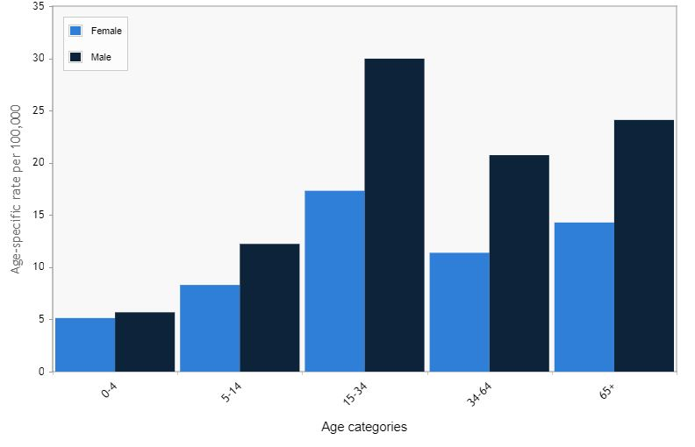
MINNESOTA EMERGENCY DEPARTMENT VISITS
Heat-related illness ED visits in Minnesota, by sex and age
Minnesota data:
Highest number of visits from men, 15-35 years old
Due to increased exposure
  Outdoor occupations
  Exercising outdoors
  Sports
Notes:
Minnesota emergency department visits show that men ages 15-34 years old are showing up more to emergency departments due to heat-related illness, than any other sex or age category. This is likely due to increased exposure to heat because of outdoor occupations and exercising outdoors.
Source: Minnesota Public Health Data Access and Minnesota Hospital Association. Available online at: https://apps.health.state.mn.us/mndata/heat_ed#sexandage

Slide 36

RISK FACTORS
Lack of air conditioners in homes
Low socioeconomic status
Living in urban areas: urban heat island effect
Living in topmost floor
Living in nursing homes or being bedridden
Living alone or lack of social or family ties
Prolonged exposure to sun
Drinking alcohol
Notes:
Factors that make persons more at risk to extreme heat include:
Lack of air conditioners in homes
Low socioeconomic status
Living in urban areas: urban heat island effect
Living in topmost floor
Living in nursing homes / being bedridden
Living alone / Lack of social or family ties
Prolonged exposure to sun
Drinking alcohol
Image: Open window – Pixabay. Available online at: https://pixabay.com/en/open-window-air-balcony-fire-escape-1246191/

Slide 37
OUTLINE
Climate changes in Minnesota
Extreme heat and climate change
Urban heat island effect
Human health impacts of extreme heat and vulnerable populations
Strategies: Public health professionals and individuals
Notes:
The final section will cover strategies that public health professionals and individuals can use to prevent heat-related illness.

Slide 38






STRATEGIES: PUBLIC HEALTH PROFESSIONALS
1. Develop a heat response plan
4. Activate the response plan and notify the public
2. Predict the extreme heat event
5. Implement the response plan
3. Assess risk and determine activation of response plan
6. Evaluate the response plan
Notes:
Key Steps for Responding to an Extreme Heat Event
The key steps for responding to an extreme heat event have been summarized below.
Step 1: Create a heat response plan
The first step in preparing to respond to an extreme heat event is to develop a heat response plan. A heat response plan is essential for describing and coordinating activities to prevent heat-related morbidity and mortality. The next slide will describe the minimum elements of an effective response plan.
Step 2: Predict extreme heat event and transfer information to lead agency
For successful notification of an upcoming heat event, it is critical for the lead agency of the response plan to develop partnerships with the NWS to ensure early weather forecasts capable of predicting extreme heat conditions a few days in advance of an extreme heat event. In Minnesota, the NWS provides weather forecasts and determines the issuance of heat advisories, watches or warnings. All Minnesota jurisdictions involved in planning and implementing heat response plans should develop relationships with their local NWS station to ensure daily monitoring of weather conditions and early detection and transfer of information regarding the characteristics of the upcoming event to the lead agency of the response plan.
Step 3: Assess risk and determine activation of response plan
Once the lead agency is informed of a possible extreme heat event, the agency, in collaboration with its partners, needs to determine if the characteristics are indicative of an extreme heat event that could trigger activation of the heat response plan. Generally, the lead agency reviews the NWS forecast data and health-impact information to determine whether location-specific criteria for an extreme heat event are satisfied, and then, if the conditions are met, the agency activates the plan. Activation of the heat response plan should happen before the extreme heat event occurs to ensure that preventive measures and strategies are implemented at the most opportune time for preventing illnesses and deaths from extreme heat.
Step 4: Activate response plan and notify the public
Assuming the impending heat event meets location-specific criteria for an extreme heat event, the lead agency activates the response plan. Immediately after a decision has been made to activate the extreme heat response plan, the public needs to be informed of the timing, severity and duration of the forecasted extreme heat event. Effective public notification of an upcoming extreme heat event helps eliminate the risk of the heat event taking a population by surprise. Notifying the public of anticipated conditions, strategies to stay cool and hydrated, and places to go to cool off will enable many residents to prepare and will enable the organizations involved in the response to concentrate on known high-risk individuals and locations. Advance public notification about the availability of cooling centers will increase the likelihood that at-risk individuals can take advantage of these services. All messages regarding an upcoming extreme heat event should be coordinated with media outlets to ensure the public receives consistent and accurate information. The communications strategy should be described in detail within the heat response plan.
Step 5: Implement response plan
The fourth step in responding to an extreme heat event is to implement the strategies in the response plan. The strategies should reflect the demographics and vulnerabilities of the community. See the next two sections for a detail description of several strategies that can be inserted into the response plan. The response plan should clearly delineate which participating agencies and organizations are responsible for implementing each strategy.
Step 6: Evaluate response plan
Each step of responding to an extreme heat event should be reviewed and evaluated after an extreme heat event. Evaluation is critical for improving the plan and making it more effective for preventing heat-related illnesses and deaths.

Slide 39

STRATEGIES: PUBLIC HEALTH PROFESSIONALS
Heat response plans should be developed before an extreme heat event occurs.
Notes:
Heat response plans have been shown to be effective in reducing heat-related mortality. Heat response plans describe in detail the roles and actions of government agencies and nongovernmental organizations for preventing morbidity and mortality from an extreme heat event. Each city or county in Minnesota should have a heat response plan; sometimes heat response plans are added as an annex to local all-hazards plan.
The level of detail and the number of strategies in the plan will vary based on available resources, geographic location, agencies and organizations involved in planning and responding, and the types and distribution of vulnerable populations. The key is to develop heat response plans BEFORE and extreme heat event occurs.
Image: Planning – Pixabay. Available online at: https://pixabay.com/en/concept-man-papers-person-plan-1868728/

Slide 40

STRATEGIES: PUBLIC HEALTH PROFESSIONALS
CRITICAL ELEMENTS OF A HEAT RESPONSE PLAN
Lead agency
Criteria for activating and deactivating the plan
Roles and activities of agencies and organizations
A communications plan
Identification of high-risk and vulnerable persons
Strategies for preventing deaths and illnesses
Evaluation of the response plan
Notes:
All Response Plan Should Contain the following Elements:
Lead agency: A lead agency for implementing the extreme heat response plan should be identified. Typically, a health department is the lead agency in charge of responding to extreme heat events, but this can vary at the local level. The lead agency will activate the plan and help coordinate the efforts of organizations involved in the response.
Criteria for activating and deactivating the plan: Criteria for activating and deactivating an extreme heat response plan vary and should be based on location-specific factors that affect the relationship between weather and mortality. These factors may include air temperatures, dew point temperatures, wind, daytime highs and overnight lows, and how long the hot weather is expected to last. Some public health departments have their own thresholds and calculations that include health-related criteria for extreme heat events. Others use the NWS criteria for activation.
Roles and activities of agencies and organization involved with the plan: Implementation of a heat response plan requires close collaboration between government agencies (e.g., local public health department, city emergency management, NWS) and non-governmental organizations, especially organizations that serve the community and vulnerable populations (e.g., the Red Cross, Meals on Wheels, Salvation Army). Engaging local organizations that work with vulnerable populations in planning and implementing the response plan will make it easier to identify appropriate strategies for the vulnerable populations in the community. Additionally, these organizations are most likely to perform successful outreach and strategies targeted to specific populations. The plan must clearly articulate the roles and responsibilities of all the organizations involved in the plan.
Communications plan: The communications plan needs to articulate communication strategies both between partners involved in the response plan and with the public. There should be frequent communication between the NWS, the lead agency in charge of the response plan and other collaborating agencies and organizations. Additionally, the plan should identify communication strategies for communicating heat-related information before, during and after an extreme heat event. For specific examples of communications materials and strategies, see the MDH Extreme Heat Toolkit at http://www.health.state.mn.us/divs/climatechange/extremeheat.html.
Identification of high-risk and vulnerable persons: See next slide.
Evaluation: Response plans should be reviewed and evaluated after an extreme heat event. Modifications to the plan should address lessons learned and changes in local conditions. This ensures continuous quality improvement and rectifies any challenges or mistakes observed from implementing the plan during previous events. The agencies and organizations involved in responding to the extreme heat events should partake in the evaluation process. Records on heat-related morbidity and mortality that occurred during the extreme heat event also should be collected and analyzed and used to adjust strategies and/or criteria for activating the heat response plan.
Image: Organization chart – Pixabay. Available online at: https://pixabay.com/en/organization-organization-chart-2478211/

Slide 41
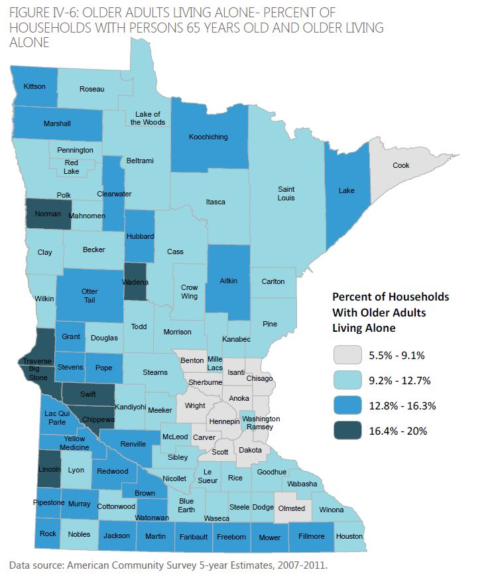
STRATEGIES: PUBLIC HEALTH PROFESSIONALS
Identify high-risk and vulnerable persons:
  Map populations at risk to assist development of strategies for targeted outreach in heat response plan
  See MDH Climate Change website for statewide maps of vulnerable populations and data sources for risk factors: www.health.mn.gov/climatechange
Notes:
Quantifying and mapping vulnerable populations and other risk factors provide important information for planning and implementing appropriate strategies that reach the most vulnerable members of a community. The lead response agency or another entity should create data summaries and/or maps to identify the most vulnerable populations in their community and where the populations reside, so that appropriate preventive actions and strategies for these populations can be determined before an extreme heat event.
Image: Older adults living alone – MDH. Available online at: http://www.health.state.mn.us/divs/climatechange/extremeheat.html

Slide 42
STRATEGIES: PUBLIC HEALTH PROFESSIONALS
Prevent illness and death
  Promote pre-summer awareness education and ongoing communication with the public
  Plan with local partners (e.g., local Red Cross chapter, social service organizations, etc.)
  Activate a heat line
  Designate community “cooling centers”
  Suspend utility shutoffs and provide transportation and financial assistance
  And more!
Notes:
Pre-summer awareness campaign & ongoing communication with public: Educate and prepare your community during an extreme heat event. Maintain good communication, know your target (vulnerable populations and others), know when to warn the public of an extreme heat event, communicate all heat-related information promptly in simple and clear language, and ensure regular communication between all agencies during an extreme heat event. Promote behavior changes such as encouraging people to wear light clothing, drink adequate water, eat light meals, and avoid strenuous work and exercises.
Plan with local partners (e.g., agencies, LPH, NGOs, and the community): Developing a database/list of high-risk facilities (e.g., those with mobility/health impaired residents) and organizations that serve vulnerable populations and their locations aids prioritization of prevention efforts to populations vulnerable to extreme heat and facilitates dissemination of extreme heat information to the organizations that serve these populations through faxes, emails, and/or telephone contact trees. Nursing homes and other elderly centers, for example, should be contacted and provided information to ensure that their populations are staying cool and are being assessed for symptoms of overexposure to heat.
Activate a heat line: An emergency heat line provides real-time advice and information during extreme heat events that can help prevent heat-related illnesses. A heat line can be activated when the response plan is activated or heat-related messages can be incorporated into more general, full-time systems (e.g., 311 line).
Designate community cooling-centers: Spending time in an air-conditioned building during an extreme heat event is one of the most effective means of reducing a person's risk of developing a heat-related illness. Designating specific public buildings with air conditioning as cooling shelters and providing information on large private buildings with air conditioning, where the public can freely congregate (e.g., shopping malls and movie theaters), can increase the use of these resources and minimize negative health impacts.
Suspend utility shutoffs and provide transportation and financial assistance: Local governments should develop partnerships and/or policies to prevent power and water companies from shutting off services to their customers due to nonpayment of bills during extreme heat events. Drinking water, taking cool baths/showers and using air conditioners are some of the most effective ways of preventing heat-related morbidity and mortality.

Slide 43
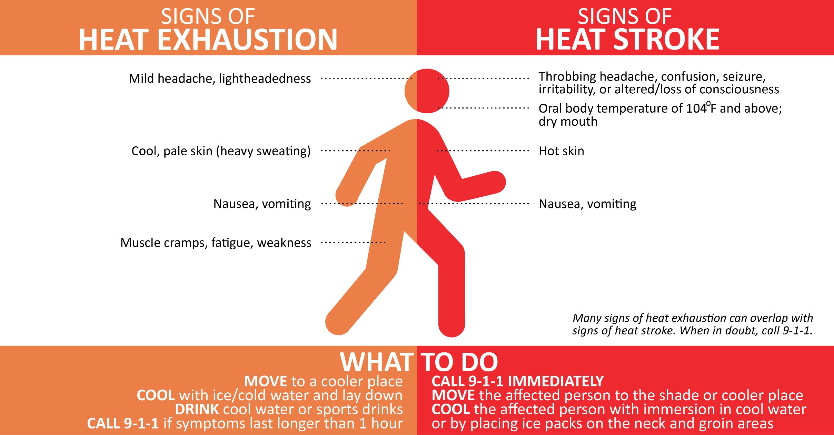
STRATEGIES: PUBLIC HEALTH PROFESSIONALS
Notes:
For example, this is a graphic developed by the Minnesota Department of Health to educate the public on recognizing the signs of heat exhaustion and heat stroke. This is available for professional and public use on our website.

Slide 44

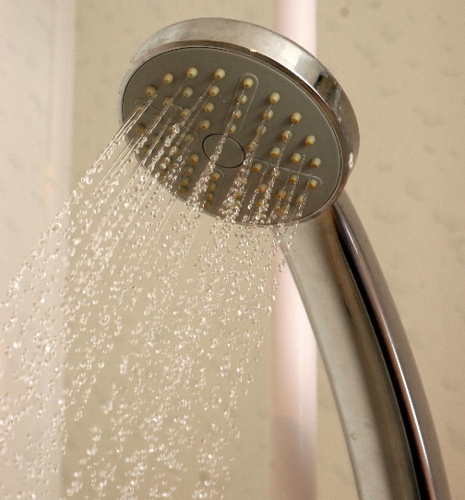



STRATEGIES: INDIVIDUALS
Stay hydrated!
Stay cool!
Wear loose, light-colored clothing
Check on at risk individuals…
Stay informed!
Notes:
This slide covers strategies individuals can do to deal with extreme heat conditions.
Stay Hydrated!
Drink plenty of fluids
Avoid alcoholic beverages
Avoid drinks that are high in sugar
Stay Cool!
Stay indoors, in air-conditioned places
Fans are not effective in high 90s°F
Wear lightweight, light-colored, loose fitting clothing
If you must be outside:
Schedule outdoor activities carefully
Take time to adjust to the heat: the most instances of heat-related morbidity and mortality may not happen in the hottest region during an extreme heat event, but rather the coolest, where the population is not acclimated to heat or lacks adaptive capacity (access to cooled indoor environments).
Pace yourself
Check on persons at more risk to heat:
Do not leave children or pets in cars
Check on elderly neighbors
Stay informed!
Listed to the local news for daily weather forecast
Get health and safety info from local public health department
Images:
Elderly hands – Pexels. Available online at: https://www.pexels.com/photo/man-hands-waiting-senior-33786/
Person in tee shirt – Pexels. Available online at: https://www.pexels.com/photo/adult-agriculture-beautiful-daylight-220139/

Slide 45
What can individuals do to address climate change?
Notes:
We as individuals can play many roles in mitigating and adapting to climate change. The next slides list actions each of us can take to make a difference.

Slide 46

Energy
1
Notes:
Energy production is one of the big three contributors to our changing climate because burning oil, coal, and natural gas to generate electric power puts a lot of GHGs into the air.
Image: Windmill – Pexels. Available online at: https://www.pexels.com/photo/road-street-desert-industry-477230/

Slide 47
Energy: Individual Action and Collective Action
INDIVIDUAL ACTION
Use less energy to heat or cool homes
Use energy-efficient appliances and lightbulbs
Reduce, reuse, recycle what we buy and use on a daily basis
COLLECTIVE ACTION
Use more renewable energy (solar, wind, and biofuels)
Use less fossil fuel energy (oil, coal, natural gas)
Support policy change for renewable energy
Notes:
As individuals, we can each reduce the amount of GHG emissions we cause in a number of ways like using less energy to heat or cool homes (turning the temp up or down 2 degrees, adding insulation and weather stripping, planting trees for shade); using energy-efficient appliances and light bulbs; and reducing/reusing/recycling what we buy and use on a daily basis.
However, what is really going to make a difference is having all of us rely more on renewable energy sources like solar, wind, and biofuels and less on fossil fuel energy sources like oil, coal, and natural gas. As individuals, we can support public and private sector policy changes that lead to more renewable energy production. A policy example is Minnesota’s Next Generation Energy Act of 2007 that has achievable GHG reduction targets by 2025 and beyond.
Image: Windmill – Pexels. Available online at: https://www.pexels.com/photo/road-street-desert-industry-477230/

Slide 48

Transportation
2
Notes:
Transportation is the second big contributor to our changing climate because burning fuel to power vehicles emits a lot of GHGs into the air.
Image: Person biking – Pexels. Available online at: https://www.pexels.com/photo/person-wearing-black-and-gray-sleeveless-dress-riding-a-step-through-bicycle-521474/

Slide 49
Transportation: Individual Action and Collective Action
INDIVIDUAL ACTION
Burn less gasoline or diesel fuel
Walk, bike, use transit, carpool, and telecommute when possible
Drive an electric vehicle (powered by wind or solar energy)
COLLECTIVE ACTION
Support public and private sector policies
  To increase gas and diesel mileage standards
  Incentivize the production of electric vehicles
  Build more transit options
Notes:
As individuals, we can each reduce the amount of GHG emissions we cause by using transportation choices that burn less gasoline or diesel fuel like walking, biking, using transit, carpooling, and telecommuting when possible. Another option would be to drive an electric vehicle powered by wind or solar energy.
However, what is really going to make a difference is if we all have more transportation options that either burn less or don’t use any gasoline or diesel fuel. As individuals, we can support public and private sector policies like increasing gas and diesel mileage standards, incentivizing the production and purchase of electric vehicles, building more transit options where sufficient population density exists, and having policies that support telecommuting.
Image: Person biking – Pexels. Available online at: https://www.pexels.com/photo/person-wearing-black-and-gray-sleeveless-dress-riding-a-step-through-bicycle-521474/

Slide 50

Agriculture
3
Notes:
Agriculture is the third big contributor to GHG emissions because it takes a lot of energy to produce, process, and transport food.
Image: Food – Pexels. Available online at: https://www.pexels.com/photo/tomatoes-carrots-and-radish-on-the-top-of-the-table-196643/

Slide 51
Agriculture: Individual Action and Collective Action
INDIVIDUAL ACTION
Buy more locally grown foods
Eat fewer processed foods and less meat
Grow some of our own food
COLLECTIVE ACTION
Support policies that incentivize:
  Foods produced with fewer chemicals
  Food that are less processed
  Food that are transported shorter distances
Notes:
As individuals, we can each reduce the amount of GHG emissions we cause by buying more locally grown foods, eating fewer processed foods and less meat, and even growing some of our own food.
However, what is really going to make a difference is if we all have access to foods that are produced, processed, and transported using less energy. As individuals, we can support public and private sector policies that incentivize foods produced with fewer chemicals, foods that are less processed and closer to their natural state, and foods that are transported shorter distances.
Image: Food – Pexels. Available online at: https://www.pexels.com/photo/tomatoes-carrots-and-radish-on-the-top-of-the-table-196643/

Slide 52

SUMMARY
Minnesota’s climate has become warmer and more humid
Minnesota is likely to experience more frequent and/or intense EHE
Minnesota may experience higher illnesses and deaths due to EHE
Certain populations are more vulnerable to EHE
Public health professionals should be aware of where those populations are located and know how to mitigate the risks to EHE
Notes:
In summary . . .
Minnesota’s climate has become warmer and more humid
Minnesota may experience more frequent and/or intense EHE
Minnesota may experience higher morbidity and mortality due to EHE
Certain populations are more vulnerable to EHE
Public health practitioners should be aware of where those populations are located and know how to mitigate the risks to EHE
Image: Spoon and Cherry – Pixabay. Available online at: https://pixabay.com/en/cherry-on-a-spoon-cherry-sculpture-1545765/

Slide 53
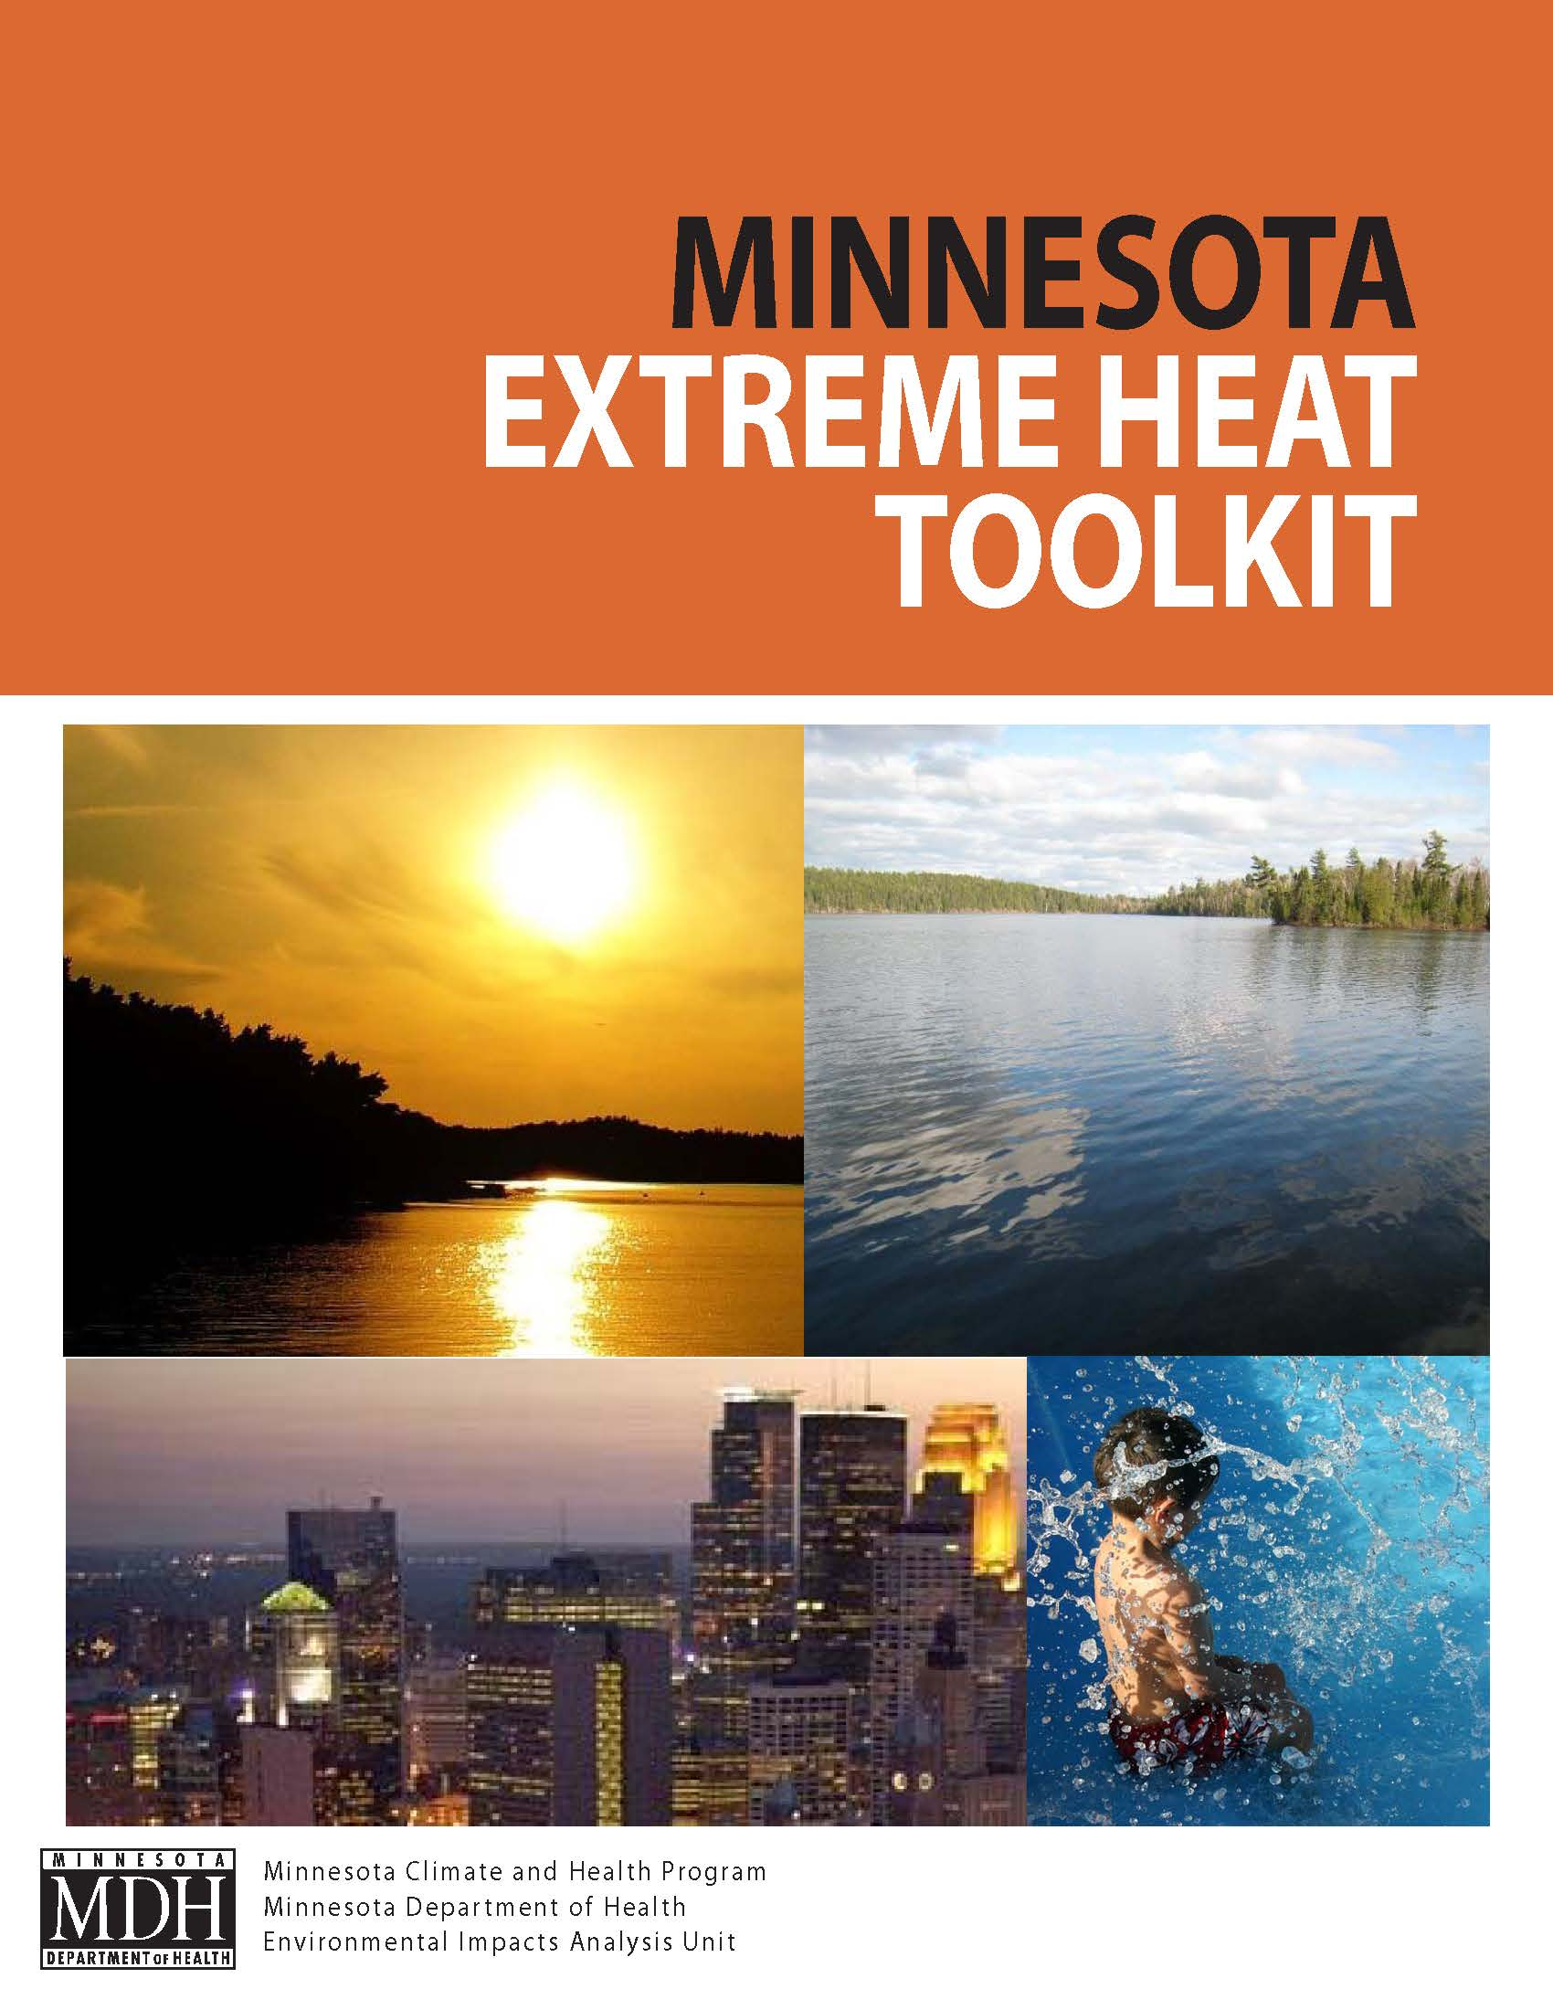
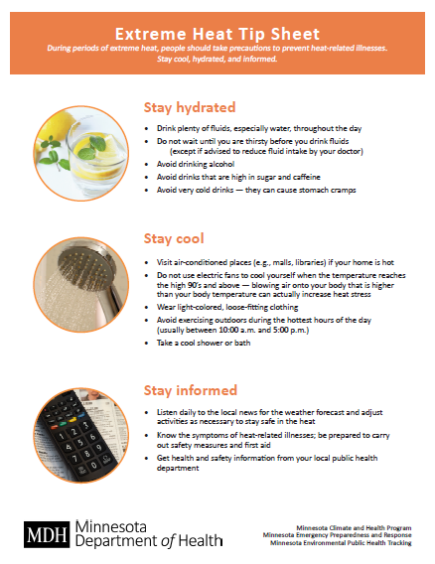
MDH EXTREME HEAT RESOURCES
  www.health.mn.gov/heatplanning
Notes:
The MN Climate and Health Program have developed resources to help plan for extreme heat events and avoid negative health impacts including our Minnesota Extreme Heat Toolkit and Extreme Heat Tip Sheet. Both are available for download on our website at www.health.mn.gov/heatplanning.

Slide 54
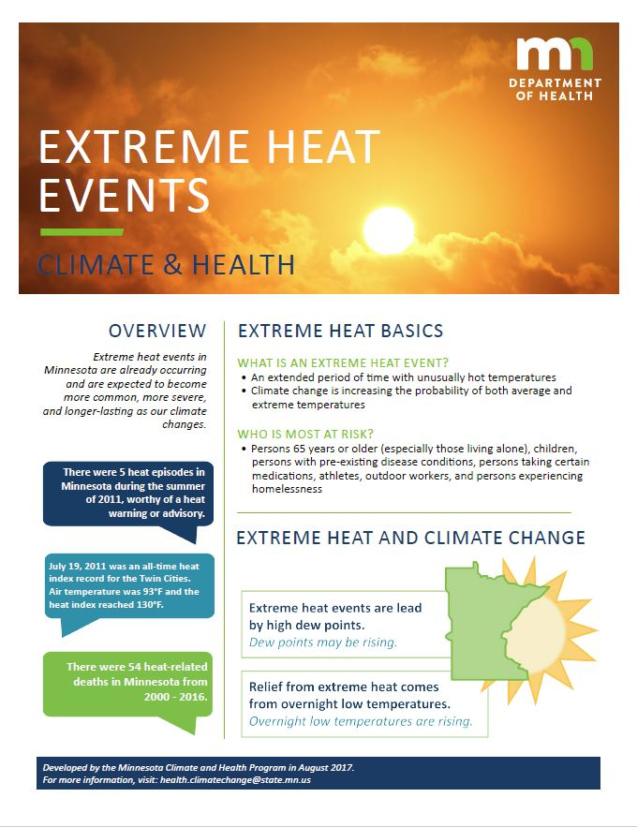
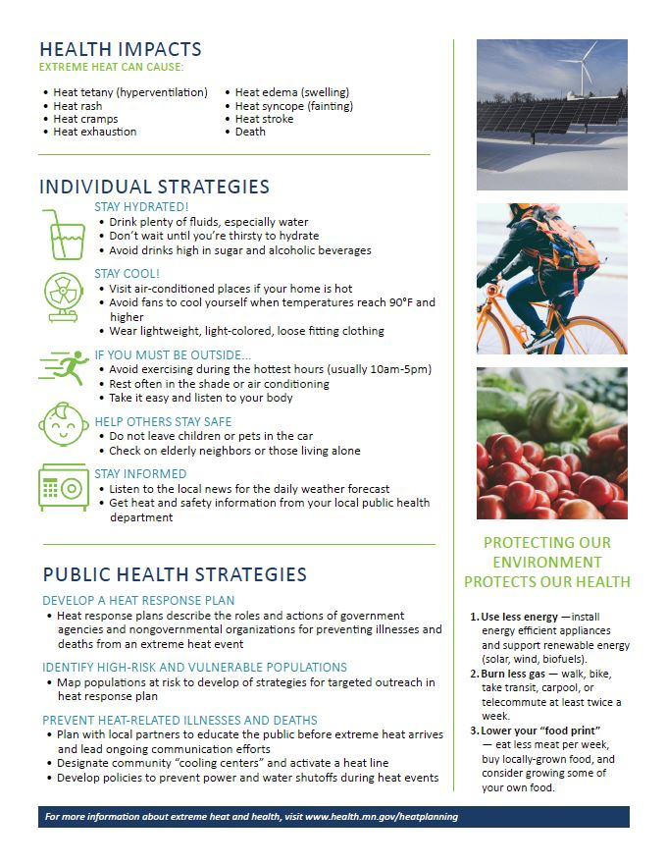
MDH EXTREME HEAT RESOURCES
  www.health.mn.gov/heatplanning
Notes:
The MN Climate and Health Program has also created a two page summary sheet for this training module, providing a brief overview of the topics we discussed today. It is also available on our website at www.health.mn.gov/heatplanning.

Slide 55
OTHER EXTREME HEAT RESOURCES
Minnesota Department of Health (MDH) Climate & Health Program
  www.health.mn.gov/heatplanning
Minnesota Public Health Data Access Portal
  https://apps.health.state.mn.us/mndata/heat
Minnesota State Climatology Office
  http://climate.umn.edu/
National Weather Service – Twin Cities
  www.crh.noaa.gov/mpx/
Centers for Disease Control & Prevention (CDC) Climate & Health Program
  www.cdc.gov/climatechange/
Notes:
Here are some additional resources for more information on extreme heat, climate change and public health issues.

Slide 56
ACKNOWLEDGEMENTS
This work was supported by cooperative agreement 5UE1EH000738 from the Centers for Disease Control and Prevention
Special thanks to the following professionals for their contributions to the creation of this training module:
Pam Blixt, Minneapolis Health & Family Support
Geri Maki, MDH
Myrlah Olson, MDH
Dr. Mark Seeley, University of Minnesota
Don Sheldrew, MDH
Dr. Peter Snyder, University of Minnesota
Dr. Tracy Twine, University of Minnesota

Slide 57
Questions?
Contact Minnesota Climate and Health Program
health.climatechange@state.mn.us
651-201-4898

Slide 58
REFERENCES: 1 of 5
Anderson, GB and Bell, ML. 2011. “Heat waves in the United States: Mortality risk during heat waves and effect modification by heat wave characteristics in 43 US communities,” Environmental Health Perspectives, 119(2), 210.
Arbor Day Foundation. 2017. Everyone Can Plant a Tree & Help Fight Climate Change. Available online: www.arborday.org/trees/climatechange/plantatree.cfm
Berko, J., Ingram, D.D., Saha, S. and Parker, J.D. 2014. Deaths Attributed to Heat, Cold, and Other Weather Events in the United States, 2006-2010. National Health Statistics Report, July 30, 2014. Available online: https://www.cdc.gov/nchs/data/nhsr/nhsr076.pdf
Blumenfeld, K. 2016. Minnesota Department of Natural Resources, State Climatology Office; personal communication on August 9, 2016.
Centers for Disease Control and Prevention (CDC). 2009. “Extreme Heat: A Prevention Guide to Promote Your Personal Health and Safety,” Available online: https://www.cdc.gov/disasters/extremeheat/heat_guide.html
Centers for Disease Control and Prevention (CDC). 2013. Heat-Related Deaths After an Extreme Heat Event – Four States, 2012, and United States, 1999-2009. Morbidity and Mortality Weekly Report, June 7, 2013. Available online: https://www.cdc.gov/mmwr/preview/mmwrhtml/mm6222a1.htm
Do It Green Minnesota. 2017a. Eating Low: Back to Basics. Available online: https://doitgreen.org/topics/food/eating-low-back-basics

Slide 59
REFERENCES: 2 of 5
Do It Green Minnesota. 2017b. The Connection Between Recycling and Global Warming. Available online: https://doitgreen.org/topics/climate-change/connection-between-recycling-and-global-warming
Do It Green Minnesota, 2017c. Save the Rainwater! Available online: https://doitgreen.org/topics/gardening/save-rainwater
Do It Green Minnesota. 2017d. Achieving a Sustainable Lawn. Available online: https://doitgreen.org/topics/gardening/achieving-sustainable-lawn
Environmental Quality Board (EQB). 2015. Minnesota and climate change: our tomorrow starts today. Available online: https://www.eqb.state.mn.us/content/climate-change
Friedlein, M. 2011. Matt Friedlein, Meteorologist, National Weather Service - Twin Cities/Chanhassen, MN, Personal communication, August 29, 2011
Larsen, J. 2006. “Setting the Record Straight: More than 52,000 Europeans Died from Heat in Summer 2003,” Plan B Updates, Earth Policy Institute. Available online: http://www.earth-policy.org/plan_b_updates/2006/update56
Medina-Ramon, M, and Schwartz, J. 2007. Temperature, temperature extremes, and mortality: A study of acclimatisation and effect modification in 50 US cities. Occupational and Environmental Medicine, 64, 827-833.
Minnesota Department of Health (MDH). 2015. Minnesota Climate and Health Profile Report. Available online: http://www.health.state.mn.us/divs/climatechange/docs/mnprofile2015.pdf

Slide 60
REFERENCES: 3 of 5
Minnesota Department of Natural Resources (MDNR), 2016. Historic Mega-Rain Events in Minnesota. Available online: http://www.dnr.state.mn.us/climate/summaries_and_publications/mega_rain_events.html
Minnesota Public Radio (MPR) News. 2012. Is cooling the house heating up the planet? August 27, 2012. Available online: www.mprnews.org/story/2012/08/25/regional/air-conditioning-global-warming
National Aeronautics and Space Administration (NASA). 2016. Global Climate Change: Vital Signs of the Planet. Available online: http://climate.nasa.gov/causes
National Oceanic and Atmospheric Administration (NOAA). 2017a. NOAA National Centers for Environmental information, Climate at a Glance: U.S. Time Series, Precipitation, published February 2017. Available online: http://www.ncdc.noaa.gov/cag
National Oceanic and Atmospheric Administration (NOAA). 2017b. NOAA National Centers for Environmental information, Climate at a Glance: U.S. Time Series, Average Temperature, published February 2017. Available online: http://www.ncdc.noaa.gov/cag
National Weather Service (NWS). 2009a. National Oceanic and Atmospheric Administration’s National Weather Service. Glossary. Available online: http://nws.noaa.gov/glossary/index.php?letter=h
National Weather Service (NWS). 2009b. National Oceanic and Atmospheric Administration’s National Weather Service (Modified June 25, 2009). Available online: http://www.epa.gov/heatisld/resources/glossary.htm#u

Slide 61
REFERENCES: 4 of 5
National Weather Service (NWS). 2010a. Image from National Oceanic and Atmospheric Administration’s National Weather Service. Available online: http://www.nws.noaa.gov/om/heat/index.shtml
National Weather Service (NWS). 2010b. Service area map for the six National Weather Service stations serving Minnesota and Western Wisconsin, http://www.crh.noaa.gov/images/mpx/nwsmn_wi_responsibility.gif
National Weather Service (NWS). 2011. National Weather Service Weather Forecast Office. Grand Forks, ND. “Hottest Place On Earth?” July 2011. Available online: http://www.crh.noaa.gov/news/display_cmsstory.php?wfo=fgf&storyid=71074&source=2
Scott, M. 2006. “Beating the Heat in the World’s Big Cities,” NASA, Earth Observatory. Available online: http://earthobservatory.nasa.gov/Features/GreenRoof/greenroof.php
Seeley, M. 2011. “Climate Trends in Minnesota: Current Trends and Projections,” MN State Climatology Office, Available online: http://climate.umn.edu/seeley/
Snyder, P. 2012. “Islands in the Sun,” presented January 19, 2012. University of Minnesota Department of Soil, Water, and Climate.
Trenberth, K.E. 2011. Changes in precipitation with climate change. Available online: http://www.int-res.com/articles/cr_oa/c047p123.pdf
United States Department of Agriculture (USDA) Agricultural Research Service. 2012. USDA Plant Hardiness Zone Map. Available online: http://planthardiness.ars.usda.gov

Slide 62
REFERENCES: 5 of 5
United States Environmental Protection Agency (U.S. EPA). 2008. “Reducing Urban Heat Islands: Compendium of Strategies,” Available online: http://www.epa.gov/heatisld/resources/compendium.htm
United States Environmental Protection Agency (U.S. EPA) 2016. Climate Change, What You Can Do: At Home. Available online: www.epa.gov/climatechange/what-you-can-do-home
What’s Your Impact. 2017. Available online: http://whatsyourimpact.org/fight-climate-change/drive-less
Whitman, S., Good, G., Donoghue, E.R., Benbow, N., Shou, W., and Mou, S. 1997. “Mortality in Chicago attributed to the July 1995 heat wave,” American Journal of Public Health, 87(9), 1515.
Xcel Energy. 2017. Renewable Energy Options – Residential. Available online: www.xcelenergy.com/programs_and_rebates/residential_programs_and_rebates/renewable_energy_options_residential
Zandlo J. 2008. Observing the climate. Minnesota State Climatology Office. Available online: http://climate.umn.edu/climateChange/climateChangeObservedNu.htm
Zhang, K., Rood, R.B., Michailidis, G., Oswald, E.M, Schwartz, J.D., Zanobetti, A., Ebi, K.L. and O'Neill, M.S. 2012: Comparing exposure metrics for classifying ‘dangerous heat’ in heat wave and health warning systems. Environment International, 46, 23-29.

Slide 63
PHOTO AND IMAGE CREDITS
Slide 4 Lightening bold and sun – Microsoft Clip Art
Slide 5 Leaves – Microsoft Clip Art
Slide 6 Climate and health graphic – MDH, 2016
Slide 7 Minnesota average annual temperature – NOAA, 2017
Slide 8 Minnesota average annual temperature – NOAA, 2017
Slide 9 Thermometer – Microsoft Clip Art
Slide 10 Change in plant hardiness zones – Arbor Day Foundation, 2015
Slide 11 Minnesota average annual precipitation – NOA, 2017
Slide 12 Minnesota mega-rain events graphic – MDH, 2017
Slide 13 Flood and drought map – MDH, 2015
Slide 14 Highest annual dew points – MNDNR
Slide 16 Increase in average temperature graphic – CDC, 2009
Slide 17 Sunset – Pexels. Available online at: https://www.pexels.com/photo/sunset-147465/
Slide 18 NOAA’s National Weather Service Heat Index – NWS, 2010
Slide 19 National Weather Service Stations – NWS, 2010
Slide 20 Kids swimming – Pixabay. Available online at: https://pixabay.com/en/sunglasses-people-water-blue-1284419/
Slide 21 Heat episode graphic – MDH, 2017
Slide 22 Current heat index – The Weather Channel
Slide 23 Minnesota Weather Almanac – Seeley, 2011

Slide 64
PHOTO AND IMAGE CREDITS
Slide 24 Extreme heat and climate change graphic – MDH, 2017
Slide 26 Urban heat islands – Snyder, 2012
Slide 27 Maximum daily temperature graph – Snyder, 2012
Slide 28 Target Field green roof – The Kestrel Design Group. Available online at: http://www.greenroofs.com/projects/pview.php?id=1000
Slide 29 New York City thermal image – NASA
Slide 30 Person sweating – Pexels
Slide 32 Chicago skyline – Pixabay. Available online at: https://pixabay.com/en/architecture-buildings-business-1853632/
Slide 34 Person running – Pexels. Available online at:
https://www.pexels.com/photo/man-in-white-long-sleeve-shirt-on-track-in-field-126401/
Slide 35 Heat-related illness ED visits – Minnesota Public Health Data Access
Slide 36 Open window – Pixabay. Available online at:
https://pixabay.com/en/open-window-air-balcony-fire-escape-1246191/
Slide 38 Pencil, clock, graph, phone, person, hand – MDH
Slide 39 Planning board – Pixabay. Available online at: https://pixabay.com/en/concept-man-papers-person-plan-1868728/
Slide 40 Organization chart – Pixabay. Available online at:
https://pixabay.com/en/organization-organization-chart-2478211/
Slide 41 Percent of elderly people who live alone in Minneapolis map – MDH, 2011

Slide 65
PHOTO AND IMAGE CREDITS
Slide 43 Sign of heat exhaustion and heat stroke – MDH, 2016
Slide 44 Lemon water – Pexels. Available online at: https://static.pexels.com/photos/3303/water-drink-fresh-lemons.jpg
Slide 44 Shower head – Pexels. Available online at: https://pixabay.com/en/shower-water-wet-bathroom-stream-653671/
Slide 44 Light colored shirt – Pexels. Available online at:
https://www.pexels.com/photo/adult-agriculture-beautiful-daylight-220139/
Slide 44 Elderly hands – Pexels. Available online at: www.pexels.com/photo/man-hands-waiting-senior-33786/
Slide 44 Remote control – Pexels. Available online at: https://pixabay.com/en/television-remote-control-525705/
Slide 46 Windmill – Pexels. Available online at:
www.pexels.com/photo/road-street-desert-industry-477230/
Slide 48 Person biking – Pexels. Available online at:
www.pexels.com/photo/person-wearing-black-and-gray-sleeveless-dress-riding-a-step-through-bicycle-521474
Slide 50 Food – Pexels. Available online at:
www.pexels.com/photo/tomatoes-carrots-and-radish-on-the-top-of-the-table-196643/
Slide 52 Spoon and Cherry – Pixabay. Available online at:
https://pixabay.com/en/cherry-on-a-spoon-cherry-sculpture-1545765/
Slide 53 Minnesota Extreme Heat Toolkit – MDH
Slide 54 Minnesota Extreme Heat Events Summary Sheet – MDH

