Slide 1
Lights Out! An Incident Response Game: How-to-Play

Slide 2
Land Acknowledgement
Every community owes its existence and vitality to generations from around the world who contributed their hopes, dreams, and energy to making the history that led to this moment. Some were brought here against their will, some were drawn to leave their distant homes in hope of a better life, and some have lived on this land for more generations than can be counted. Truth and acknowledgment are critical to building mutual respect and connection across all barriers of heritage and difference.
We begin this effort to acknowledge what has been buried by honoring the truth. We are standing on the ancestral lands of the Dakota people. We want to acknowledge the Dakota, the Ojibwe, the Ho Chunk, and the other nations of people who also called this place home. We pay respects to their elders past and present. Please take a moment to consider the treaties made by the Tribal nations that entitle non-Native people to live and work on traditional Native lands. Consider the many legacies of violence, displacement, migration, and settlement that bring us together here today. Please join us in uncovering such truths at any and all public events.*
*This is the acknowledgment given in the USDAC Honor Native Land Guide – edited to reflect this space by Shannon Geshick, MTAG, Executive Director Minnesota Indian Affairs Council

Slide 3
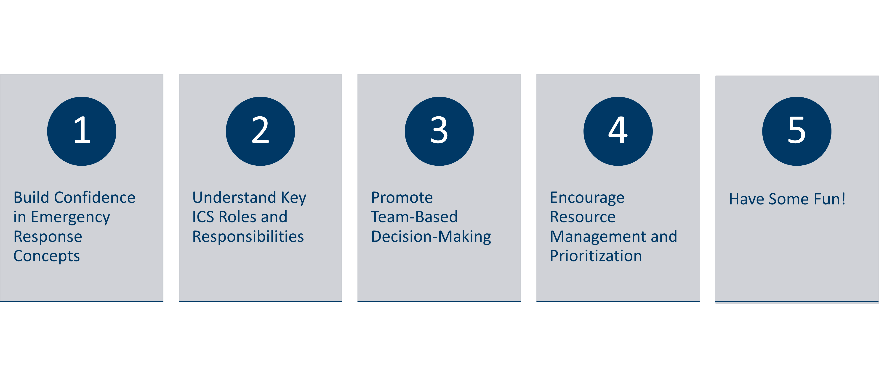
Objectives

Slide 4
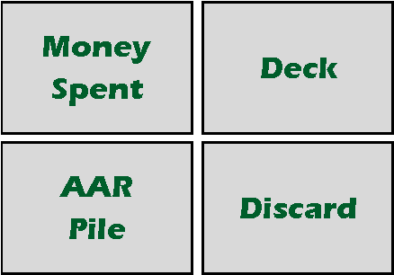




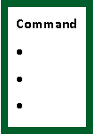



Response Game
Players are the ICS Command Staff responding to a disaster.
Spend resources to address problems and perform activities to improve the Situation.
Win: Move the Situation Progress Track to 10.
Lose: If any of the 4 Metrics go to 0.

Slide 5
Hide footer information the right way
Distribute Command, Operations, Logistics, Planning and Finance roles to all players.
Give each role 10 resource tokens
Put Metric Sheet and Deck/Discard sheet where everyone can read it.
Put tokens on 1 for Situation Progression and 3 for each Metric
Shuffle Activity, Problem, and Advantage cards together and put in “Deck” Space
Notes:
I usually hide the footers. They’re great if you need them, but I find they add visual clutter

Slide 6
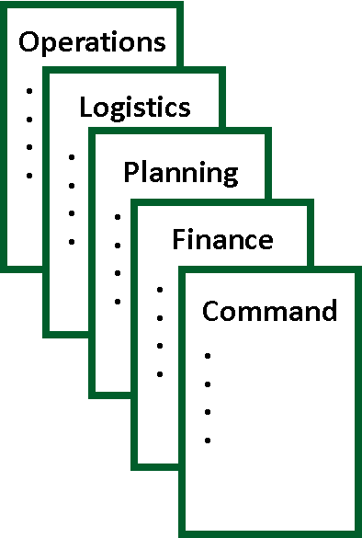
Response Roles
Each player has an ICS Role and “resources” to use during the game
Best with 4-5 players, but playable at any number.
Once per game, at any time use the action on the role SUPERPOWER card

Slide 7
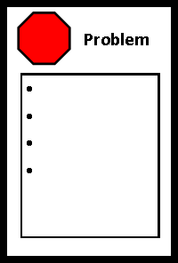
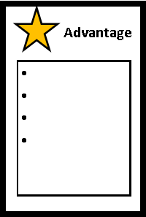
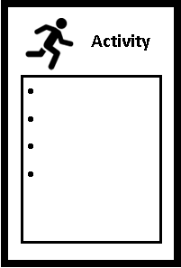
How-to-Play: Each Player's Turn
Draw 3 cards. If the deck runs out of cards, shuffle the discard pile. Resolve the cards in the following order.
Resolve Problem Card:
If one or more Problem Cards are drawn, pick one, discard the rest, and discard all Advantage Cards.
Select one option on the Problem card. Adjust metrics and spend resources as indicated.
Resolve Advantage Card:
If one or more Advantage Cards are drawn (and no Problem Cards), pick one to resolve, and discard the rest
Resolve Activity Cards:
If more than one Activity was drawn, pick one to resolve. Players discuss and agree on which option to select.
If no consensus, the active player makes the final choice.
Put resolved cards in the After-Action Review Space and unresolved cards in the Discard Pile.

Slide 8
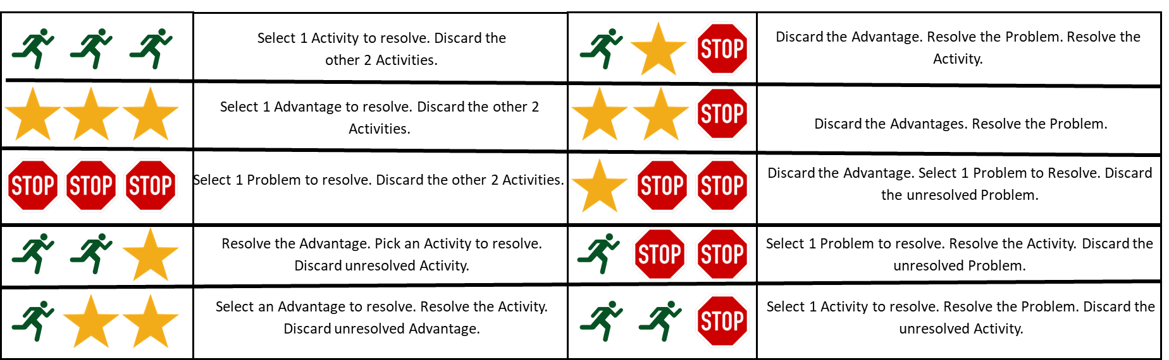
How to Resolve Card Draws

Slide 9
End of Game
The players win when: Situation Progression reaches 10 on the track. Add the values of each Metric for final score.
The players Lose when: any Metric goes to zero
Post-game Hotwash with discussion questions

