Slide 1
Spike Alert Imagery Templates
The templates in this PowerPoint are free for you to use.
You are also encouraged to edit/customize them to suit your needs.
Suggestions for customization:
Add your agency’s logo and/or delete the MDH logo.
Add or edit text boxes to include links to local resources.
Add descriptive text alongside each image you post online.
For any questions regarding these editable imagery templates, please email
health.drugodprev@state.mn.us

Slide 2
Editable Images

Slide 3
Editable Version #1
Overdose Spike Alert
How to edit:
Add/remove text, logos, and links.
Resize images and textboxes to fit.
When finished editing:
Click and drag to select every element of the finalized image.
Right-click on the EDGE of the group of selected elements and select “Save as Picture.”
(Area Name Here) is currently experiencing an unusually high number
of drug overdoses.
Local health providers are aware of the increased risk and ready to help.
Add Icon
Resource/Reminder #1.
Explain how to access this resource here.
Add Icon
Resource/Reminder #2.
Explain how to access this resource here.
Add Logos.
Add Links/QR Codes.

Slide 4
Editable Version #2
Overdose Spike Alert
(Area Name Here) is currently experiencing an unusually high number
of drug overdoses.
Local health providers are aware of the increased risk and ready to help.
Add Icon
Resource/Reminder #1.
Explain how to access this resource here.
Add Icon
Resource/Reminder #3.
Explain how to access this resource here.
Add Icon
Resource/Reminder #2.
Explain how to access this resource here.
Add Icon
Resource/Reminder #4.
Explain how to access this resource here.
Add Logos.
Add Links/QR Codes.
Add contact information.

Slide 5
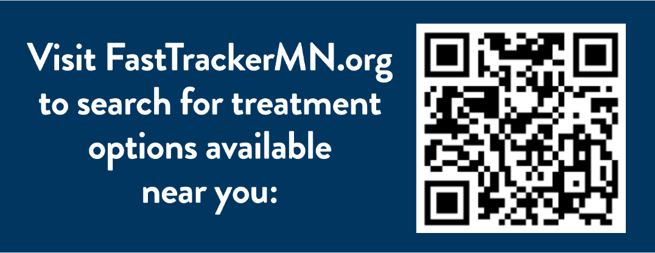
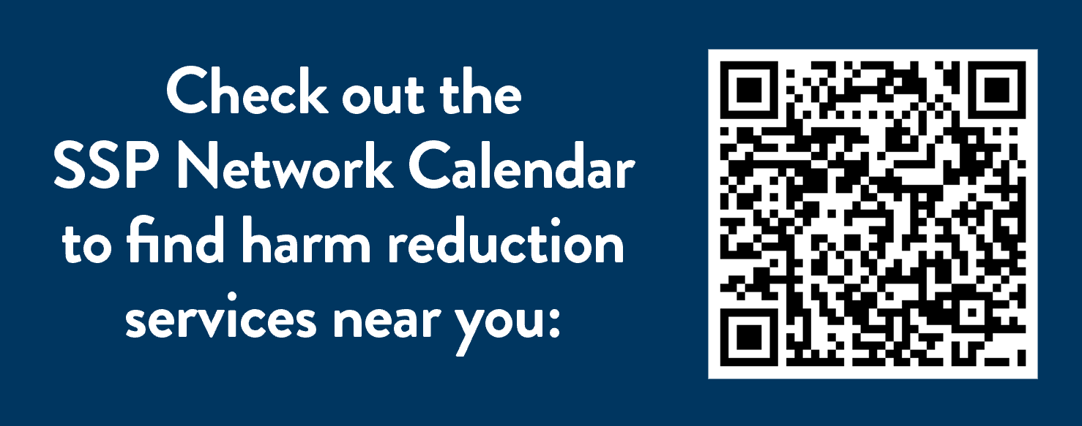
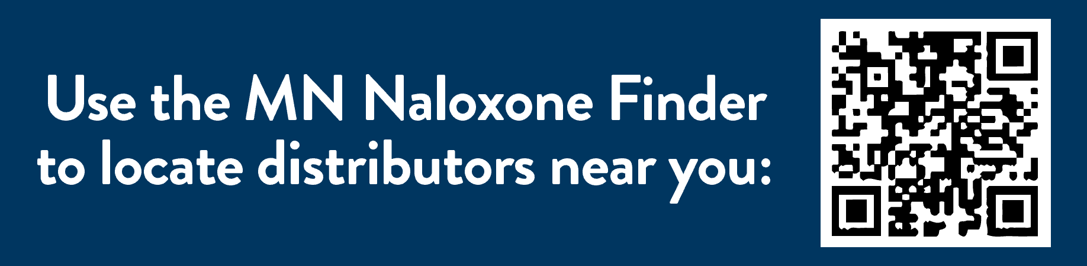
Links and QR Codes
To save an entire image:
Click anywhere in each blue box.
Right click, select “save as picture.”
To select only the QR code:
Select the group of elements
Right click
Select “Ungroup” under “Group” settings.
FastTrackerMN.org https://fasttrackermn.org
Syringe Services Programs Network Calendar https://www.health.state.mn.us/people/syringe/calendar.html
Know the Dangers Naloxone Finder https://knowthedangers.com/naloxone-finder

Slide 6










Useable Icons

Slide 7
Finalized Images

Slide 8
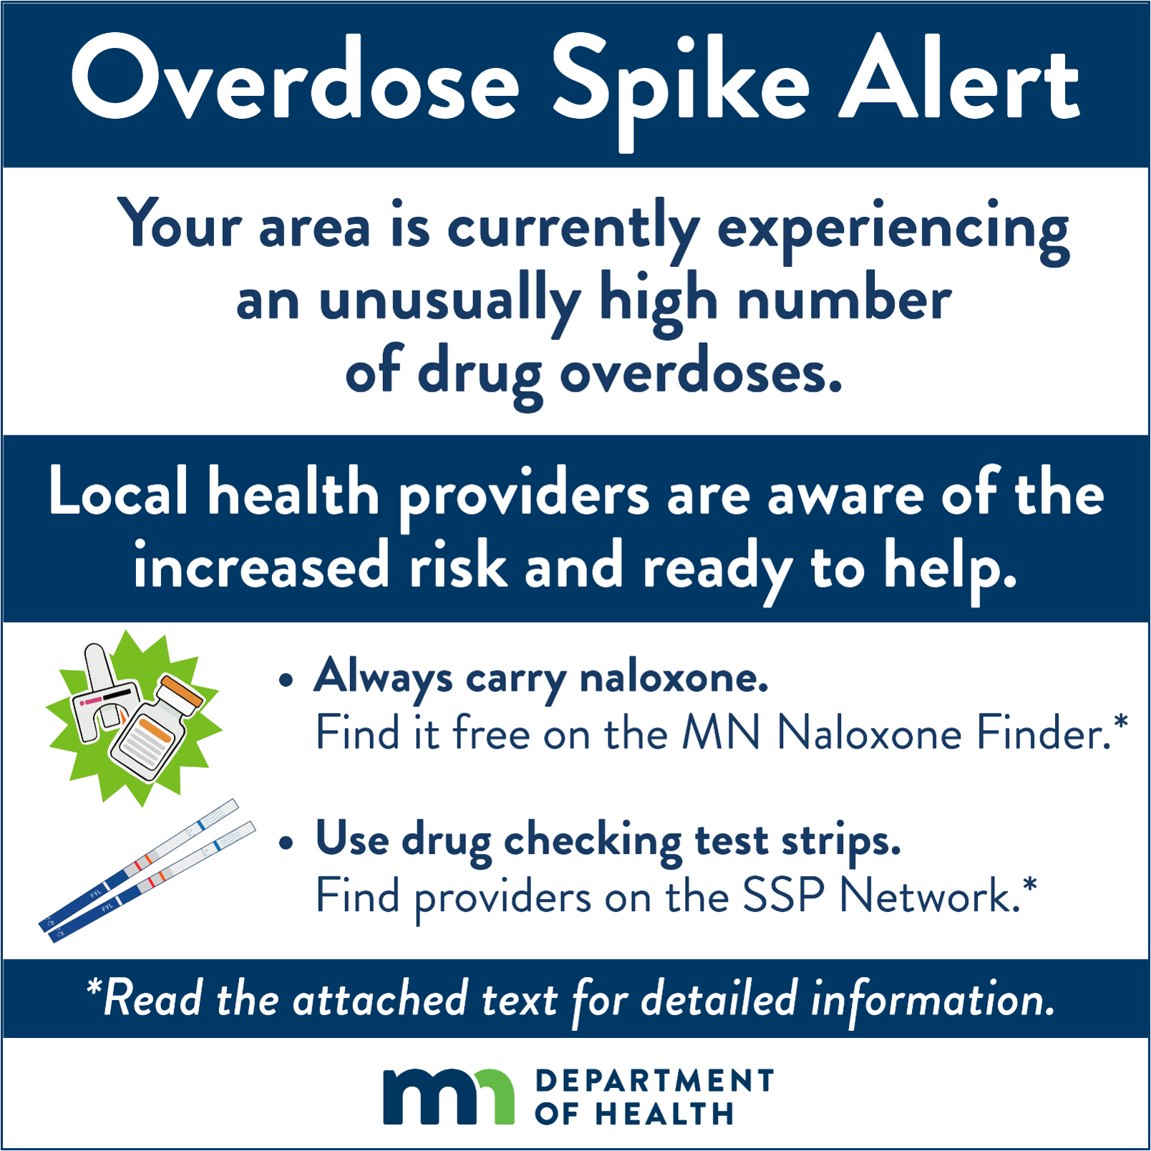
To save this image:
Right-click on the image and select “Save as Picture”.
Be sure to add text along with the image that contains the links suggested:
Know the Dangers Naloxone Finder https://knowthedangers.com/naloxone-finder
Syringe Services Programs Network Calendar https://www.health.state.mn.us/people/syringe/calendar.html
Text on finalized image reads:
Overdose Spike Alert. Your area is currently experiencing an unusually high number of drug overdoses. Local health providers are aware of the increased risk and ready to help. Always carry naloxone. Find it free on the MN Naloxone Finder. Use drug checking test strips. Find providers on the SSP Network. Ready the attached text for detailed information.

Slide 9
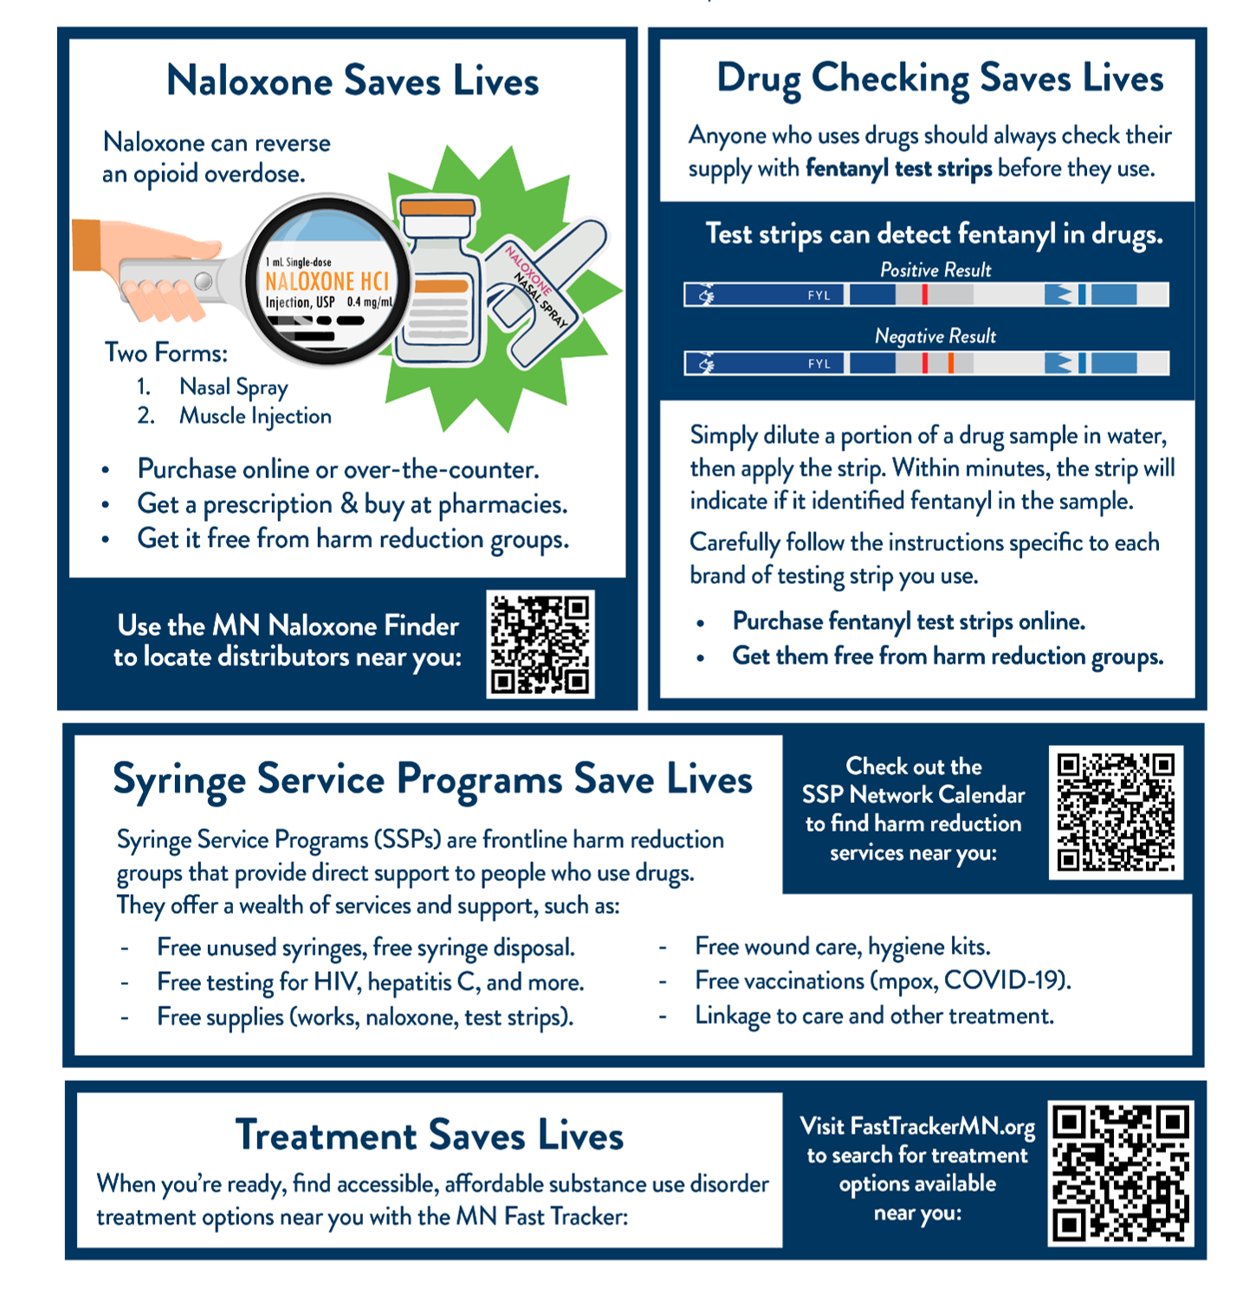
Text on finalized image in four sections reads:
Naloxone Saves Lives.
Naloxone can reverse an opioid overdose. Two Forms: Nasal Spray and Muscle Injection. Purchase online or over-the-counter. Get a prescription & buy at pharmacies. Get it free from harm reduction groups. Use the MN Naloxone Finder to locate distributors near you.
Drug Checking Saves Lives.
Anyone who uses drugs should always check their supply with fentanyl test strips before they use. Simply dilute a portion of a drug sample in water, then apply the strip. Within minutes, the strip will indicate if it identified fentanyl in the sample. Carefully follow the instructions specific to each brand of testing strip you use. Purchase fentanyl test strips online. Get them free from harm reduction groups.
Syringe Service Programs Save Lives.
Syringe Service Programs (SSPs) are frontline harm reduction groups that provide direct support to people who use drugs. They offer a wealth of services and support, such as: Free unused syringes, free syringe disposal; Free testing for HIV, hepatitis C, and more; Free supplies (works, naloxone, test strips); Free wound care, hygiene kits; Free vaccinations (mpox, COVID-19); Linkage to care and other treatment; Check out the SSP Network Calendar to find harm reduction services near you.
Treatment Saves Lives.
When you’re ready, find accessible, affordable substance use disorder treatment options near you with the MN Fast Tracker. Visit FastTrackerMN.org to search for treatment options available near you.

Slide 10
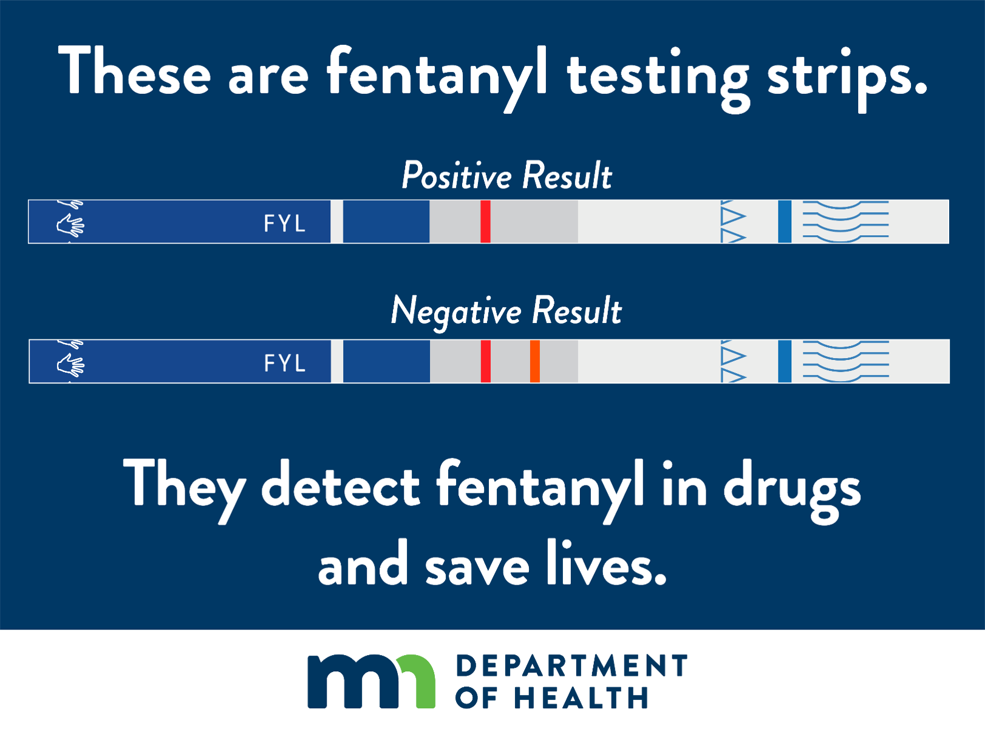
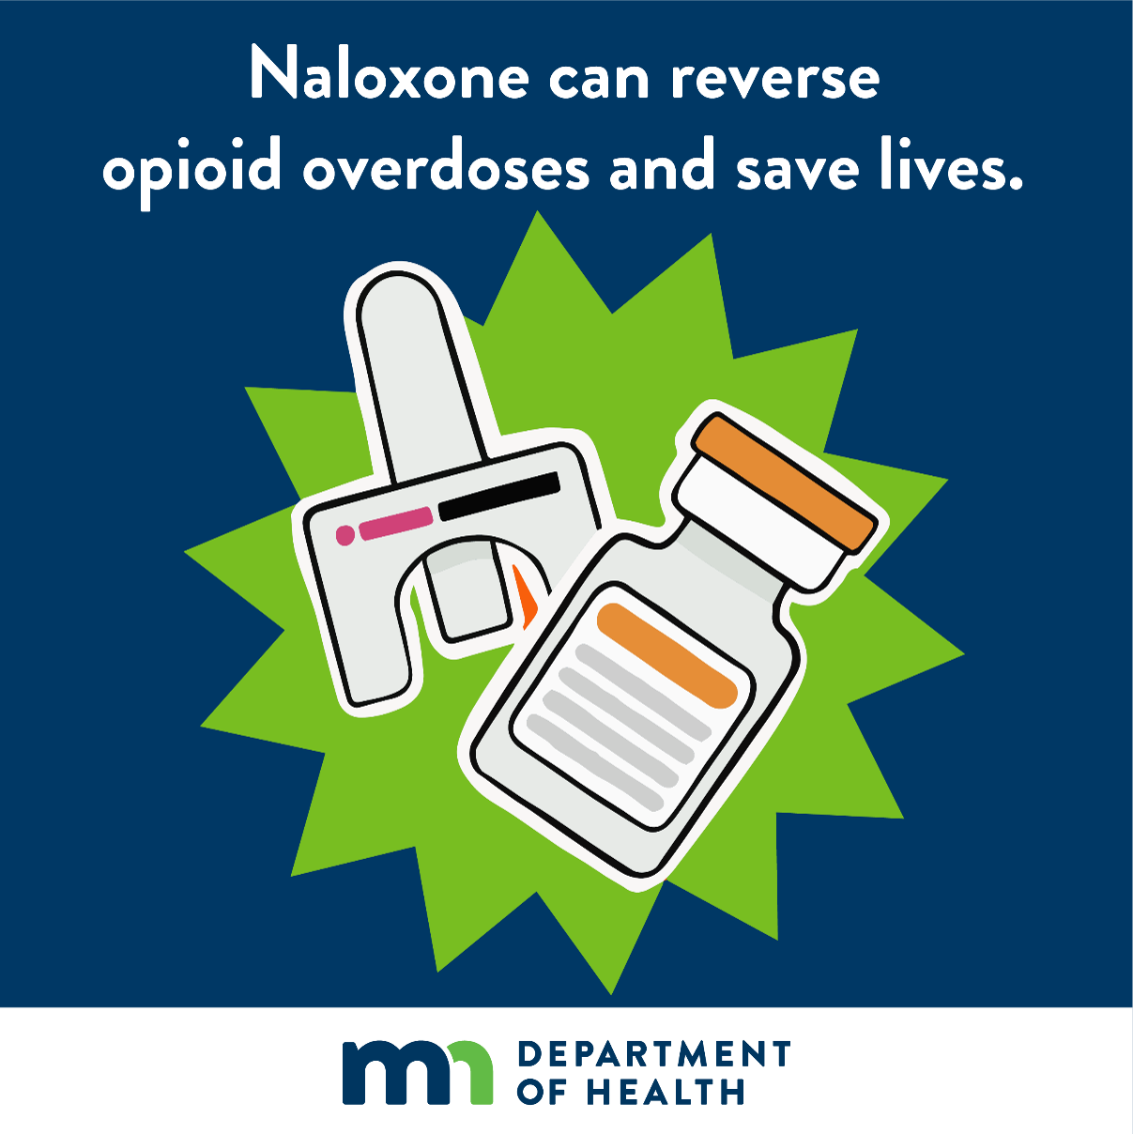
Images with MDH logo

Slide 11
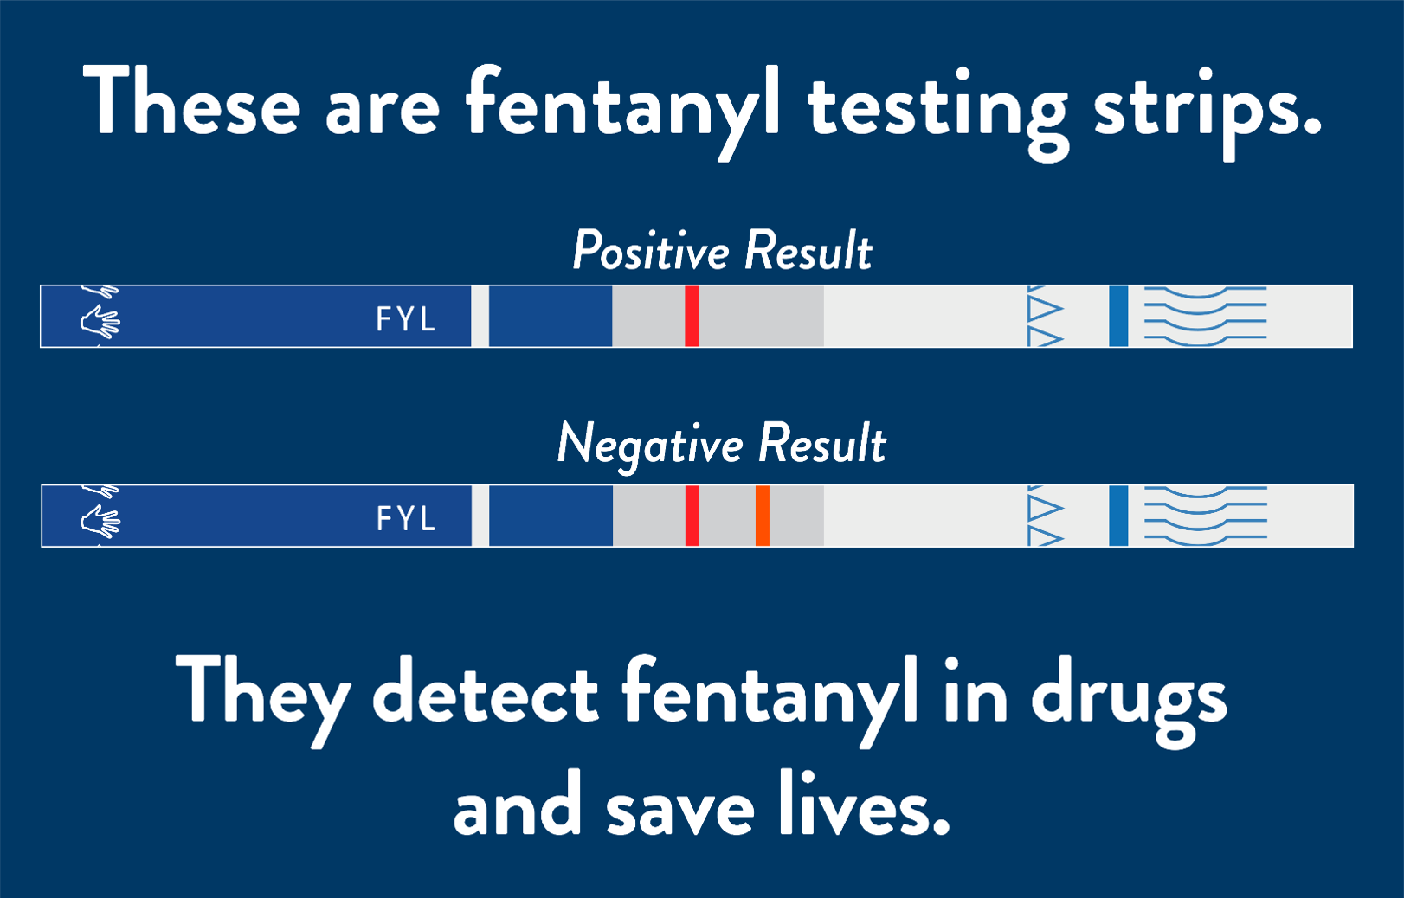
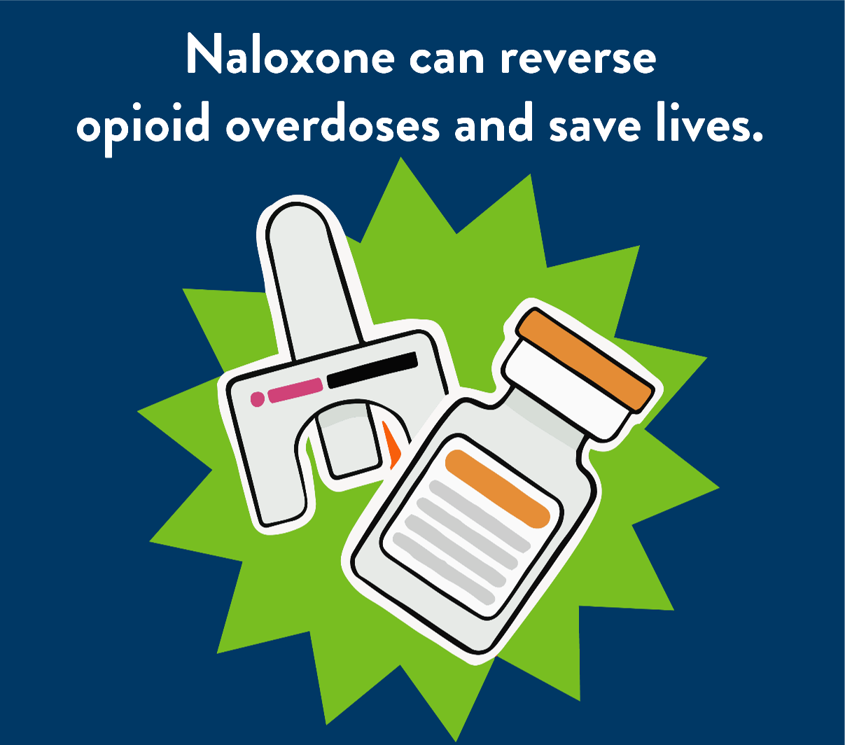
Images without MDH logo

Slide 12
If you want to make a map with certain counties highlighted:
Right-click and “ungroup” the images within the map.
Shade individual counties by selecting them, going to format > shape fill, and choosing a color. Select multiple counties by holding the shift key while you select.
If you need to resize or move the map, group it first by selecting all the map elements and going to format > group > group. Hold shift while resizing to prevent distortion. Ungroup the map again before making additional edits.
If you need a different or more advanced map, please contact a cartographer or GIS professional that supports your organization.
If you are sharing this slide/deck as a PowerPoint or PDF:
You’ll need to create a “flattened,” accessible version of the map. You can do this by taking a screenshot of the map you created and adding alternative text.
Use the Snipping Tool app or Print Screen button to take a screenshot of the map as it appears on your screen.
Paste the screenshot into a slide layout (control + V),
Select the image and use the crop tool (format > crop) to remove all unwanted areas surrounding the map.
Add alternative text to describe the new, flattened map graphic. Ensure the alternative text for the image matches the goal of the map (e.g. “State of Minnesota county map with Itasca, Aitkin, Carlton, St. Louis, Lake and Cook Counties highlighted.”)
Find accessible map design information (https://mn.gov/mnit/about-mnit/accessibility/maps/design.jsp) on the MNIT public website.

Slide 13
Thank You!
For any questions regarding these editable imagery templates,
please email health.drugodprev@state.mn.us

