Slide 1












Let’s talk about asthma in Minnesota
MDH Asthma Program
Notes:
Welcome to this educational session about asthma!
My name is…
In this presentation, we will talk about what asthma is, its impact in Minnesota, what can make it worse, how to manage it, and some resources that can be very helpful.
We want this session to be interactive and useful to you!
This presentation is intended to be a resource you can draw from as needed. It contains a lot of information, and not all of the content will be appropriate for every educational session or every audience.
You can adapt this presentation to your audience, presentation style, and the time available.

Slide 2

Who can share what asthma is?
Notes:
Who can share what asthma is?

Slide 3
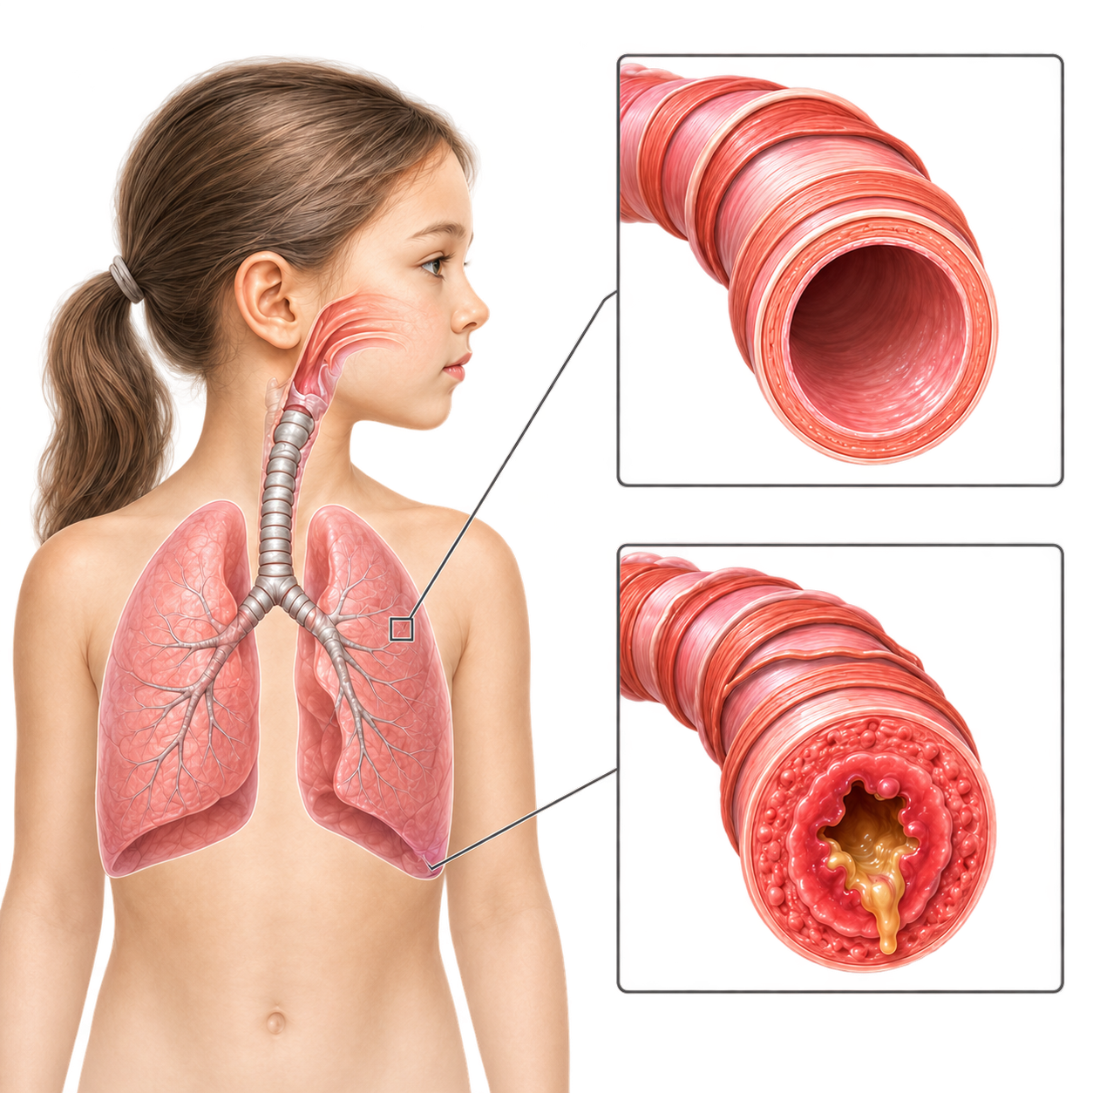
Asthma is like breathing through a straw
Muscle
Lining
Tightened muscle
Mucus
Inflamed lining
Notes:
Asthma is a chronic condition, meaning it lasts a long time or can last a lifetime, similar to other chronic conditions such as high blood pressure, diabetes, or arthritis.
During an asthma flare-up, breathing is like trying to move air through a very narrow tube like a straw.
What happens during an asthma attack?
1) The airways swell.
2) The muscles around the airways tighten.
3) Thick mucus builds up.
These changes make it harder to breathe and can cause coughing, wheezing, or chest tightness.

Slide 4



Do you recognize these famous people with asthma?
Source: Hispanic Executive
Source: Wikipedia
Source: YES Market Media | Shutterstock
Notes:
Famous people today and throughout history have had asthma.
Does anyone know the names of the people in these photos?
Names:
Jessica Alba
Beethoven
David Beckham

Slide 5
Who and why?
1. Who gets asthma?
2. Why do people have asthma?
Notes:
Who gets asthma? (You can ask the audience before sharing the answers.)
Asthma can affect people of all ages.
Although it can begin at any time in life, it usually begins in childhood.
Asthma is one of the most common chronic conditions in children, and recognizing it early supports better management.
Why do people have asthma? (You can ask the audience before sharing the answers.)
The exact cause of asthma is not fully understood.
Experts believe it develops from a combination of genetics and environmental exposures.
Children with a family history of asthma or allergies may be at greater risk, but anyone can develop asthma.
People with asthma have sensitive airways that react strongly to certain triggers, which we will discuss shortly.

Slide 6
428,370 Minnesotans have asthma
1 in 19 children
1 in 11 adults
Source: Behavioral Risk Factor Surveillance System (BRFSS), 2023
Notes:
Asthma affects hundreds of thousands of Minnesotans. It is one of the most common chronic conditions among both children and adults, making it an important public health concern across the state.

Slide 7
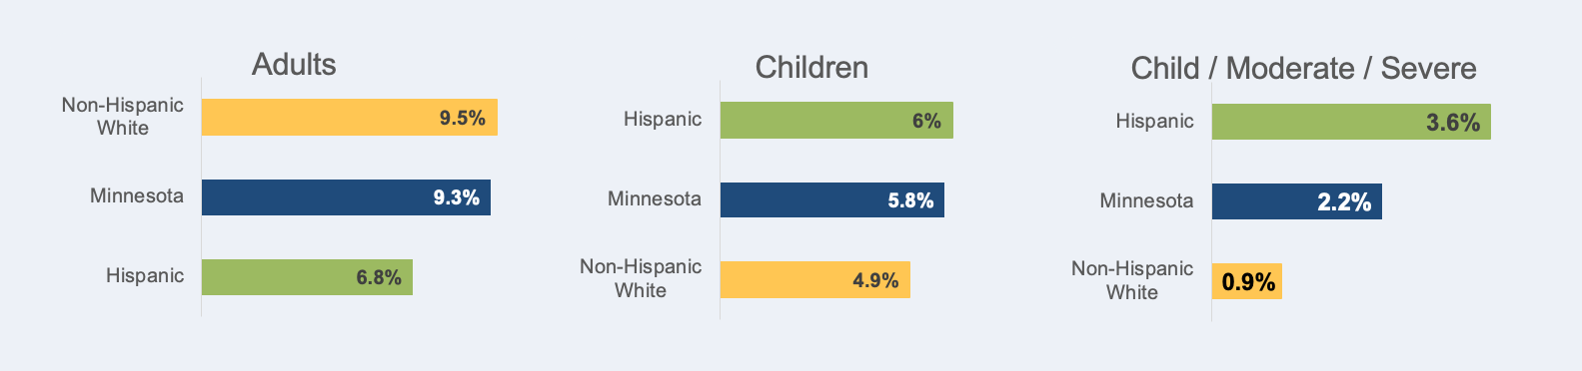

Asthma Prevalence
Source: Adults—Behavioral Risk Factor Surveillance System; Children—National Survey of Children’s Health
Notes:
We want to share some Minnesota asthma data to provide more context about how common asthma is and how serious the issue is in Minnesota.
Asthma is slightly less common (also called less prevalent) among Hispanic adults compared with the statewide average and non-Hispanic White adults. Asthma is about as common among Hispanic or Latino children as among non-Hispanic White children. However, Latino children are more likely to have moderate-to-severe asthma than non-Hispanic White children.
We only include data for Minnesota overall, non-Hispanic White people, and Hispanic/Latino people for several reasons:
1) Not every measure has reliable estimates for every racial or ethnic group in Minnesota because some groups have small sample sizes.
2) To keep the information consistent and easy to interpret, we focus on the groups most relevant to this presentation and those with reliable data across the measures.
3) We include the Minnesota average to provide statewide context, and non-Hispanic White Minnesotans as a comparison group commonly used in public health.
4) Because this presentation focuses on Latino communities, we highlight Latino Minnesotans while keeping the information consistent and easy to interpret across measures.
This approach also applies to the next slide.

Slide 8
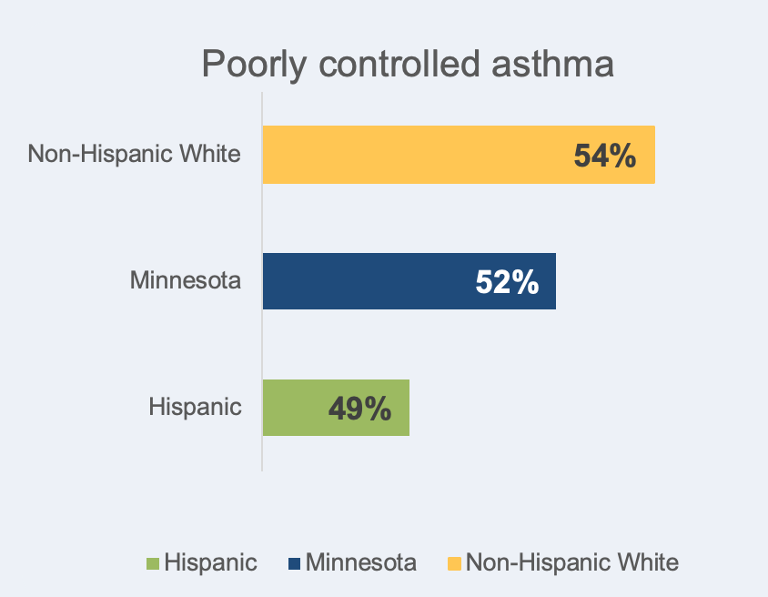
Poorly Controlled Asthma
Fuente: Health Care Quality Measures/MN Community Measurement
Notes:
About half of Minnesotans with asthma have poorly controlled asthma, which is similar for Minnesota’s Latino population.
As mentioned on the previous slide, we only include data for Minnesota overall, non-Hispanic White people, and Hispanic/Latino people for several reasons.

Slide 9
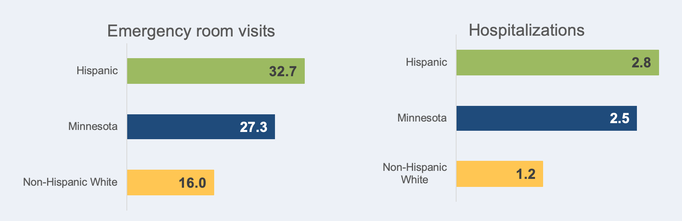
Emergency Department Visits and Hospitalizations
Asthma Emergency Department Visits and Hospitalizations, 2024
Rate per 10,000 people
Source: Minnesota Hospital Association
Notes:
Although asthma is similarly common across communities, Minnesota’s Latino community is more likely to visit the emergency department or be hospitalized for asthma than non-Hispanic White people.
This suggests there may be barriers to consistent asthma management and to preventing more serious outcomes among Latino Minnesotans.
Again, we are only including data for Minnesota overall, non-Hispanic White people, and Hispanic/Latino people for several reasons.
In addition, in a 2025 study we conducted with the Latino community in the Twin Cities, we identified several barriers that cause many people to avoid going to the doctor until they feel very sick. These included:
Economic barriers.
Language and cultural barriers.
Fear related to immigration status.
Difficulty navigating the healthcare system and accessing preventive and specialty care.

Slide 10
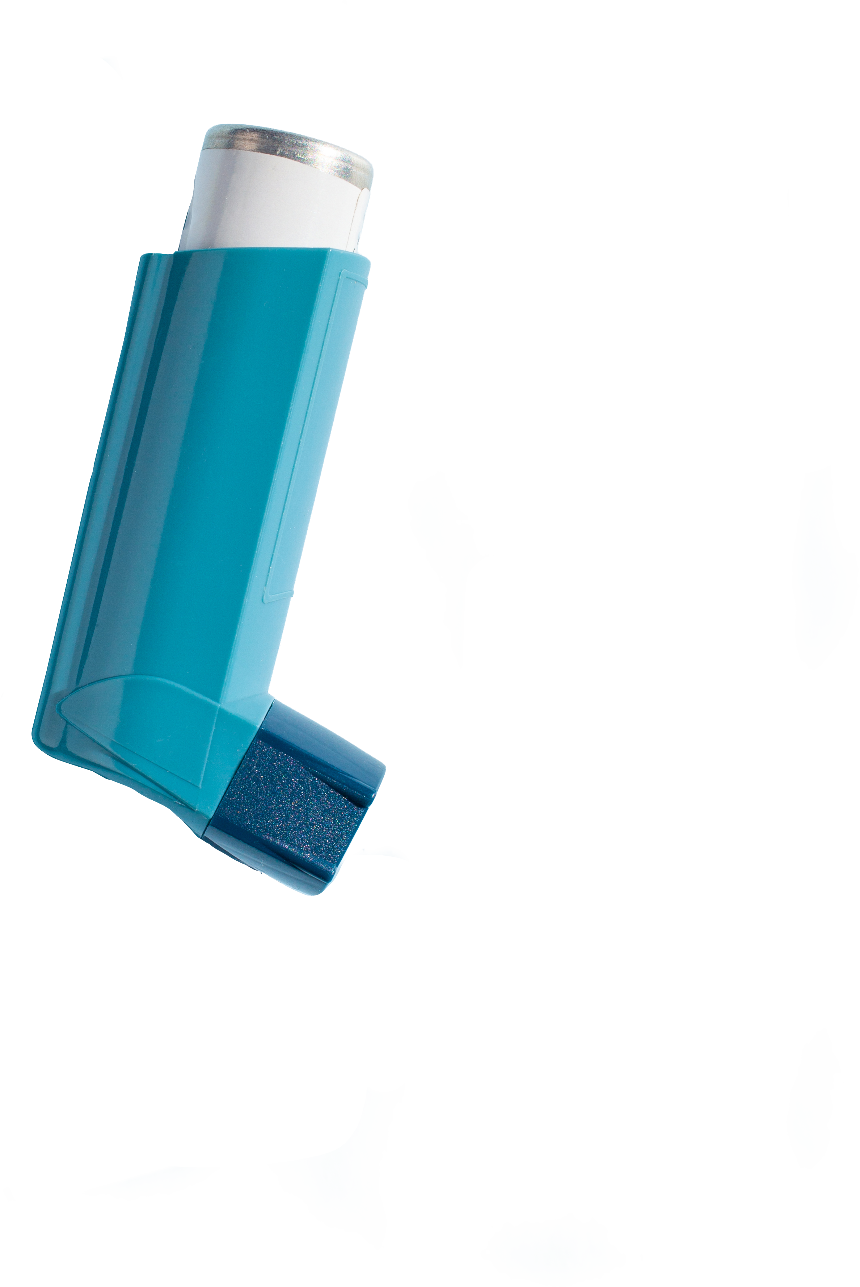
Does asthma affect everyone in the same way??
Notes:
I’d like to ask you:
Does asthma affect everyone in the same way?
Let’s vote by raising our hands.
Who says yes?
Who says no?

Slide 11

Asthma affects each person differently
Symptoms can vary from person to person.
Talk with your healthcare provider about your own symptoms!
Notes:
Asthma does not look the same for everyone. Symptoms can vary greatly from person to person.
Common symptoms vary in type and intensity.
Some people may have mild symptoms such as an occasional cough, while others may experience wheezing (a whistling sound when breathing), chest tightness, or shortness of breath.
Each person’s asthma pattern is unique. What triggers one person’s asthma may not affect another person. That is why individualized care is important.
Because asthma varies so much, it is important to talk with your healthcare provider to understand your own symptoms and how to manage them safely.

Slide 12

Who can share some asthma symptoms?
Notes:
Who can share some asthma symptoms?

Slide 13

What are the symptoms of asthma?
Wheezing (whistling sound when breathing)
Coughing
Shortness of breath
Chest tightness or pain
Notes:
This slide shows common asthma symptoms.
Wheezing is a whistling sound that can happen when a person breathes out. It is caused by narrowed airways.
Asthma-related coughing often gets worse at night or early in the morning, which can make it hard to sleep.
For some people, coughing may be the only symptom they notice. Others may experience shortness of breath, feeling as though they cannot catch their breath or cannot fully get the air out of their lungs.
Some people may experience chest tightness or pain. It can feel as though something is squeezing, pressing, or sitting on the chest. This is a sign that the airways are narrowing.

Slide 14
Asthma can be controlled, but if it is not controlled, it can be FATAL…
Having symptoms may mean your asthma is not well controlled.
Talk with your healthcare provider if:
Your asthma interferes with usual activities such as school or work.
You have symptoms or use your quick-relief (rescue) inhaler more than twice a week.
Symptoms wake you up two or more times a month.
You refill your quick-relief inhaler prescription more than twice a year
Notes:
Asthma is a condition that can be managed with appropriate care, medication, and monitoring.
Symptoms are a warning sign! Having symptoms—especially frequent symptoms—may mean your asthma is not well controlled.
It is important to talk with your healthcare professional if symptoms happen often, especially if they interfere with sleep or daily life or require frequent use of a quick-relief or rescue inhaler.
We’ll talk more about inhalers soon!
If symptoms are not treated quickly, uncontrolled asthma can even be fatal. This is an extreme example of why early recognition and proper management are essential.

Slide 15
Symptoms can change from:
Hour to hour
Day to day
Month to month
As people grow, encounter new triggers, or experience changes in their health or environment.
Notes:
Asthma can change over time. A person’s asthma can change depending on their health, environment, or exposure to triggers.
Changes can happen from hour to hour. Symptoms may suddenly get worse, especially with triggers such as exercise, allergens, or illness.
Changes can happen from day to day. Some days breathing may feel normal, while on other days symptoms may be more noticeable.
Changes can also happen from month to month.
Symptoms can also change as people grow, encounter new triggers, or experience changes in their health or environment.
Seasons, weather, and respiratory infections can affect a person’s asthma control.

Slide 16

What are the 2–3 most common asthma triggers you know?
Source: Evan Frost | MPR News
Notes:
Many things can trigger an asthma attack.
What are the 2 or 3 most common triggers you know?

Slide 17

What can trigger an asthma attack?
Notes:
What can trigger an asthma attack?

Slide 18

Environmental triggers
Pollen
Smoke
Strong odors from cleaning products, perfumes, air fresheners, or candles
Dust mites
Mold
Pet dander, saliva, and droppings
Pests such as cockroaches and mice
Source: AP Photo/Sue Ogrocki
Notes:
Now, a fairly long list of triggers—some of which we just mentioned. (It is fine to read only the bolded parts to keep this shorter.)
Airborne pollutants: Car exhaust, industrial emissions, or poor indoor air quality can irritate the airways and worsen symptoms.
Seasonal pollen from trees, grasses, and weeds can trigger asthma, especially in people with allergies.
Smoke: Smoke from cigarettes, fireplaces, wood-burning stoves, wildfires, and other outdoor fires contains particles that can inflame the airways.
Strong odors from cleaning products, perfumes, air fresheners, or candles can irritate sensitive airways. Even small amounts can cause coughing, wheezing, or difficulty breathing in people with asthma.
Dust mites are tiny spider-like creatures found in nearly every home, especially in bedding, carpets, and upholstered furniture. Their body parts and droppings can irritate the airways and trigger asthma symptoms.
Mold grows in damp places. Water leaks, dampness, or moisture in the air can allow mold to spread. Breathing in mold spores can inflame the airways and cause coughing, wheezing, or difficulty breathing.
Pet dander, saliva, and droppings: Proteins in skin flakes, saliva, and waste from furry or feathered pets—such as cats, dogs, and birds—can trigger asthma symptoms, even when the animal is not physically present.
Pests such as cockroaches and mice: Droppings, body parts, and debris from pests can be strong allergens. These particles can become airborne and trigger asthma flare-ups, especially in infested homes or buildings.
In addition, breathing cold, dry air or experiencing sudden temperature changes can cause the airways to narrow.

Slide 19

Non-environmental triggers:
Aerobic exercise
Viral infections
Strong emotions
Notes:
There are also some triggers that are not strictly environmental:
Aerobic exercise: Activities such as running, biking, or playing sports can cause the airways to narrow, especially in cold or dry air. This is called exercise-induced bronchoconstriction and can cause coughing, wheezing, or difficulty breathing during or after activity.
Viral infections: Colds, flu, RSV, and other respiratory viruses are among the most common causes of asthma flare-ups, especially in children.
Strong emotions: Intense feelings—such as laughing hard, crying, fear, or stress—can change breathing patterns. These rapid changes in breathing can tighten the airways and trigger symptoms.

Slide 20

How can we help someone during an asthma attack?
Notes:
Changing topics, we’d like to talk about how to help someone who is having an asthma attack. (Continue to the next slide.)

Slide 21

Key Actions
Have the person stop the activity and sit upright.
Stay with the person and help them remain calm.
If available: Follow the person’s Asthma Action Plan and have them use their quick-relief medication (nebulizer or albuterol).
Monitor symptoms: if they get worse, seek medical help or call 9-1-1.
Notes:
There are several key actions to help someone who is having an asthma attack:
First, ask the person to stop what they are doing and sit upright. Staying upright—not lying down—helps open the airways and makes breathing easier.
Stay with the person and help them remain calm.
Anxiety can make symptoms worse, so staying calm helps prevent further tightening of the airways.
Have the person breathe slowly through the nose and breathe out through pursed lips.
If the person has an Asthma Action Plan, follow it. The plan usually includes use of a quick-relief inhaler, a SMART therapy inhaler, or a nebulizer. (We will talk more about medications and Asthma Action Plans later.)
Watch symptoms closely. Look for signs that they are improving or getting worse.
If symptoms get worse, do not wait—seek medical help or call 911.

Slide 22
What are some ways people can manage asthma at home or wherever they go?
Notes:
There are many ways to control or manage asthma.
What are some ways people can manage asthma at home or wherever they go?

Slide 23

How can you manage asthma at home?
Keep notes about your symptoms.
Identify and avoid asthma triggers.
Exercise regularly to keep your heart healthy.
Do not smoke and avoid secondhand smoke.
Eat healthy foods.
Notes:
We already mentioned some ways to manage asthma at home.
Avoid tobacco smoke. Smoking and exposure to secondhand smoke are major triggers. Smoke particles can irritate and inflame the airways, making asthma harder to control.
Eat healthy foods. A balanced diet supports overall health and may help reduce inflammation that can worsen asthma symptoms.
Exercise regularly for a healthy heart. Staying active strengthens the heart and lungs. Many people with asthma can exercise safely with proper management and awareness of their triggers.
Identify your personal asthma triggers. Knowing what usually triggers symptoms can help reduce exposure and prevent flare-ups.
Keep notes about your symptoms. Tracking symptoms, triggers, and medication use can reveal patterns and help guide conversations with a healthcare professional.

Slide 24

How can you manage asthma with help from a healthcare provider?
Visit your healthcare provider as often as you decide together is necessary
Have an Asthma Action Plan.
Get vaccinated against the flu and other illnesses.
Learn which medicines to take, when to take them, and how to use inhaler devices correctly.
Ask your doctor for a prescription for a spacer.
Notes:
There are many ways a healthcare professional can help manage asthma:
See your healthcare provider regularly. Work with your provider to decide how many visits you need each year. Regular checkups help make sure your asthma is well controlled and your treatment plan is up to date.
Have an Asthma Action Plan. We’ll talk more about these plans soon!
Stay up to date on vaccines. Getting a flu shot and other recommended vaccines helps protect your lungs from infections that can trigger asthma flare-ups.
Know which medicines you take, when to take them, and how to use inhalers correctly. We’ll talk more about this later.
Ask your doctor for a prescription for a spacer. This device attaches to the inhaler and helps more medicine reach the lungs.

Slide 25
Questions for your healthcare provider at your next visit:
Can you explain this information in a simpler way?
Can I request an interpreter for this visit?
Do you have materials in Spanish?
Can you explain how my Asthma Action Plan works??
Notes:
When you visit your healthcare provider or pharmacist, it is okay to ask questions. Asking questions can make the visit much more useful.
(It is fine to read only the bolded parts below to keep this brief.)
Ask for simple, easy-to-understand explanations. “Could you explain things in plain language without using too many medical terms?” This helps make sure the person fully understands their asthma, medications, and care plan.
Request an interpreter if needed. “Is there someone who can interpret during this visit?” Access to interpretation supports accurate communication and better health outcomes.
Ask for materials in your preferred language. “Do you have materials in Spanish?” Written information in the appropriate language helps families review instructions at home.
Ask for help understanding the Asthma Action Plan. “I’m having trouble understanding my plan for managing my asthma. Can you explain how it works and when I’m supposed to use it?” This helps make sure the person knows what to do every day, what to do when symptoms get worse, and when to seek help.
Can anyone think of other questions?

Slide 26

Does anyone know what an Asthma Action Plan is?
Notes:
Does anyone know what an Asthma Action Plan is?

Slide 27
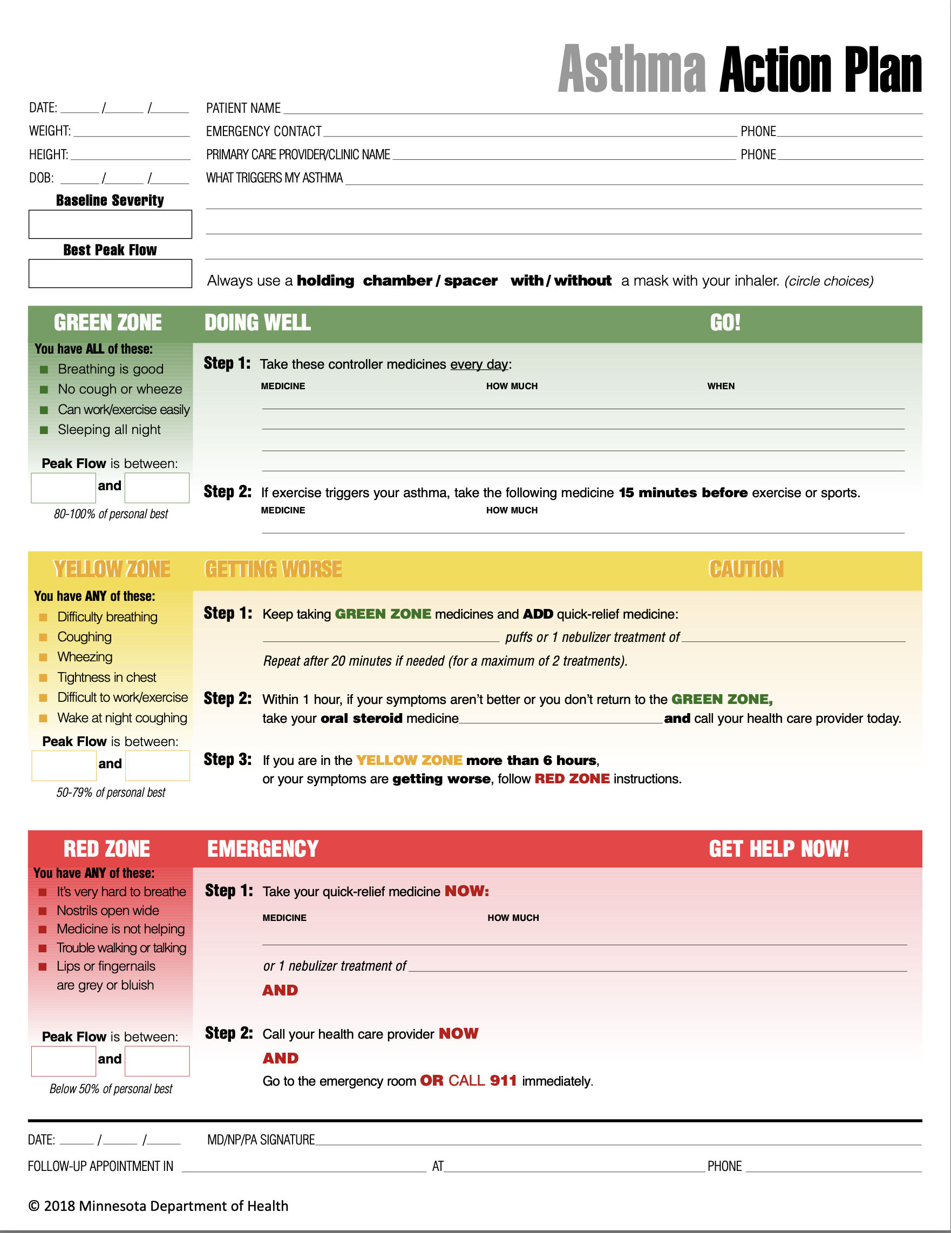
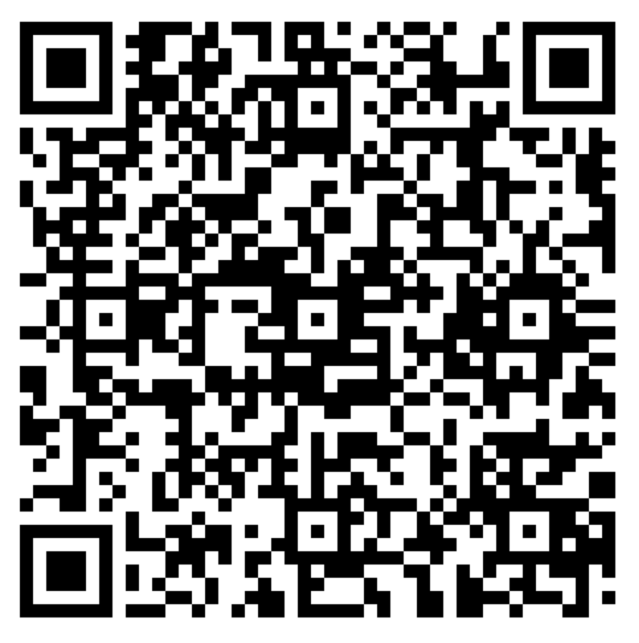
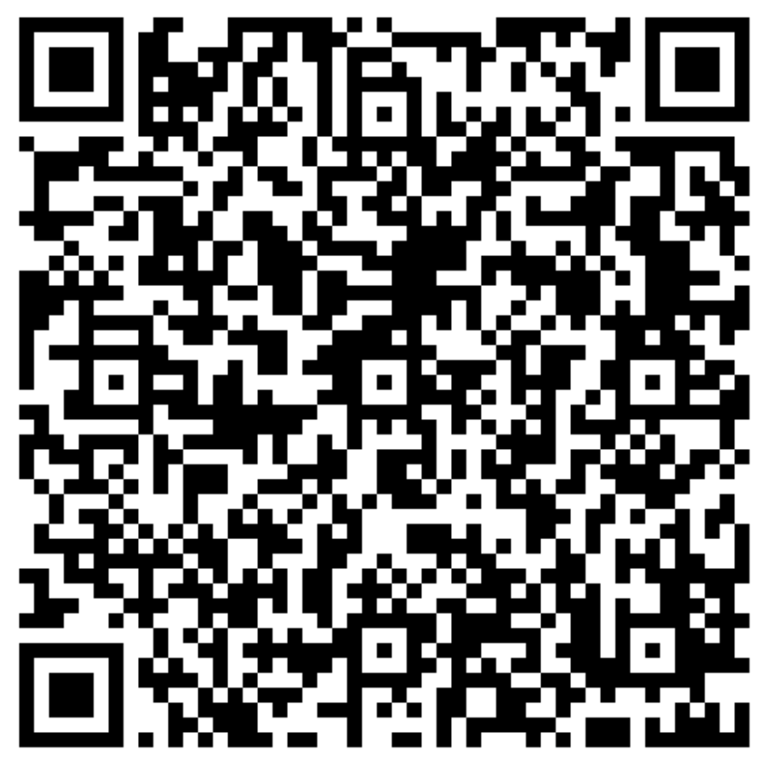
Adult Asthma Action Plan
Child Asthma Action Plan
Notes:
Let’s talk about Asthma Action Plans, which are an important tool:
An Asthma Action Plan is a written, individualized worksheet that explains how to keep asthma under control.
It includes asthma-management strategies: medications and ways to eliminate, reduce, and prevent triggers.
It provides guidance about when to call a healthcare professional or when to seek emergency care.
There are Asthma Action Plans for both adults and children.
If a person has an Asthma Action Plan, healthcare staff can review it with them to make sure they understand how to use it. If the person does not have one, encourage them to ask their healthcare provider for one.
The Asthma Action Plan should include:
- Asthma triggers
- Names of medications, how much to take, and when to take them
- How to recognize signs that asthma is getting worse
- What to do in an emergency
A medical provider completes this written plan with the patient. Each person with asthma should have their own copy, and a copy should be given to child care, school, sports coaches, and anyone who spends a lot of time with that person.
QR codes for the slide:
Link to Spanish AAP (Adult): Spanish Adult Asthma Action Plan 2018-Adulto Plan De Accion Para Asma
Link to Spanish AAP (Child): Spanish Child Asthma Action Plan 2018//Plan De Accion Para Asma - para el niño
In English slideset:
Link to English AAP (Adult): Adult Asthma Action Plan 2018
Link to English AAP (Child): Child Asthma Action Plan 2018

Slide 28

Does anyone know of any asthma medications?
Notes:
Now we’re going to take a closer look at asthma medications.
Question for the audience:
Does anyone know of an asthma medication they would like to share?

Slide 29
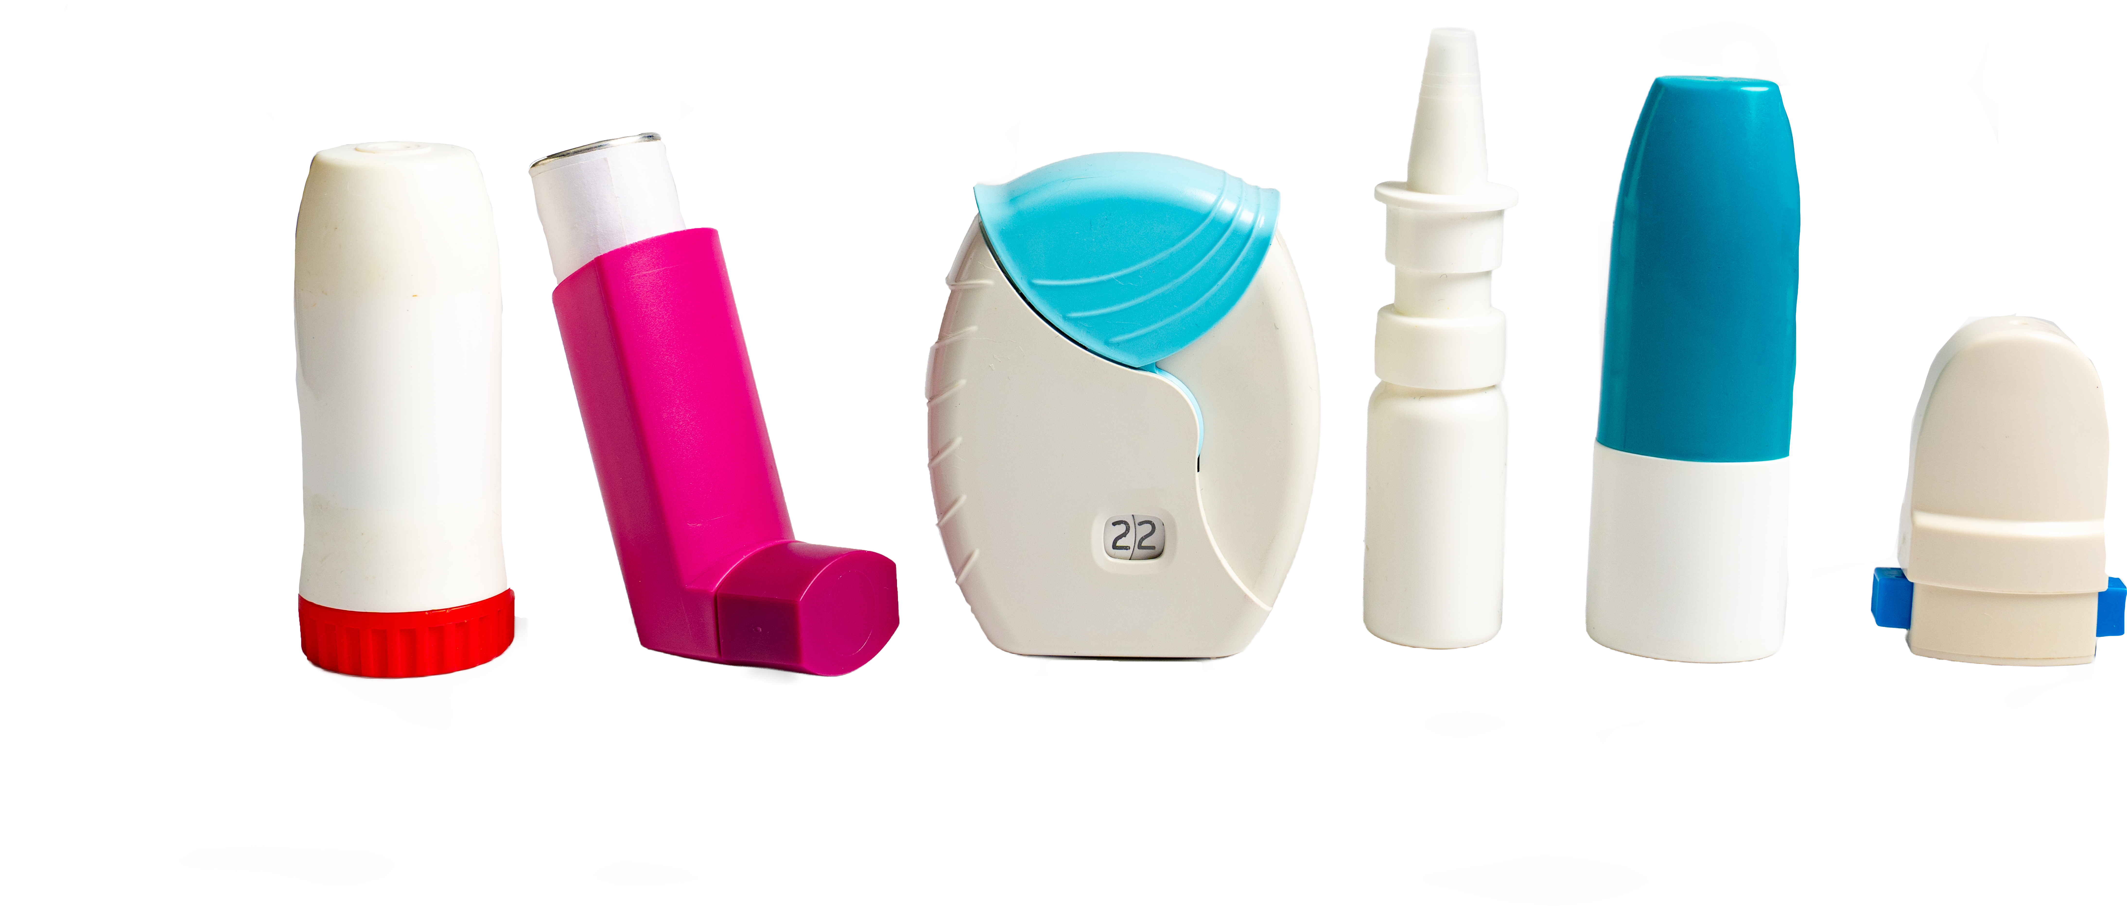
Daily Controller Medications
How do they work?
Reduce airway inflammation and mucus buildup.
How do you take them?
Use as prescribed to control ongoing symptoms and prevent asthma attacks.
Important!
Rinse your mouth after use to help prevent oral health problems.
Notes:
One general category of asthma medicine is long-term controller medication:
Long-term, or simply controller, medicines keep asthma stable over time.
These medicines work by reducing chronic inflammation in the airways. This helps prevent mucus buildup that can make breathing difficult.
These medicines should be taken consistently as prescribed—even when you feel well—to keep symptoms under control and reduce the risk of asthma attacks.
One additional note: Rinse your mouth after each inhalation to protect oral health and reduce the risk of irritation or infection.

Slide 30
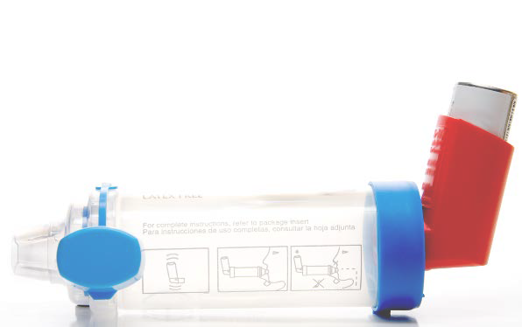
Quick-Relief Medications
How do they work?
Open the airways so air can move more easily from the windpipe into the lungs.
How do you take them?
Use as needed to help prevent or treat an asthma attack.
Important!
They can cause side effects and should always be taken as prescribed.
Notes:
Another general category is quick-relief medication.
Quick-relief medicines, also known as “rescue” medicines, are bronchodilators: they open the airways and relax the muscles around the breathing tubes.
These medicines are used when symptoms such as wheezing and shortness of breath appear or to treat an asthma attack.
Sometimes quick-relief medicine is prescribed before exercise or exertion to prevent symptoms.
These medicines are usually delivered through an inhaler (ideally with a spacer/chamber) or a nebulizer.
When asthma attacks occur, quick-relief medicines work right away to stop the attack.
Although rescue medicines work quickly to open the airways, using them too often can cause side effects and may be a sign that asthma is not well controlled.
If someone needs their rescue inhaler more than twice a week, they should talk with their healthcare professional about adjusting their medicine or Asthma Action Plan.
(If there are questions about side effects, examples include:
Shakiness/feeling jittery
Fast heart rate
Headache
Throat irritation
Coughing after use
Temporary dizziness
When are these side effects most common? When using more than 2 puffs at a time; children are more susceptible to feeling jittery; when using the inhaler without a spacer/chamber; and when using quick-relief medicine frequently, more than 2 days per week.)

Slide 31
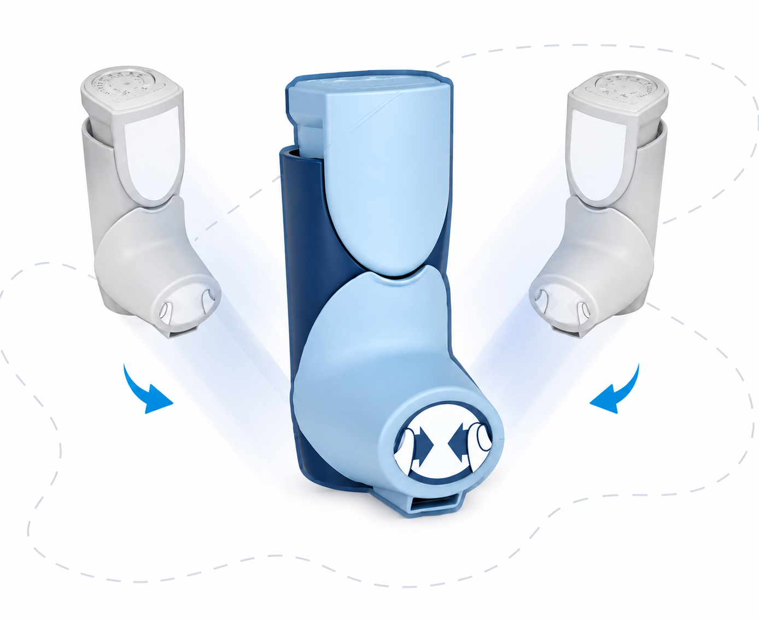
SMART or MART Therapy
SMART (Single Maintenance and Reliever Therapy)
MART (Maintenance and Reliever Therapy)
These approaches use one inhaler for both daily control and quick relief of symptoms.
Notes:
Now, a newer type of combination treatment:
SMART therapy uses one inhaler for both daily control and quick relief.
This newer approach to asthma management combines long-term control and fast-acting relief in one inhaler, helping simplify treatment and improve symptom control.
It is recommended for people age 5 and older with moderate persistent asthma that is not well controlled.
Talk with your healthcare professional to determine whether this type of inhaler may work for you.
Examples: Symbicort and Dulera (available in the U.S.).

Slide 32
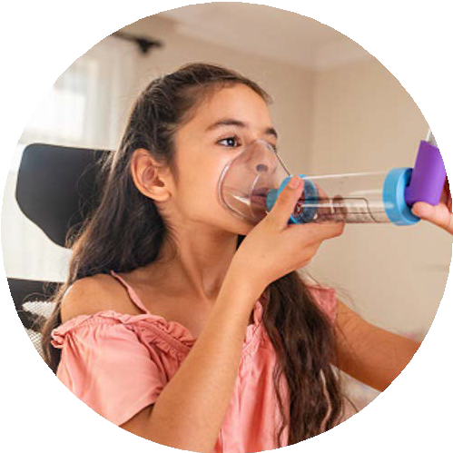
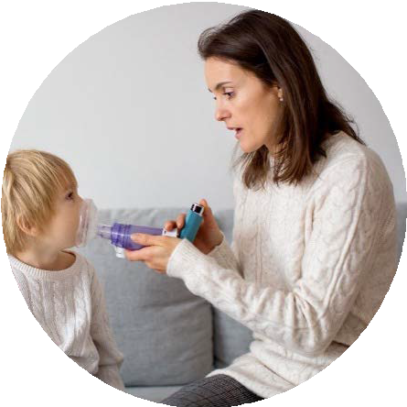
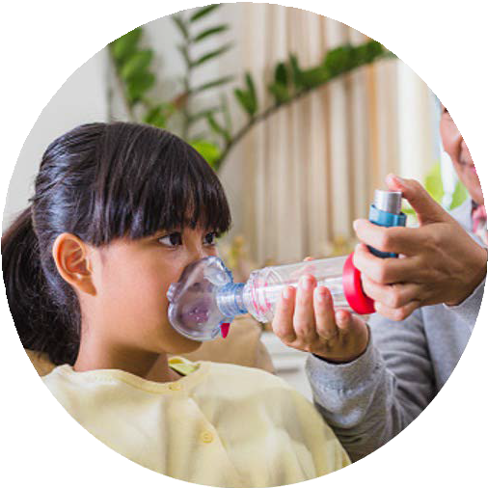
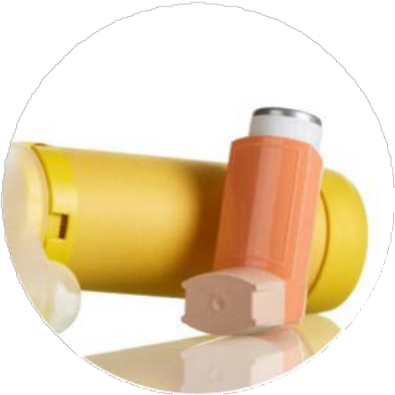
Spacers
Help more medicine reach the lungs and less stay in the mouth and throat
Caregivers can help children use an inhaler correctly with a spacer
Spacers should be used with all metered-dose inhalers
Help prevent inhaling the medicine too quickly
Notes:
Spacers improve medication delivery.
These devices attach to the inhaler and help the medicine reach deeper into the lungs. They reduce the amount of medicine that ends up in the mouth or throat instead of the lungs.
Using a spacer still requires coordination with breathing. The user needs to coordinate their breath with the inhaler to inhale the medicine correctly.
The chamber traps and holds the medicine, giving the user time to breathe in slowly and deeply.

Slide 33
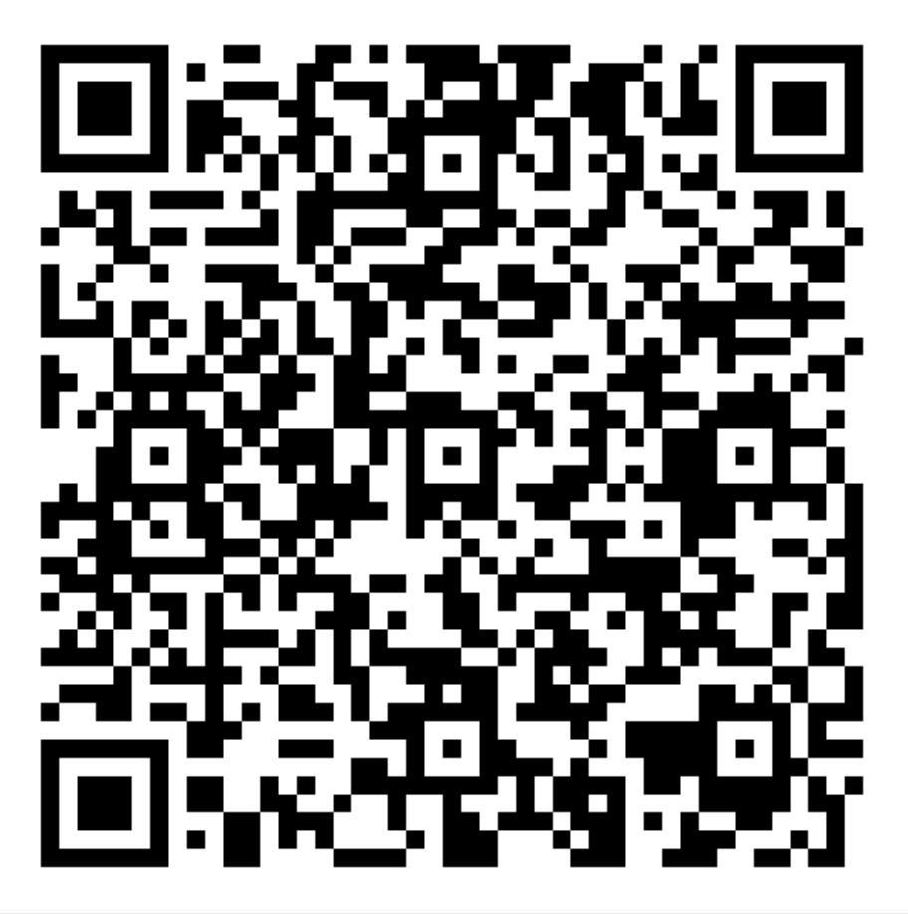
Air Quality and Asthma
Check the air quality in your community before going outside.
Scan the QR code with your phone or mobile device to check local air quality conditions.
You can also visit the Minnesota Pollution Control Agency webpage:
https://www.pca.state.mn.us/air-water-land-climate/current-air-quality-conditions
(For Spanish on your computer: select Spanish from the list at the top left of the page. Navigation may vary on mobile devices.)
Notes:
An important asthma trigger for many people is poor air quality, as we discussed earlier.
Poor air quality is becoming more common in Minnesota as wildfire smoke and other air pollutants increase, especially in the summer.
There are some important steps you can take, starting with checking the air quality in your community before going outside.
The Minnesota Pollution Control Agency and the U.S. Environmental Protection Agency offer useful tools for staying up to date on air quality.

Slide 34
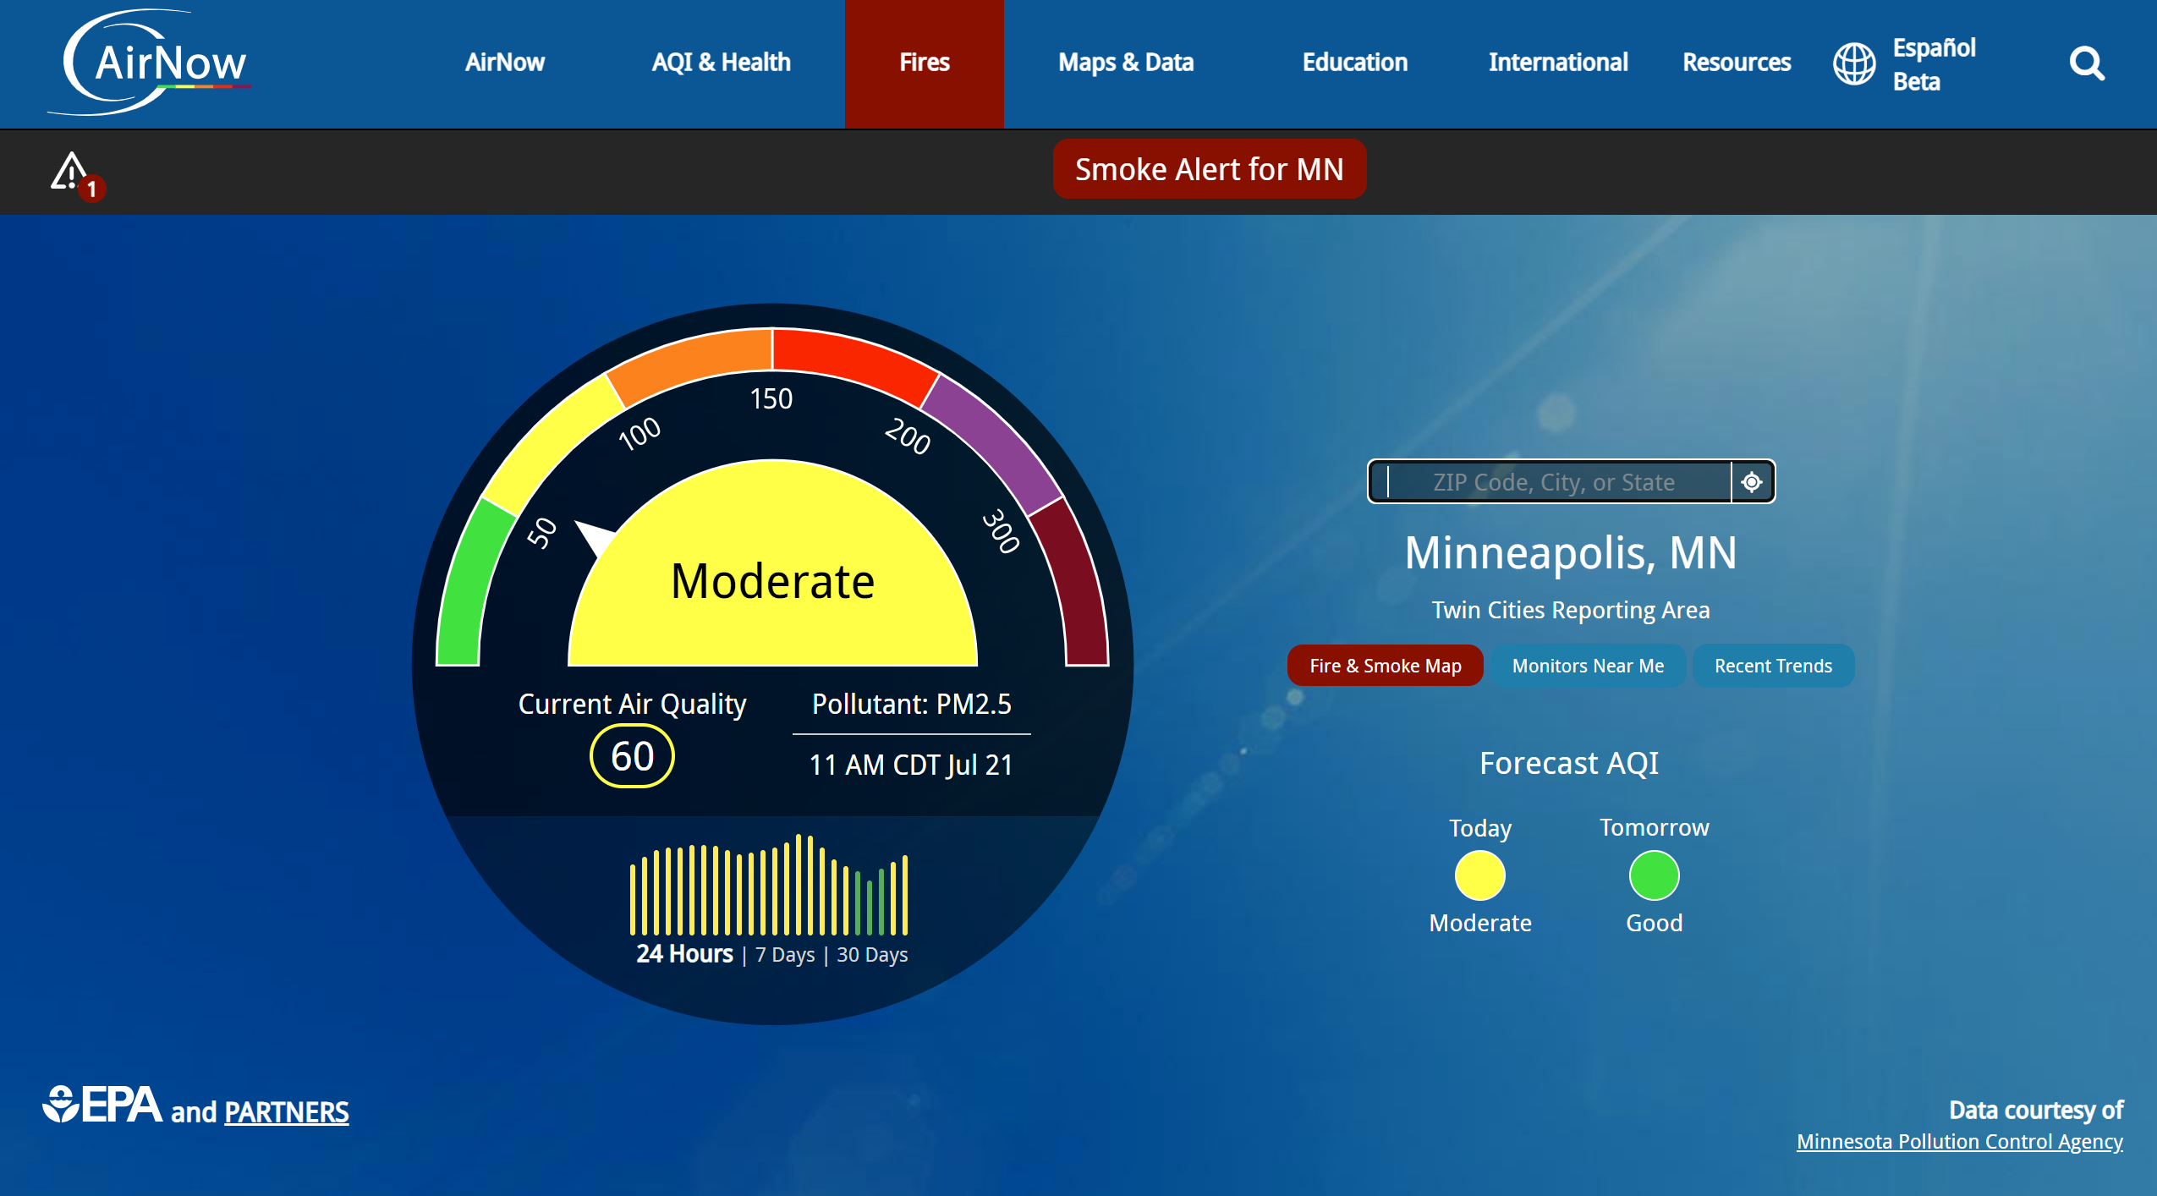


Apps
App Store (iOS)
Google Play Store
(Android)
Available for iPhone (iOS) and Android. The app is in English only.
https://www.airnow.gov
Notes:
The AirNow app allows you to check air quality based on your ZIP code.
It can be downloaded to an Android phone or iPhone, but only in English currently.

Slide 35
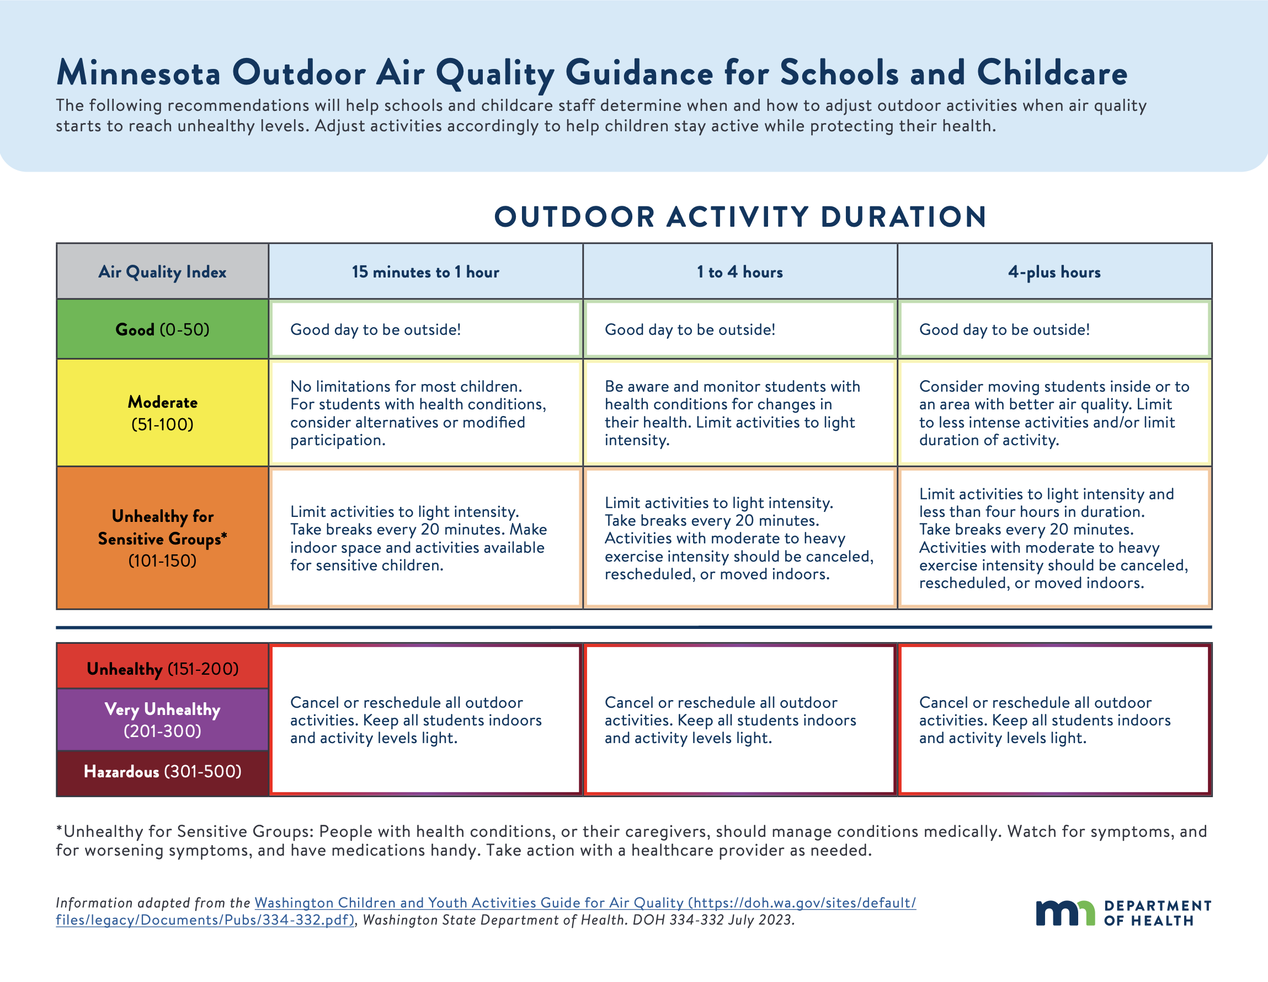
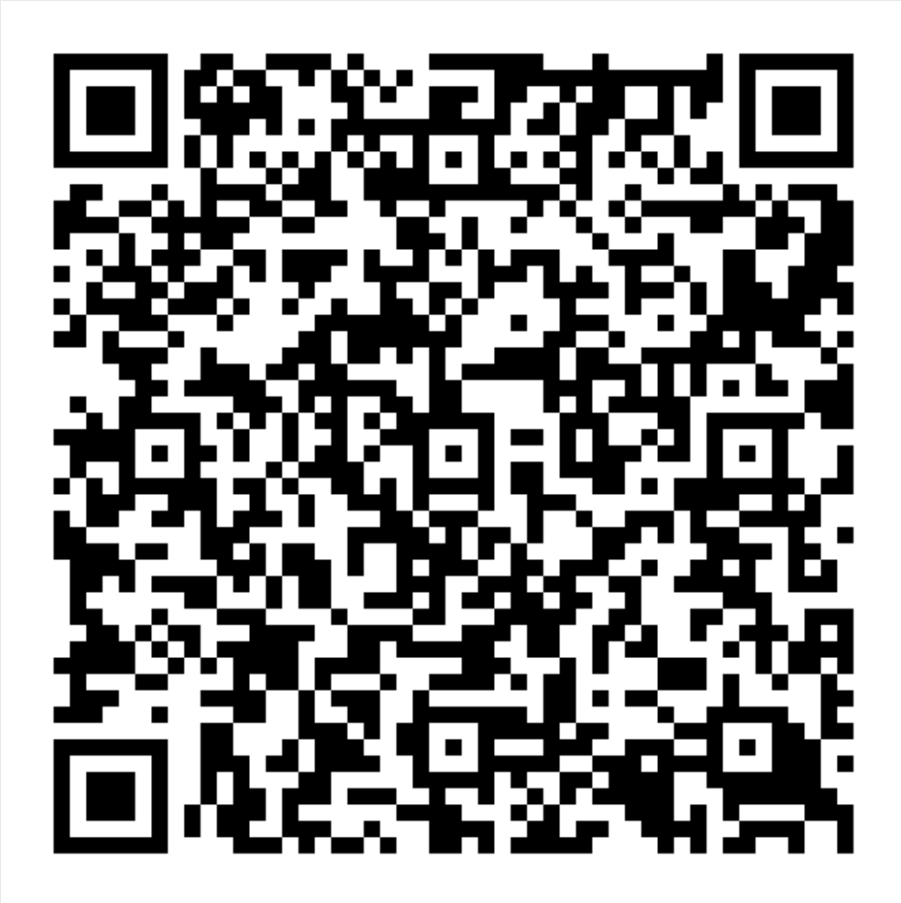
MN Outdoor Air Quality Guidance for Schools and Child Care
View the guide here:
Notes:
The Minnesota Outdoor Air Quality Guidance, developed by the Minnesota Department of Health, is a resource to help schools and child-care programs protect children during poor air quality.
The guidance provides clear steps for schools and child-care programs to adjust outdoor activities—such as recess, sports, and field trips—based on current air quality levels.
It helps staff make safe decisions for all children, especially those with asthma or other respiratory conditions, by using the Air Quality Index (AQI) to reduce exposure on days when the air is unhealthy.
It can also be used as guidance at home or anywhere else.
You can use the QR code to access the resource in Spanish (change to Somali for Somali version).
(Relevant links for QR codes in English and Spanish for each slide are below. Pending addition of Somali)
Link to English Version: Minnesota Outdoor Air Quality Guidance for Schools and Child Care
Link a la version en español: Guía de calidad del aire exterior de Minnesota para escuelas y programas de cuidado infantil

Slide 36

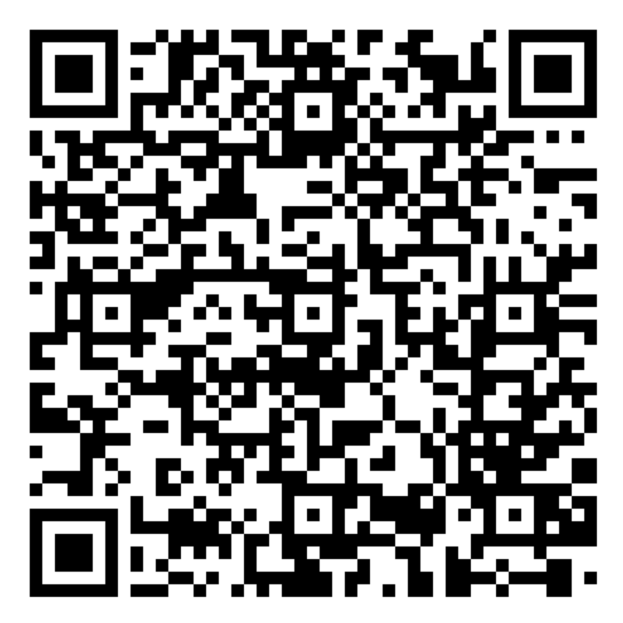
Find more asthma information in Spanish here
https://www.health.state.mn.us/diseases/asthma/communities/spanish/index.html
Notes:
Finally: Where can we find asthma information in Spanish?
MDH has a webpage that offers a wide range of asthma resources, trainings, and educational information in Spanish (change to Somali for pending Somali translation of slideset and pending Somali webpages).
You can use the QR code to access this webpage.

Slide 37
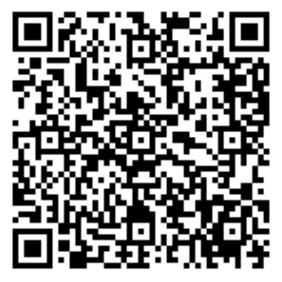
The MDH Asthma Program Is Here for You!
Subscribe to receive information from the Asthma Program
public.govdelivery.com/accounts/MNMDH/subscriber/new?topic_id=MNMDH_49
Email: health.asthma@state.mn.us
Call: 651-201-5909
Notes:
We’ll close with information about the MDH Asthma Program: how to contact the team and how to stay up to date on news and updates.
Stay informed by subscribing to the Asthma Program mailing list (GovDelivery), where you can receive updates, resources, and announcements through this QR code. These are in English.
Contact the team directly by email (address shown on the slide) with questions or for resources or program support. The Program Manager can respond to emails in Spanish.
Call the Asthma Program at the phone number shown on the slide for help or additional information. If a voicemail message is left in Spanish, the team can return the call in Spanish.

