Slide 1
Annual HIV, STI, and Hepatitis 2023 Data Release Live Webinar
MDH STI/HIV/TB Section and Hepatitis Unit
Notes:
Good afternoon, everybody, this is Chryssie Jones. I am the manager of the STI/HIV/TB section at the Minnesota Department of Health. Welcome and I thank you for joining us for the annual HIV, STI, and hepatitis 2023 data release. We are going to wait just about 30 seconds to give people a little bit of time to join us before we get started. In the meantime, I will be going over the agenda and some ground rules, and if you have any questions or if you're having any issues at all, please put your message in the chat and it will be monitored. We will get started in about 30 seconds. Thanks.

Slide 2
Annual HIV/STI and Hepatitis 2023 Data Release Agenda
Thursday, April 25 from 2-3 p.m.
Introduction
2023 STI Data
2023 HIV Data
2023 Hepatitis Data
Prevention
  Southside Harm Reduction
  Native American Community Clinic (NACC)
Partner Services Update
Question & Answers
Notes:
OK, we're going to go ahead and get started. Again, my name is Chrissy Jones. I am the section manager for the STI/HIV/TB section at the Minnesota Department of Health. Welcome to the annual HIV/STI 2023 data release. Today, our meeting will run from 2 to 3 o'clock this afternoon. We will be going over our 2023 STI, HIV, and hepatitis data. We’ll also hear some updates from our Prevention Unit, and we’re glad a few of our partners are here to give an update. We’ll also hear from our Partner Services Unit. And then we'll have some time at the end for questions and answers.

Slide 3
Reminders
Please submit questions to the Q&A throughout the presentation, answered at the end
  Q&A option is to the left of the settings gear, near the top of the screen
Select the “more” option on your screen to enable subtitles
Notes:
Some reminders as we're working through this webinar, if you have any questions or comments throughout the presentation, please put them in the chat box and all questions will be answered at the end. The ones that we are not able to get to today will be sent out via electronic communication. Please note that Q&A option is to the left of your settings gear near the top of your screen. You can select the more option on your screen if you want to enable subtitles also.

Slide 4
Tribal-State Relations Acknowledgment Statement
The state of Minnesota is home to 11 federally recognized Indian tribes with elected tribal government officials. The State of Minnesota acknowledges and supports the unique status of the Minnesota tribal nations and their absolute right to existence, self-governance, and self-determination. The United States and the State of Minnesota have a unique relationship with federally recognized Indian tribes, formed by the Constitution of the United States, treaties, statutes, case law, and agreements. The State of Minnesota and the Minnesota Tribal governments significantly benefit from working together, learning from one another, and partnering where possible.
This partnership, through a government-to-government relationship, with the eleven tribal nations of Minnesota has the potential to effectively address inequities and build trust that will lead to better outcomes for all of Minnesota.
Notes:
Before we begin our webinar, we take a moment to acknowledge the state of Minnesota is home to 11 federally recognized …

Slide 5
Sexually Transmitted Infection (STI) Surveillance Report, 2023
Minnesota Department of Health STI Surveillance System

Slide 6
Introduction 1/2
Under Minnesota law, physicians and laboratories are required to report all laboratory-confirmed cases of chlamydia, gonorrhea, syphilis, and chancroid to the Minnesota Department of Health (MDH) within one working day.
The MDH does not maintain statistics for other, non-reportable STIs (ex: herpes, HPV/genital warts).
This slide set describes trends in reportable STIs in Minnesota by person, place, and time.
Analyses exclude cases reported from federal and private prisons.

Slide 7
Introduction 2/2
STI surveillance is the systematic collection of data from cases for the purpose of monitoring the frequency and distribution of STIs in a given population.
STI surveillance data are used to detect problems, prioritize resources, develop and target interventions, and evaluate the effectiveness of interventions.

Slide 8
Interpreting STI Surveillance Data (1/2)
Factors that impact the completeness and accuracy of STI data include:
  Level of STI screening by healthcare providers
  Individual test-seeking behavior
  Sensitivity of diagnostic tests
  Compliance with case reporting
  Completeness of case reporting
  Timeliness of case reporting
Increases and decreases in STI rates can be due to actual changes in disease occurrence and/or changes in one or more of the above factors.
COVID-19 lockdowns likely played a role in the number of cases reported/diagnosed during the COVID-19 pandemic years
Notes:
Factors that impact the completeness and accuracy of STI data include:
Level of STI screening by healthcare providers, individual test-seeking behavior, sensitivity of diagnostic tests, compliance with case reporting, completeness of case reporting, timeliness of case reporting.
Increases and decreases in STI rates can be due to actual changes in disease occurrence and/or changes in one or more of the above factors.
COVID-19 lockdowns likely played a role in the number of cases reported/diagnosed during the COVID-19 pandemic years

Slide 9
Interpreting STI Surveillance Data (2/2)
The surveillance system only includes cases with a positive laboratory test. Cases diagnosed solely on symptoms are not counted.
Since 2012 we have included cases that had only a lab report and no corresponding case report form. This has increased the number of unknowns in some variables.
In 2020, the COVID-19 response accelerated the use of laboratory reporting by facilities, again increasing the number of unknown variables.
Rate are computed using Census data. Census data uses weighted estimates to calculate intercensal estimates.
Surveillance data represent cases of infection, not individuals. A person with multiple infections in a given year will be counted more than once.
Caution is warranted when interpreting changes in STI numbers that can seem disproportionately large when the number of cases is small.

Slide 10
Census data updates
To better represent historical rates, historical census data and population estimates were used to calculate disease incidence rates.
Census data was used for 3 years intervals then sequential estimates are used for future years.
  2014-2016: Utilized 2014 census estimates published and released in 2021
  2017-2019: Utilized 2017 census estimates published and released in 2021
  2020-2022: Utilized 2020 census estimates published and released in 2021
  2023: Utilized 2022 estimates published in June of 2023
Notes:
2014-2016 Single-Race Population Estimates 2010-2020 https://wonder.cdc.gov/Single-Race-v2020.HTML
2017-2019: Single-Race Population Estimates 2010-2020 https://wonder.cdc.gov/Single-Race-v2020.HTML
2020-2022: Single-Race Population Estimates 2020-2022 https://wonder.cdc.gov/Single-Race-v2022.HTML
2023: Single-Race Population Estimates 2020-2022 https://wonder.cdc.gov/Single-Race-v2022.HTML

Slide 11
Overview of STIs in Minnesota
Minnesota Department of Health STI Surveillance System

Slide 12
STIs in Minnesota:
Number of Cases Reported in 2023
Total of 31,232 STI cases reported to MDH in 2023:
  21,767 Chlamydia cases
  7,717 Gonorrhea cases
  1,748 Syphilis cases (all stages)
  0 Chancroid cases
Notes:
In the year 2023, a total of 31,232 STI cases were reported to the Minnesota Department of Health:
21,767 Chlamydia cases
7,717 Gonorrhea cases
1748 Syphilis cases (all stages)
0 Chancroid cases

Slide 13
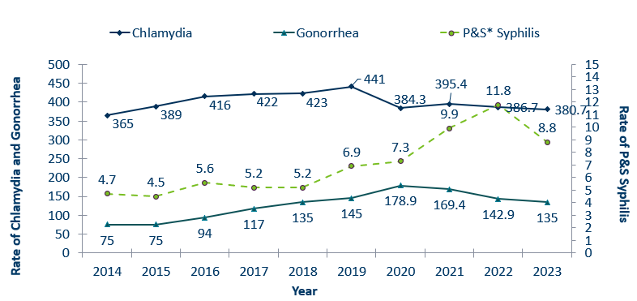
STIs in Minnesota:
Rate per 100,000 by Year of Diagnosis, 2014-2023
 | 2014 | 2015 | 2016 | 2017 | 2018 | 2019 | 2020 | 2021 | 2022 | 2023
Chlamydia | 365 | 389 | 416 | 422 | 423 | 441 | 384.3 | 395.4 | 386.7 | 380.7
Gonorrhea | 75 | 75 | 94 | 117 | 135 | 145 | 178.9 | 169.4 | 142.9 | 135
P&S* Syphilis | 4.7 | 4.5 | 5.6 | 5.2 | 5.2 | 6.9 | 7.3 | 9.9 | 11.8 | 8.8
* P&S = Primary and Secondary
Notes:
The rate of chlamydia in MN decreased by 1.6% to 380 per 100,000 compared to 386.7 per 100,000 in 2022.
The rate of gonorrhea in MN decreased 5% to 135 per 100,000 compared to 142.9 per 100,000 in 2022.
The rate of primary and secondary syphilis decreased by 25% from 11.8 in 2022 to 8.8 per 100,000 in 2022.

Slide 14
Syphilis
Minnesota Department of Health STI Surveillance System

Slide 15
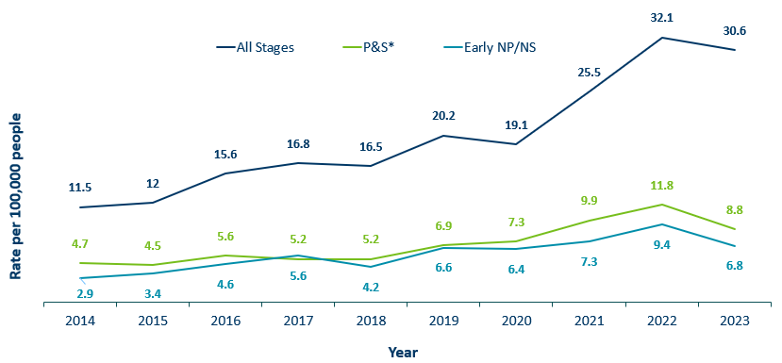
Syphilis Rates by Stage of Diagnosis, Minnesota, 2014-2023
 | 2014 | 2015 | 2016 | 2017 | 2018 | 2019 | 2020 | 2021 | 2022 | 2023
All Stages | 11.5 | 12 | 15.6 | 16.8 | 16.5 | 20.2 | 19.1 | 25.5 | 32.1 | 30.6
P&S* | 4.7 | 4.5 | 5.6 | 5.2 | 5.2 | 6.9 | 7.3 | 9.9 | 11.8 | 8.8
Early NP/NS | 2.9 | 3.4 | 4.6 | 5.6 | 4.2 | 6.6 | 6.4 | 7.3 | 9.4 | 6.8
* P&S = Primary and Secondary
Notes:
The overall syphilis rate is 30.8 per 100,000. A 4% decrease from 2022, and a 180% increase from a decade ago.
Of concern is the rate of primary and secondary syphilis which is 8.8 per 100,000, a 84% increase from 2014 a decade ago.

Slide 16
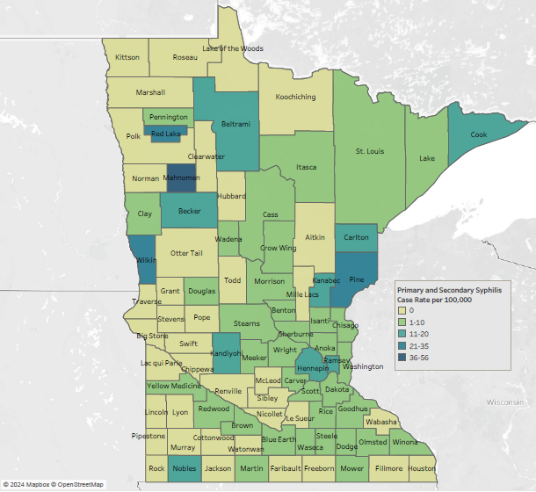
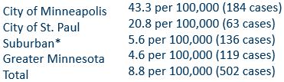
2023 Minnesota Primary & Secondary Syphilis Rates by County
*7-county metro area, excluding the cities of Minneapolis and St. Paul
Notes:
The statewide rate of primary and secondary syphilis decreased to 8.8 cases per 100,000 from 10.6.
Within the metro, the highest rate of primary and secondary syphilis remains in the City of Minneapolis at 43.3 cases per 100,000 population.
The City of St. Paul has the second highest rate in the metro at 20.8 per 100,000.
Data:
City of Minneapolis: 43.3 per 100,000 (184 cases)
City of St. Paul: 20.8 per 100,000 (63 cases)
Suburban*: 5.6 per 100,000 (136 cases)
Greater Minnesota: 4.6 per 100,000 (119 cases)
Total: 8.8 per 100,000 (502 cases)

Slide 17
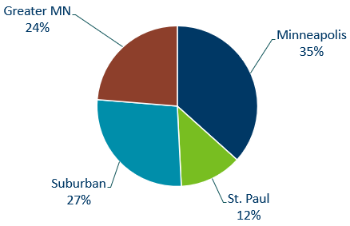
Primary & Secondary Syphilis Infections by Residence at Diagnosis
Minnesota, 2023
Total Number of Cases = 502
Suburban = Seven-county metro area including Anoka, Carver, Dakota, Hennepin (excluding Minneapolis), Ramsey (excluding St. Paul), Scott, and Washington counties. Greater MN = All other Minnesota counties outside the seven-county metro area.
Notes:
The City of Minneapolis had the largest percent of all reported primary and secondary cases with 35%
Second to Suburban MN with 27 % of the cases.
Third largest was Greater MN with 24%
St. Paul Reported 12%.

Slide 18
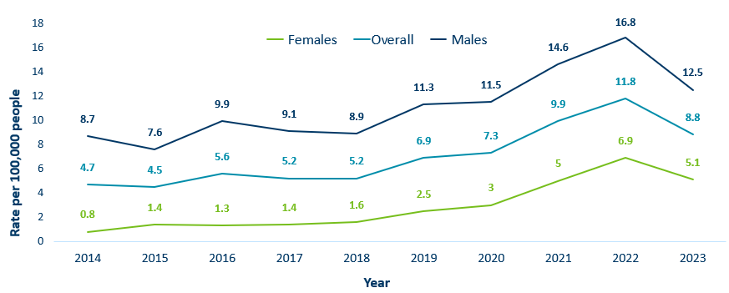
Primary & Secondary Syphilis Rates by Gender, Minnesota, 2014-2023
 | 2014 | 2015 | 2016 | 2017 | 2018 | 2019 | 2020 | 2021 | 2022 | 2023
Males | 8.7 | 7.6 | 9.9 | 9.1 | 8.9 | 11.3 | 11.5 | 14.6 | 16.8 | 12.5
Females | 0.8 | 1.4 | 1.3 | 1.4 | 1.6 | 2.5 | 3 | 5 | 6.9 | 5.1
Overall | 4.7 | 4.5 | 5.6 | 5.2 | 5.2 | 6.9 | 7.3 | 9.9 | 11.8 | 8.8
Notes:
Males have the highest rates of primary and secondary syphilis at 12.5 cases per 100,0000 population
The rate of primary and secondary syphilis in females is 5.1 per 100,000 per population.

Slide 19
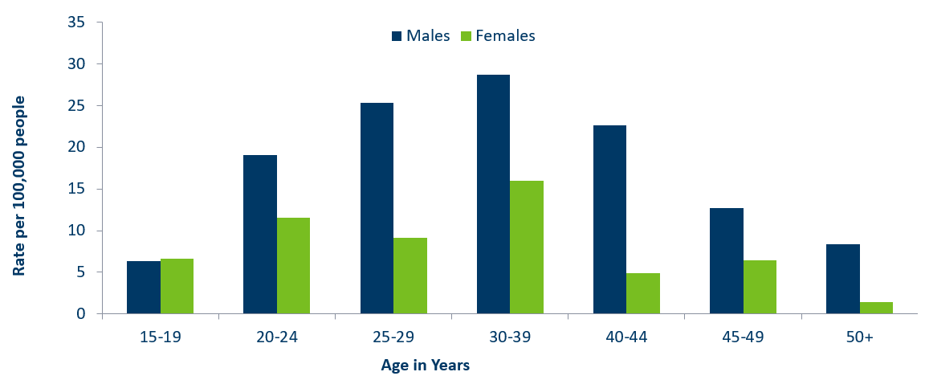
Age-Specific Primary & Secondary Syphilis Rates by Gender, Minnesota, 2023
 | 15-19 | 20-24 | 25-29 | 30-39 | 40-44 | 45-49 | 50+
Males | 6.3 | 19.1 | 25.3 | 28.7 | 22.6 | 12.7 | 8.4
Females | 6.6 | 11.5 | 9.1 | 16 | 4.9 | 6.4 | 1.4
Notes:
Males have higher rates of primary and secondary syphilis than females in all age groups. The rate in males is 2.5 times higher than females.
30-39 year old males had the highest rate at 28.7 per 100,000
30-39 year old females had the highest rate of the female population at 16 per 100,000.

Slide 20
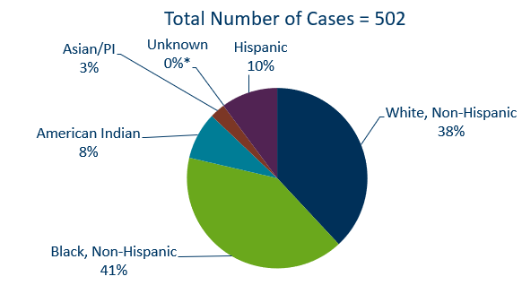
Primary & Secondary Syphilis Cases by Race
Minnesota, 2023
*Includes people reported with more than one race
Notes:
38% percent of all primary and secondary syphilis cases are White, non-Hispanic.
Black, non-Hispanic cases made up 41% of all Primary and Secondary Syphilis cases followed by, American Indian cases at 8%, Hispanic cases at 10%, and Asian/Pacific Islander cases at 3%.
Data:
Total number of cases=502
Asian/PI: 3%
American Indian: 8%
Black, non-Hispanic: 41%
White, non-Hispanic: 38%
Hispanic: 10%
Unknown: 0%*

Slide 21
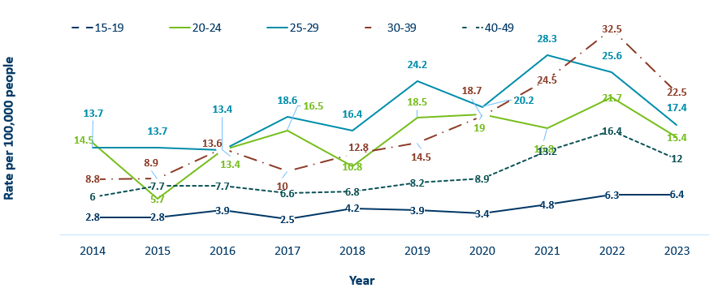
Primary & Secondary Syphilis Rates by Age
Minnesota, 2014-2023
 | 2014 | 2015 | 2016 | 2017 | 2018 | 2019 | 2020 | 2021 | 2022 | 2023
15-19 | 2.8 | 2.8 | 3.9 | 2.5 | 4.2 | 3.9 | 3.4 | 4.8 | 6.3 | 6.4
20-24 | 14.5 | 5.7 | 13.4 | 16.5 | 10.8 | 18.5 | 19 | 16.8 | 21.7 | 15.4
25-29 | 13.7 | 13.7 | 13.4 | 18.6 | 16.4 | 24.2 | 20.2 | 28.3 | 25.6 | 17.4
30-39 | 8.8 | 8.9 | 13.6 | 10 | 12.8 | 14.5 | 18.7 | 24.5 | 32.5 | 22.5
40-49 | 6 | 7.7 | 7.7 | 6.6 | 6.8 | 8.2 | 8.9 | 13.2 | 16.4 | 12
Notes:
The highest rates of primary and secondary syphilis were in the 30-39 year old age group at 22.5 cases per 100,000 population, a 31% decrease from 2022.
25-29 year olds and 20-24 had the next highest rate at 17.4 and 15.4 per 100,000, respectively.

Slide 22
Topic of Interest: Syphilis Among
Females and Congenital Syphilis in Minnesota
Minnesota Department of Health STI Surveillance System
Notes:
Topic of Interest: Syphilis Among
Females and Congenital Syphilis in Minnesota

Slide 23
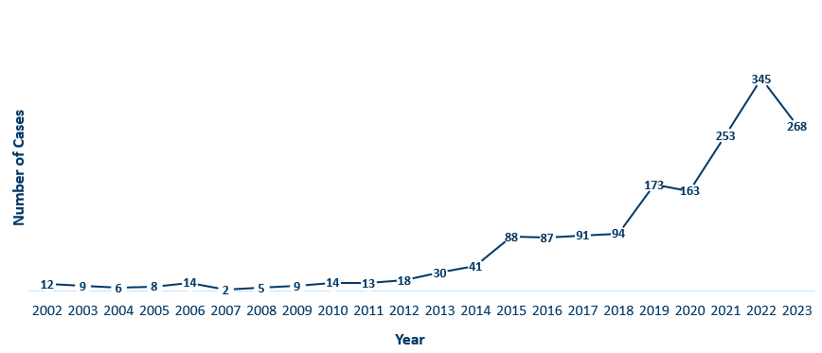
Female Early Syphilis Cases
Minnesota, 2023
Year | Cases
2002 | 12
2003 | 9
2004 | 6
2005 | 8
2006 | 14
2007 | 2
2008 | 5
2009 | 9
2010 | 14
2011 | 13
2012 | 18
2013 | 30
2014 | 41
2015 | 88
2016 | 87
2017 | 91
2018 | 94
2019 | 173
2020 | 163
2021 | 253
2022 | 345
2023 | 268
Notes:
The number of female early syphilis cases has increased dramatically over the last 10 years from 13 cases in 2011 to 345 in 2022 and 268 in 2023.
Increased 553% over the past 10 years

Slide 24
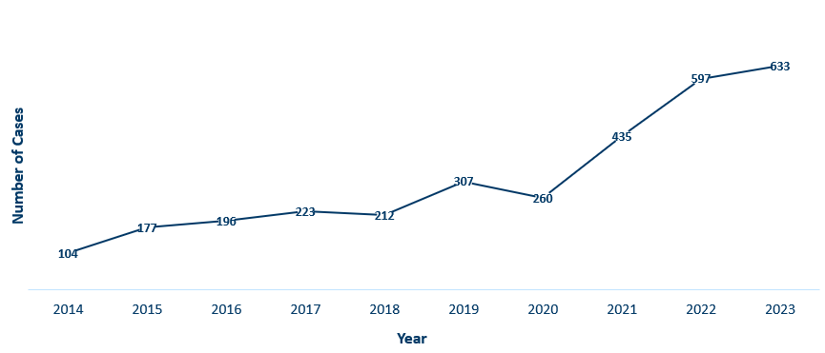
Female Syphilis Cases (All Stages)
Minnesota, 2023
Year | Cases
2014 | 104
2015 | 177
2016 | 196
2017 | 223
2018 | 212
2019 | 307
2020 | 260
2021 | 435
2022 | 597
2023 | 633
Notes:
Over the past 10 years total female syphilis cases have increased 508%

Slide 25
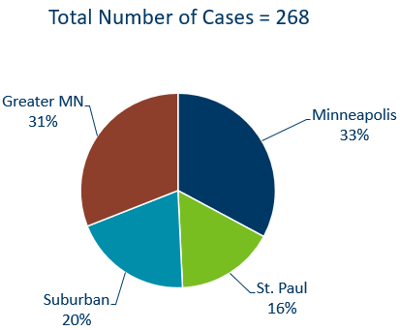
Early Syphilis Infections in Females by Residence at Diagnosis
Minnesota, 2023
Suburban = Seven-county metro area including Anoka, Carver, Dakota, Hennepin (excluding Minneapolis), Ramsey (excluding St. Paul), Scott, and Washington counties. Greater MN = All other Minnesota counties outside the seven-county metro area.
Notes:
31 percent of female early syphilis cases were residents of Greater Minnesota
20 percent of female early syphilis cases were residents of the Suburbs of the seven-county metro area
33 percent were City of Minneapolis residents, and 16 percent were St. Paul residents.

Slide 26
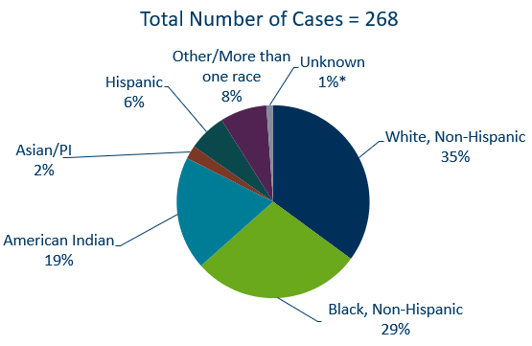
Early Syphilis Cases in Females by Race/Ethnicity
Minnesota, 2023
*Includes people reported with more than one race
Notes:
There are large disparities in women with syphilis. 19% of all early syphilis cases in females are found in the American Indian population and 29% in the Black, African American population.
Data:
White, non-Hispanic: 35%
Black, non-Hispanic: 29%
American Indian: 19%
Asian/PI: 2%
Hispanic: 6%
Other/more than one race: 8%

Slide 27
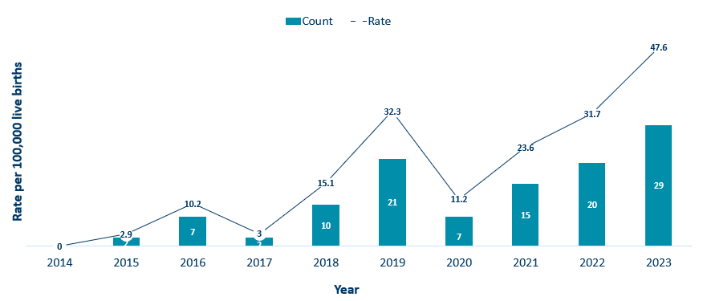
Congenital Syphilis Rates Among Infants
Minnesota, 2014-2023
Year | Rate | Count
2014 | 0 | 0
2015 | 2.9 | 2
2016 | 10.2 | 7
2017 | 3 | 2
2018 | 15.1 | 10
2019 | 32.3 | 21
2020 | 11.2 | 7
2021 | 23.6 | 15
2022 | 31.7 | 20
2023 | 47.6 | 29
Notes:
In Minnesota, the number and rate of congenital syphilis cases among infants has increased in 2023 compared to 2022. Overall, the rate has increased over the past five years from a rate of 32.3 per 100,000 live births in 2019 to 47.6 per 100,000 live births in 2023.
Syphilis may be passed from a pregnant person to the unborn baby through the placenta. The infection can cause miscarriages and stillbirths, and infants born with congenital syphilis can suffer a variety of serious health problems, including deformities, seizures, anemia and jaundice.
CDC reported that more than 3,700 congenital syphilis cases were reported in 2022, reflecting an alarming 937 percent increase in the past decade.

Slide 28
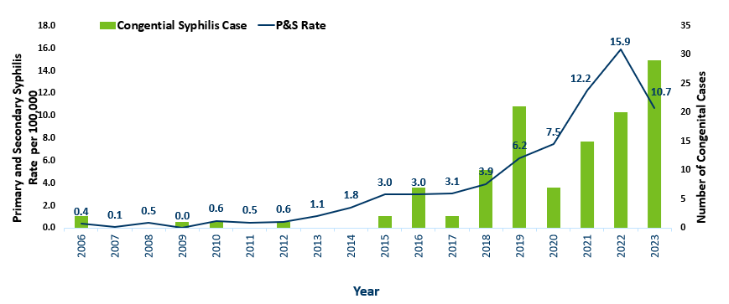
Primary and Secondary Syphilis Rates among Females aged 15-44 years and Number of Congenital Syphilis Cases – Minnesota, 2006-2023
Year | P&S Rate | Congential Syphilis Case
2006 | 0.4 | 2
2007 | 0.1 | 0
2008 | 0.5 | 0
2009 | 0.0 | 1
2010 | 0.6 | 1
2011 | 0.5 | 0
2012 | 0.6 | 1
2013 | 1.1 | 0
2014 | 1.8 | 0
2015 | 3.0 | 2
2016 | 3.0 | 7
2017 | 3.1 | 2
2018 | 3.9 | 10
2019 | 6.2 | 21
2020 | 7.5 | 7
2021 | 12.2 | 15
2022 | 15.9 | 20
2023 | 10.7 | 29
Notes:
Over the past decade syphilis has increased 1,275% among females aged 15-44

Slide 29
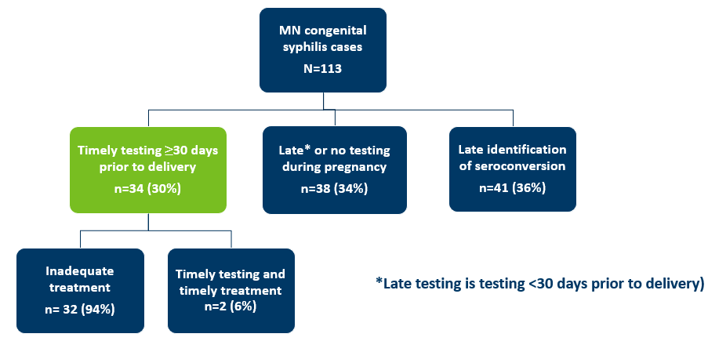
Minnesota Congenital Syphilis Cases, 2015-2023:
Missed Opportunities
MN congenital syphilis cases (N=113)
  Timely testing less than or equal to 30 days priority to delivery. N=34 (30%)
    Inadequate treatment, N=32 (94%)
    Timely testing and timely treatment, N=2 (6%)
  Late* or no testing during pregnancy. N=38 (34%)
  Late identification of seroconversion. N=41 (36%)
*late testing is testing greater than 30 days prior to delivery
Notes:
Definitions, if needed:
Late identification of seroconversion = includes new reactive syphilis test <30 days before delivery after a nonreactive test earlier in pregnancy.
2 cases – clinical evidence of congenital syphilis despite maternal therapy. Baby’s titer is higher than birthing person at time of delivery. In both of these instances pregnant person was treated and titers were declining, but babies had higher titer than birthing person.
Link to McDonald paper: Vital Signs: Missed Opportunities for Preventing Congenital Syphilis — United States, 2022 | MMWR (cdc.gov)

Slide 30
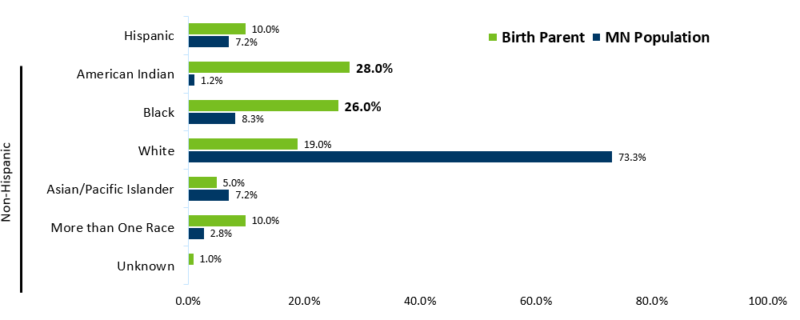
Minnesota Congenital Syphilis Cases, 2015-2023:
Ethnicity and Race of Birth Parent (n=106)
Race | MN Population | Birth Parent
Unknown |  | 1.0%
More than One Race | 2.8% | 10.0%
Asian/Pacific Islander | 7.2% | 5.0%
White | 73.3% | 19.0%
Black | 8.3% | 26.0%
American Indian | 1.2% | 28.0%
Hispanic | 7.2% | 10.0%
Source: 2020 MN Population Estimate, CDC Wonder
Data note: All race categories exclude persons who self-identify as Hispanic
Notes:
Stark disparities are seen in race and ethnicity of birth parent of an infant with congenital syphilis, with 28% and 26% of congenital syphilis cases reported among AI and Black, NH, populations respectively, accounting for over half of congenital syphilis cases, compared to a combined approximately 9% of the population in MN.
Definitions, if needed:
Population estimate is females 15-44 years for 2020.
Hispanic was first removed from the categories and then all race categories are non-Hispanic [race category].

Slide 31
What’s Being Done in Minnesota?
The MDH Partner Services Program continues to follow up on early syphilis cases and their sex partners and all pregnant syphilis cases.
All HIV/syphilis co-infected cases are assigned to Partner Services for follow-up.
Physicians are encouraged to screen men who have sex with men at least annually and to ask about sex partners.
All pregnant females should be screened for syphilis at first prenatal visit, 28 weeks’ gestation (at minimum 28-36 weeks), and at delivery.
MDH will be looking to update syphilis screening recommendations in non pregnant people in 2024.

Slide 32
Summary of STI Trends in Minnesota
From 2014-2023, the chlamydia rate increased by 4.3%. The rate of gonorrhea increased by 80%, syphilis has increased by 166%.
Adolescent and young adults aged 15-24 years old continue to make up the majority of all chlamydia or gonorrhea cases at 54%.
Syphilis has resurged in MN over the past decade, with MSM and those co-infected with HIV being especially impacted. However, the number of females impacted is near the record high for the last decade.
People of color and American Indians continue to be disproportionately affected by all STIs in Minnesota. Disparities in the rates of STIs are not explained by differences in sexual behavior, but are due to differences in health insurance coverage, employment status and access to healthcare with preventative, screening, and treatment services.
Notes:
From 2014-2023, the chlamydia rate increased by 4.3%. The rate of gonorrhea increased by 80% syphilis has increased by 166%.
Adolescent and young adults aged 15-24 years old continue to make up the majority of all chlamydia or gonorrhea cases at 54%.
Minnesota has seen a resurgence of syphilis over the past decade, with men who have sex with men and those co-infected with HIV being especially impacted. However, the number of females impacted is near the record high for the last decade.
people of color continue to be disproportionately affected by all STIs in Minnesota and nationwide. Disparities in the rates of STIs are not explained by differences in sexual behavior, but are due to differences in health insurance coverage, employment status and access to healthcare with preventative, screening and treatment services.

Slide 33
Highlights from Minnesota HIV Surveillance Report
2023
HIV/AIDS Surveillance System
April 2024
Notes:
.

Slide 34
Transmission Categories
CDC defines Transmission categories as “the term for classification of cases that summarizes an adult’s or adolescent’s possible HIV risk factors; the summary classification results from selecting, from the presumed hierarchical order of probability, the single risk factor most likely to have been responsible for transmission.”
  Male-to-male sexual contact (MMSC): includes individuals assigned male sex at birth, regardless of current gender identity, who have had sexual contact with other males, and individuals assigned male sex at birth who have had sexual contact with both males and females (bisexual contact)
  Injection drug use (IDU): includes persons who injected nonprescription drugs or who injected prescription drugs for nonmedical purposes
  Male-to-male sexual contact and injection drug use (MMSC/IDU): includes individuals assigned male sex at birth, regardless of current gender identity, who have had sexual contact with other males and injected nonprescription drugs or injected prescription drugs for nonmedical purposes
  Heterosexual contact: includes persons who have ever had sexual contact with a person known to have, or with a risk factor for, HIV infection
  Perinatal: includes persons who acquired HIV through mother-to-child transmission
  Other: includes persons with other risk factors (ie. blood transfusion, hemophilia) or whose risk factor was not reported or identified
The Minnesota Department of Health, STI/HIV/TB Section also recognizes current gender identity when trying to understand HIV transmission between groups of people
  Transgender women who have sex with men (TWSM): includes individuals assigned male at birth, that identify as female who have had sexual contact with male(s)
  Transgender women who have sex with men and injection drug use (TWSM/IDU): includes individuals assigned male at birth, that identify as female who have had sexual contact with male(s) AND injected nonprescription drugs or injected prescription drugs for nonmedical purposes
Technical Notes | Volume 33 | HIV Surveillance | Reports | Resource Library | HIV/AIDS | CDC

Slide 35
New HIV Diagnoses in Minnesota, 2023

Slide 36
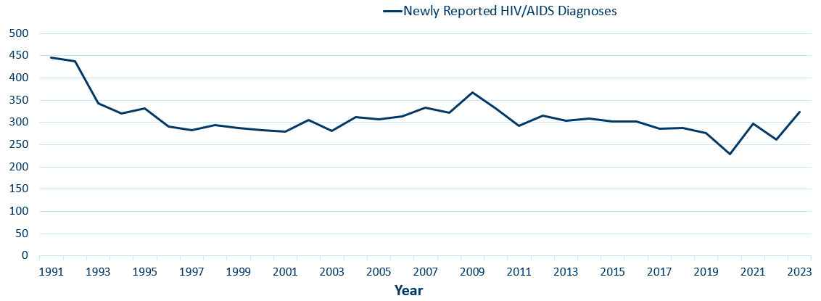
New HIV Disease Diagnoses*
HIV/AIDS Cases by Year, 1991–2023
*Includes all new cases of HIV infection (both HIV (non-AIDS) and AIDS at first diagnosis) diagnosed within a given calendar year.
Data: HIV Incidence Report 2023 Tables (PDF)
Notes:
Nationally, Minnesota is considered a low- to moderate-risk state for HIV and AIDS infections as defined by the Centers for Disease Control and Prevention (CDC). The annual number of new HIV and AIDS cases increased steadily from the beginning of the epidemic to the early 1990s. Beginning in 1996, the number of newly diagnosed AIDS cases declined sharply, primarily due to the success of new antiretroviral therapies including protease inhibitors. These treatments have been shown to be effective at preventing transmission of HIV.

Slide 37
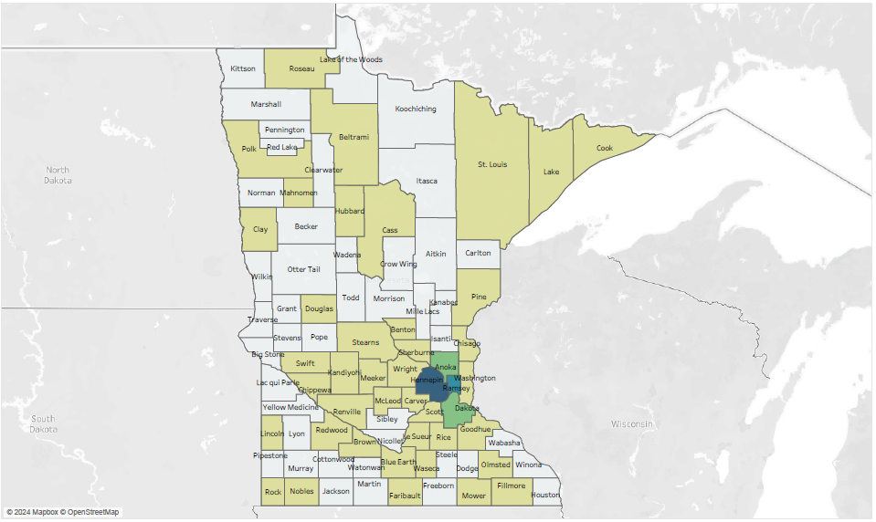
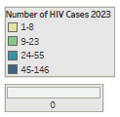
HIV Diagnoses# by County of Residence at Diagnosis, 2023
#HIV or AIDS at first diagnosis
*7-county metro area, excluding the cities of Minneapolis and St. Paul
Data: HIV Incidence Report 2023 Tables (PDF)

Slide 38
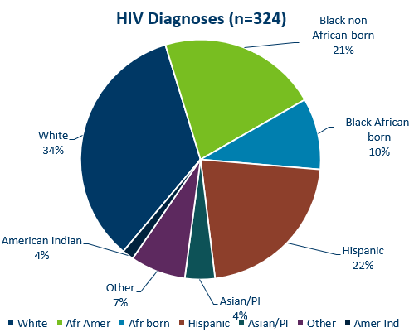
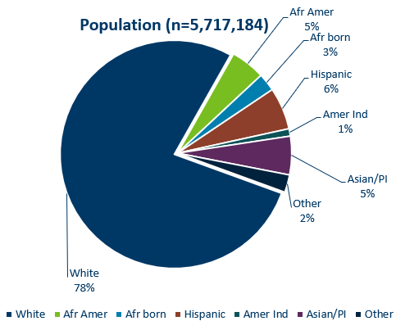
HIV Diagnoses* in Year 2023 and General Population in Minnesota by Race/Ethnicity
* HIV or AIDS at first diagnosis † Population estimates based on 2010 U.S. Census data. (n = Number of people)
Data: HIV Incidence Report 2023 Tables (PDF)
Notes:
Comparing the racial/ethnic distribution of new HIV diagnoses [LEFT] to the general population of Minnesota [RIGHT], it is apparent that disparities continue to exist. Non-Hispanic African-American and Black African-born Minnesotans jointly make up about 8% of the population in Minnesota, yet accounted for 31% of the newly diagnosed cases of HIV in 2023. Similarly, Hispanics of any race account for approximately 6% of the population, but account for 22% of the newly diagnosed cases. This is an increase from 14% in 2022 to 22% in 2023

Slide 39
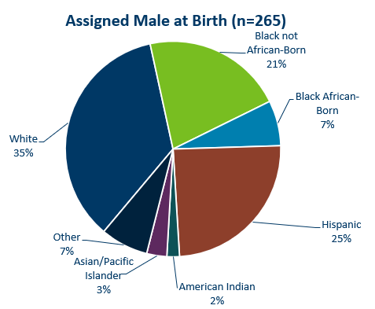
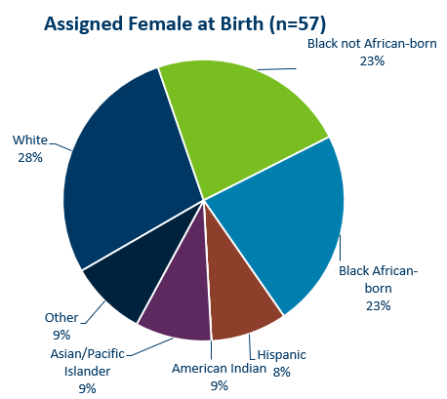
HIV Diagnoses* in 2023 by Sex Assigned at Birth and Race/Ethnicity†
*HIV or AIDS at first diagnosis (n = Number of people)
†“Black African-born” refers to Black people who reported an African country of birth; “Black not African-born” refers to all other Black people. Cases with unknown race are excluded.
Race/ethnicity missing for 2 persons
Data: HIV Incidence Report 2023 Tables (PDF)
Notes:
There are differences in the racial/ethnic distribution by sex assigned at birth. Left to right are data for people assigned Male and Female at birth.
On the LEFT, among 265 people assigned the sex of male at birth, 35% of the 2023 cases diagnosed in Minnesota are Non-Hispanic white [seen in dark BLUE]. Non-Hispanic Black non-African born [In light GREEN] and black, African-born males [light BLUE] made up 28% of cases and Hispanic males of any race accounted for 25% of cases (an increase from 17% in 2022).
ON the RIGHT, Among the 57 people assigned the sex of female at birth, the disparities of new HIV diagnoses are even more apparent among people of color. They represent 72% of new HIV cases assigned female at birth vs 65% of new HIV cases assigned male at birth. Nearly half of female infections, or 46% combined, are Black, African-born and non-African born.

Slide 40
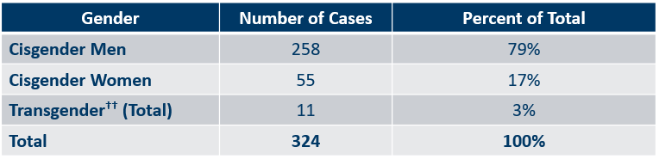
Number of Cases and Rates (per 100,000 people) of Adults and Adolescents* Diagnosed with HIV/AIDS by Gender Identity† in Minnesota, 2023
Gender | Number of Cases | Percent of Total
Cisgender Men | 258 | 79%
Cisgender Women | 55 | 17%
Transgender†† (Total) | 11 | 3%
Total | 324 | 100%
*HIV or AIDS at first diagnosis ages 13 and older.
Data: HIV Incidence Report 2023 Tables (PDF)
Notes:
Here we look at cases and rates of the 324 new HIV infections by sex assigned at birth and reported sexual behavior.
By Gender
The proportion of cases among cisgender men has increased over the last few years. Cisgender men represent 79% of all new HIV diagnoses.
The number of diagnoses among cisgender women has increased from 50 in 2022 to 55 in 2023.

Slide 41
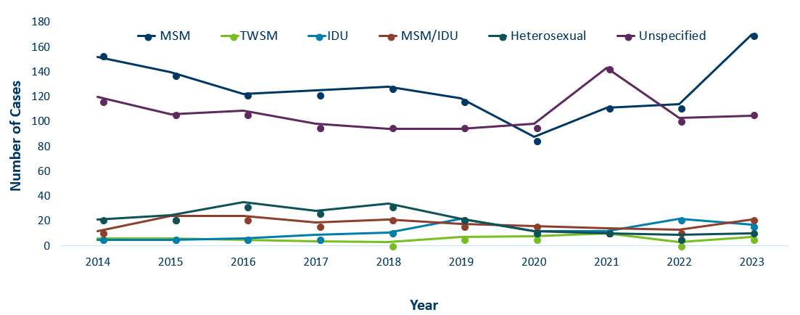
HIV Diagnoses* by Mode of Exposure and Year, 2014–2023
 | MSM | TWSM | IDU | MSM/IDU | Heterosexual | Unspecified
2014 | 152 | 6 | 5 | 12 | 21 | 120
2015 | 140 | 6 | 5 | 24 | 25 | 106
2016 | 122 | 5 | 6 | 24 | 35 | 109
2017 | 125 | 4 | 9 | 19 | 28 | 98
2018 | 128 | 3 | 11 | 21 | 34 | 94
2019 | 119 | 7 | 22 | 18 | 22 | 94
2020 | 88 | 8 | 12 | 16 | 12 | 98
2021 | 111 | 10 | 12 | 14 | 10 | 143
2022 | 114 | 3 | 22 | 13 | 9 | 103
2023 | 170 | 7 | 17 | 21 | 10 | 105
*HIV or AIDS at first diagnosis
MSM = Men who have sex with men TWSM=Transgender women who have sex with men IDU = Injection drug use Heterosexual = Heterosexual contact
Unspecified = No mode of exposure ascertained

Slide 42
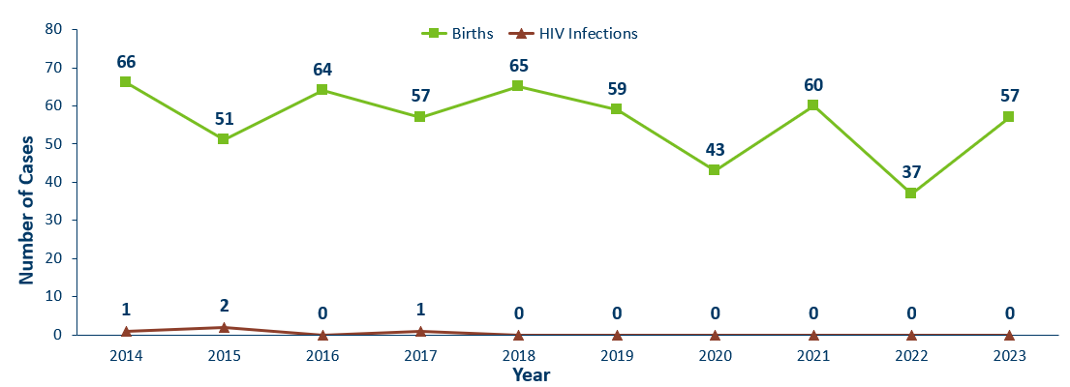
Births to Pregnant People Living with HIV and Number of Perinatal Acquired HIV Infections* by Year of Birth, 2014–2023
HIV or AIDS at first diagnosis for a child exposed to HIV during pregnant person’s pregnancy, at birth, and/or during breastfeeding.
Data: HIV Incidence Report 2023 Tables (PDF)
Notes:
The ability to interrupt the transmission of HIV from mother to child via antiretroviral therapy and appropriate perinatal care is an important accomplishment in the history of the HIV/AIDS epidemic. Without antiretroviral therapy, newborn HIV infection rates range from 25-30%, but decrease to 1-2% with appropriate medical intervention. The rate of transmission has decreased from 15% between 1994 and 1996 to 0.0% in the past three years (2021-2023). The last HIV perinatal transmission was in 2017.
For the past decade, the number of births to pregnant parents living with HIV has ranged between 37-66 births (2013-2023).
For 2023, there was an increase to 57 births to pregnant people living with HIV with no perinatal HIV baby born to a HIV-positive pregnant person in Minnesota during the year.

Slide 43
New Trends of Race/Ethnicity and Region of Birth

Slide 44
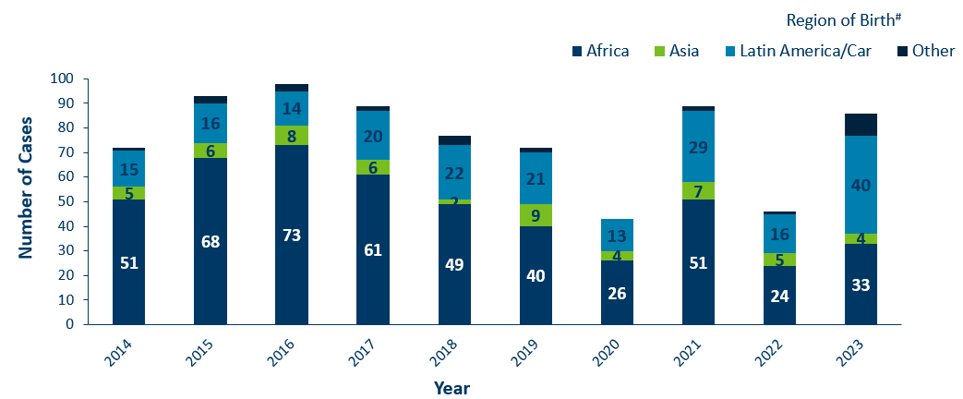
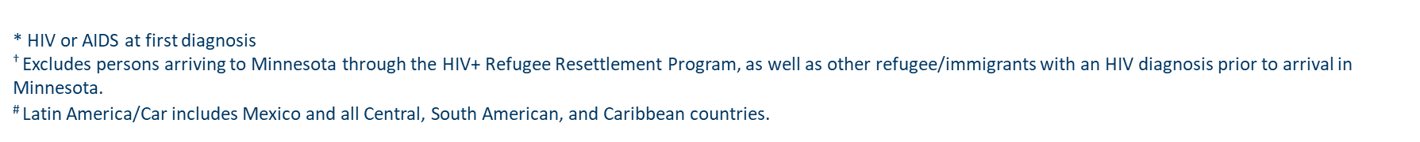
HIV Diagnoses* among Foreign-Born People† in Minnesota by Year and Region of Birth
2014–2023
 | 2014 | 2015 | 2016 | 2017 | 2018 | 2019 | 2020 | 2021 | 2022 | 2023
Africa | 51 | 68 | 73 | 61 | 49 | 40 | 26 | 51 | 24 | 33
Asia | 5 | 6 | 8 | 6 | 2 | 9 | 4 | 7 | 5 | 4
Latin America/Car | 15 | 16 | 14 | 20 | 22 | 21 | 13 | 29 | 16 | 40
Other | 1 | 3 | 3 | 2 | 4 | 2 | 0 | 2 | 1 | 9
Notes:
This slides describes HIV diagnoses by global region of birth among foreign-born people. In general, the number of new HIV infections diagnosed among foreign-born people in Minnesota has steadily increased from 20 cases in 1990 to an average of 82 cases over the last decade. This increase has been largely driven by the increase of cases among African-born people, as well as people from Mexico, Central and South America and the Caribbean.
In 2023, there were 86 cases of newly reported HIV among foreign-born people. This is one fourth of all new cases (27%).
There was a shift in data in 2023 of new diagnoses by country of birth. Up until 2022, the majority of foreign-born cases were from Africa. In 2023, The majority of foreign-born cases were from Latin America and the Caribbean (47% of all foreign-born cases).

Slide 45
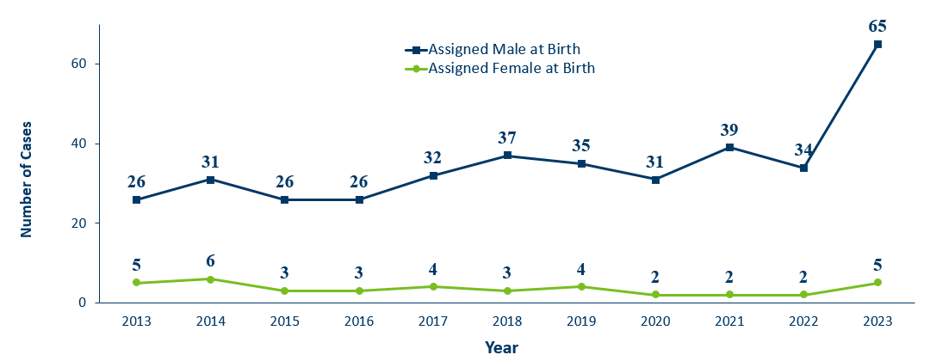
Hispanic People Newly Diagnosed with HIV/AIDS in MN by Sex assigned at Birth, 2013–2023
 | 2016 | 2017 | 2018 | 2019 | 2020 | 2021 | 2022 | 2023
Assigned Male at Birth | 26 | 32 | 37 | 35 | 31 | 39 | 34 | 65
Assigned Female at Birth | 3 | 4 | 3 | 4 | 2 | 2 | 2 | 5
*HIV or AIDS at first diagnosis
Notes:
IMPORTANT: includes foreign-born Hispanic and U.S.-born Hispanic

Slide 46
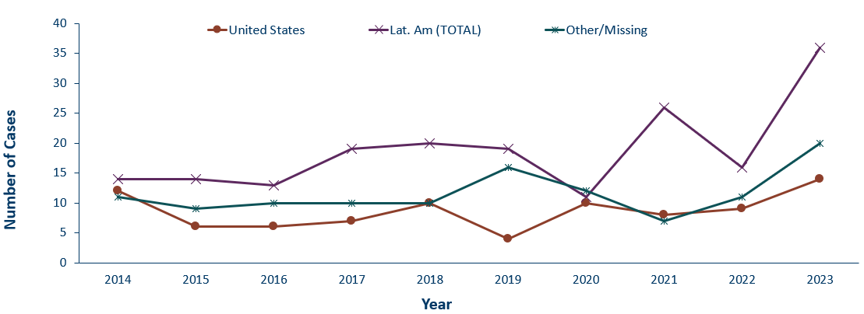
Hispanic People Newly Diagnosed with HIV Region of Birth
Year 2014–2023
 | 2014 | 2015 | 2016 | 2017 | 2018 | 2019 | 2020 | 2021 | 2022 | 2023
United States | 12 | 6 | 6 | 7 | 10 | 4 | 10 | 8 | 9 | 14
Lat. Am (TOTAL) | 14 | 14 | 13 | 19 | 20 | 19 | 11 | 26 | 16 | 36
Other/Missing | 11 | 9 | 10 | 10 | 10 | 16 | 12 | 7 | 11 | 20
* HIV or AIDS at first diagnosis

Slide 47
Adolescents & Young Adults (Ages 13-24)*

Slide 48
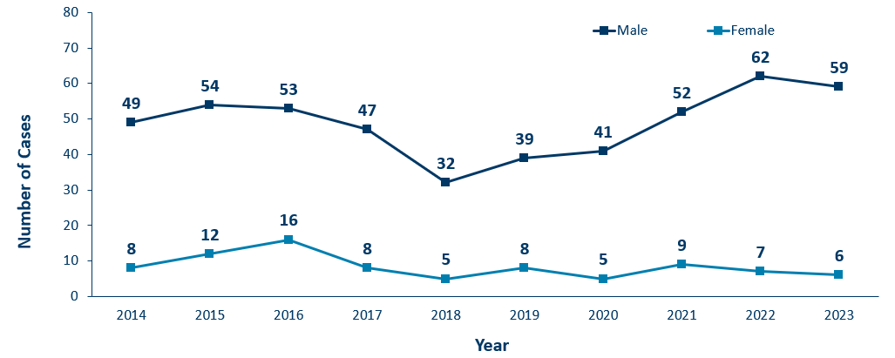
HIV Diagnoses* Among Adolescents and Young Adults† by Sex Assigned at Birth and Year 2013–2023
 | 2014 | 2015 | 2016 | 2017 | 2018 | 2019 | 2020 | 2021 | 2022 | 2023
Male | 49 | 54 | 53 | 47 | 32 | 39 | 41 | 52 | 62 | 59
Female | 8 | 12 | 16 | 8 | 5 | 8 | 5 | 9 | 7 | 6
* HIV or AIDS at first diagnosis
† Adolescents defined as 13-19 year-olds; Young Adults defined as 20-24 year-olds.
Notes:
The number of new HIV diagnoses among people assigned male sex at birth aged 13-24 has ranged from 32-62 cases over the past decade. Since the low in 2018, we’ve seen an increase of new diagnoses among males in this age group where there are 62 cases reported in 2022.
In 2023, among adolescent and young adults assigned female sex at birth, there were 6 cases.
In 2023, the total number of cases among adolescents and young adults was a slight decrease from 2022, but still higher than any other year in the last 10 years.

Slide 49
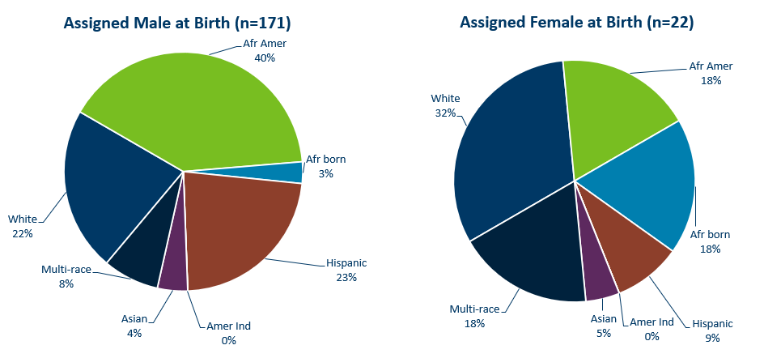
HIV Diagnoses* Among Adolescents and Young Adults† by Sex Assigned at Birth and Race/Ethnicity, 2021–2023 Combined
* HIV or AIDS at first diagnosis (n = Number of people)
Amer Ind = American Indian , Afr Amer = African American (Black, not African-born people) , and Afr born = African-born (Black, African-born people)
Notes:
Looking at racial distribution among adolescents/young adults by sex assigned at birth combining the most recent three years of data.
Between the years 2021 and 2023 we had 171 cases assigned male sex at birth [LEFT Graph] reported among adolescents and young adults, and 22 females reported in the 13-24 age group. For people assigned male sex at birth, Non-Hispanic African-American [GREEN] accounted for 40% of the cases, Non-Hispanic White [DARK BLUE] and Hispanic of any race [BROWN] young adults accounted for about 1 in 4 cases each in the 13-24 age group.
Among people with female sex assigned at birth [RIGHT], Non-Hispanic White [DARK BLUE] accounted for about one-third and black African-born and African American [LIGHT BLUE] accounted for about one fifth of the cases in the 13-24 age group.

Slide 50
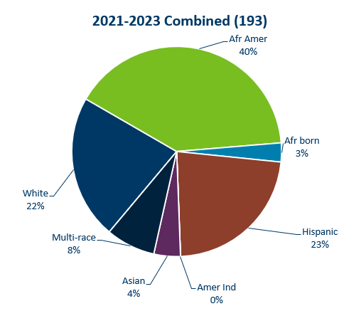
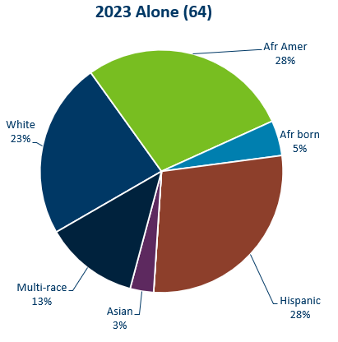
HIV Diagnoses* Among Adolescents and Young Adult† Males
Race/Ethnicity, 2021–2023 Combined & 2023 Alone
* HIV or AIDS at first diagnosis (n = Number of people)
Notes:
2021-2023 Combined (193)
African American: 40%
African Born: 3%
Hispanic: 23%
American Indian: 0%
Asian: 4%
Multi-race: 8%
White: 22%
2023 Alone (64)
African American: 28%
African Born: 5%
Hispanic: 28%
American Indian: 0%
Asian: 3%
Multi-race: 13%
White: 23%

Slide 51
Persons Living with HIV/AIDS in Minnesota

Slide 52
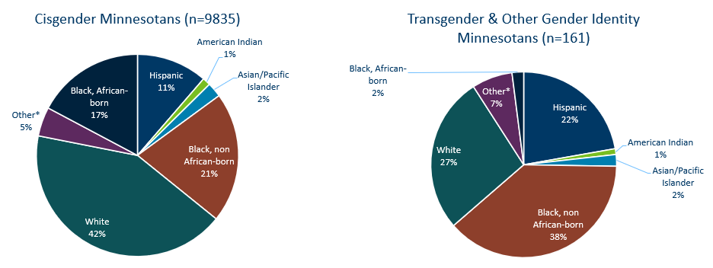
Estimated Number of Persons Living with HIV/AIDS in Minnesota
As of December 31, 2023 9,996* persons are assumed alive and living in Minnesota with HIV/AIDS. This includes:
  5,767 (58%) living with HIV infection (non-AIDS)
  4,229 (42%) living with AIDS
This number includes 2,807 persons who were first reported with HIV or AIDS elsewhere and subsequently moved to Minnesota
This number excludes 1,822 persons who were first reported with HIV or AIDS in Minnesota and subsequently moved out of state
*This number includes persons with Minnesota reported as their current state of residence, regardless of residence at time of diagnosis. It also includes state prisoners and refugees arriving through the HIV+ Refugee Resettlement Program, as well as HIV+ refugees/immigrants arriving through other programs.
Notes:
As of December 31, 2023, there were estimated to be 9,996 persons alive and living with HIV/AIDS in Minnesota. This number included 5,767 (58%) living with an HIV infection that had not progressed to an AIDS diagnosis and 4,229 (42%) living with AIDS. This number also included 2,807 persons who were first reported with HIV or AIDS elsewhere and now live in Minnesota and excluded 1,822 persons first reported with HIV or AIDS in Minnesota who now live out of state.

Slide 53
HIV Outbreaks

Slide 54
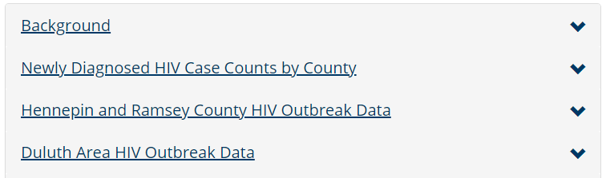
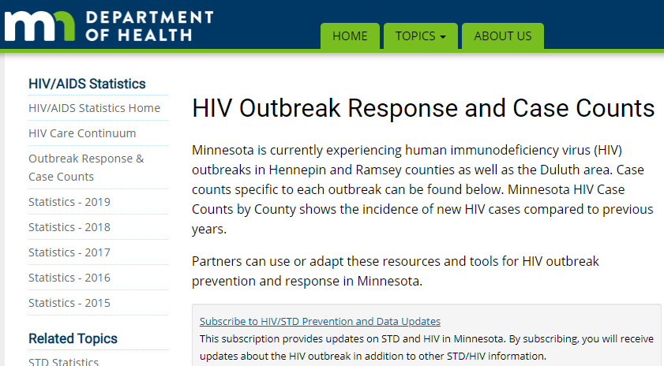
Updated webpage: Outbreak Data e-Resources
HIV Outbreak Response and Case Counts
https://www.health.state.mn.us/diseases /hiv/stats/hiv.html
Subscribe to receive our HIV/STD prevention and data e-mail updates.
Notes:
In addition to newly diagnosed HIV case counts by county, we recently updated our statistics web page to include information on outbreak data.
Please visit the Minnesota Department of Health HIV pages at www.health.state.mn for additional details.
While you’re here, you can subscribe to our listserv to receive HIV/STD prevention updates to your email.

Slide 55
Thank you.
HIV Surveillance Team
Health.HIV.Surveillance@state.mn.us
651-201-4040

Slide 56
Hepatitis A, B & C in Minnesota, 2023
Minnesota Department of Health
Hepatitis Surveillance System

Slide 57
Data limitations
The slides rely on data from HCV and HBV cases diagnosed through 2023 and reported to the Minnesota Department of Health (MDH) Hepatitis Surveillance System.
Some limitations of surveillance data:
  Data do not include hepatitis-infected persons who have not been tested
  Data do not include persons whose positive test results have not been reported to the MDH
Persons are assumed to be alive unless the MDH has knowledge of their death. Most recent match with Minnesota death records was in 2016.
Persons whose most recently reported state of residence was Minnesota are assumed to be currently residing in Minnesota unless the MDH has knowledge of their relocation.

Slide 58
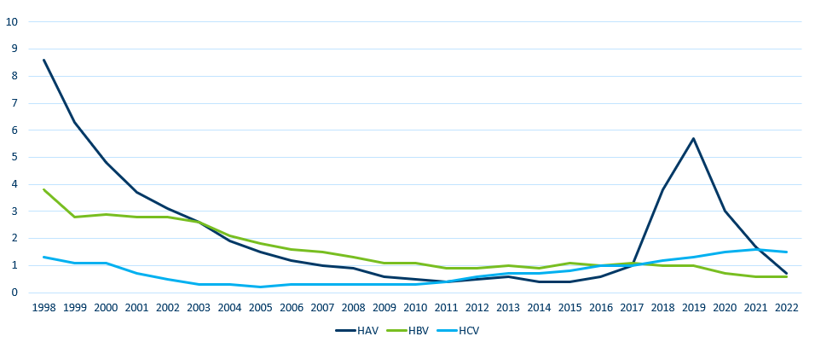
Reported rate per 100,000 population of acute viral hepatitis
United States, 1998-2022
 | HAV | HBV | HCV
1998 | 8.6 | 3.8 | 1.3
1999 | 6.3 | 2.8 | 1.1
2000 | 4.8 | 2.9 | 1.1
2001 | 3.7 | 2.8 | 0.7
2002 | 3.1 | 2.8 | 0.5
2003 | 2.6 | 2.6 | 0.3
2004 | 1.9 | 2.1 | 0.3
2005 | 1.5 | 1.8 | 0.2
2006 | 1.2 | 1.6 | 0.3
2007 | 1 | 1.5 | 0.3
2008 | 0.9 | 1.3 | 0.3
2009 | 0.6 | 1.1 | 0.3
2010 | 0.5 | 1.1 | 0.3
2011 | 0.4 | 0.9 | 0.4
2012 | 0.5 | 0.9 | 0.6
2013 | 0.6 | 1 | 0.7
2014 | 0.4 | 0.9 | 0.7
2015 | 0.4 | 1.1 | 0.8
2016 | 0.6 | 1 | 1
2017 | 1 | 1.1 | 1
2018 | 3.8 | 1 | 1.2
2019 | 5.7 | 1 | 1.3
2020 | 3 | 0.7 | 1.5
2021 | 1.7 | 0.6 | 1.6
2022 | 0.7 | 0.6 | 1.5

Slide 59
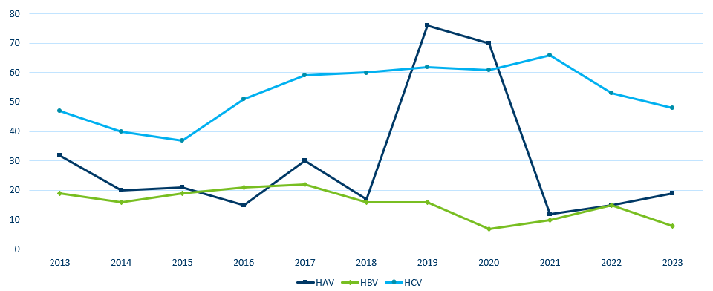
Number of Acute* Cases per year Minnesota,
2013-2023
 | HAV | HBV | HCV
2013 | 32 | 19 | 47
2014 | 20 | 16 | 40
2015 | 21 | 19 | 37
2016 | 15 | 21 | 51
2017 | 30 | 22 | 59
2018 | 17 | 16 | 60
2019 | 76 | 16 | 62
2020 | 70 | 7 | 61
2021 | 12 | 10 | 66
2022 | 15 | 15 | 53
2023 | 19 | 8 | 48
*Acute cases include seroconverters for all years for HBV and HCV

Slide 60
Chronic Viral Hepatitis C

Slide 61
Reported Number of Persons
Living with HCV in MN
As of December 31, 2023, 31,942* persons are assumed alive and living in MN with HCV.
Note: Includes all acute, chronic, and probable cases.
*Includes persons with unknown city of residence
Data Source: MN Viral Hepatitis Surveillance System
Notes:
2016 35,623

Slide 62
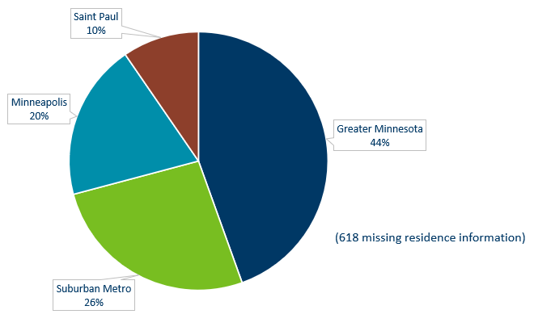
Persons Living with HCV in MN by Current Residence, 2023
Total number with residence information = 31,324
Suburban = Seven-county metro area including Anoka, Carver, Dakota, Hennepin (except Minneapolis), Ramsey (except St. Paul), Scott, and Washington counties including those in Hennepin County or Ramsey County with unknown city. Greater MN = All other Minnesota counties, outside the seven-county metro area.
Notes:
Data:
Minneapolis: 20%
Saint Paul: 10%
Greater Minnesota: 44%
Suburban Metro: 26%

Slide 63
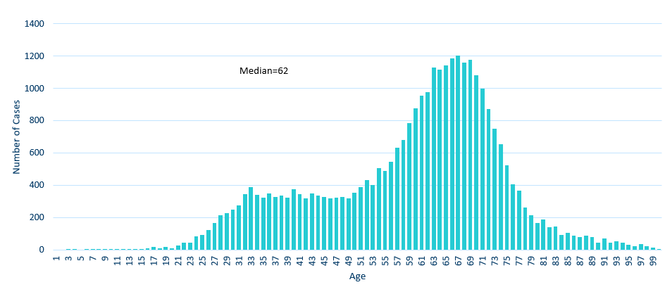
Persons Living with HCV in MN by Age, 2023
 | Series 1
1 | 0
2 | 0
3 | 2
4 | 2
5 | 0
6 | 4
7 | 2
8 | 1
9 | 5
10 | 7
11 | 3
12 | 2
13 | 3
14 | 6
15 | 7
16 | 12
17 | 21
18 | 12
19 | 20
20 | 10
21 | 28
22 | 46
23 | 45
24 | 84
25 | 93
26 | 125
27 | 169
28 | 216
29 | 227
30 | 250
31 | 278
32 | 344
33 | 387
34 | 340
35 | 325
36 | 348
37 | 326
38 | 335
39 | 322
40 | 374
41 | 345
42 | 321
43 | 351
44 | 337
45 | 330
46 | 318
47 | 325
48 | 328
49 | 319
50 | 356
51 | 387
52 | 433
53 | 402
54 | 506
55 | 488
56 | 545
57 | 634
58 | 683
59 | 786
60 | 879
61 | 954
62 | 976
63 | 1131
64 | 1117
65 | 1143
66 | 1185
67 | 1202
68 | 1158
69 | 1179
70 | 1080
71 | 997
72 | 873
73 | 750
74 | 653
75 | 526
76 | 407
77 | 368
78 | 262
79 | 216
80 | 165
81 | 190
82 | 139
83 | 144
84 | 94
85 | 107
86 | 88
87 | 79
88 | 90
89 | 80
90 | 46
91 | 70
92 | 45
93 | 52
94 | 47
95 | 32
96 | 24
97 | 35
98 | 24
99 | 15
100 | 8

Slide 64
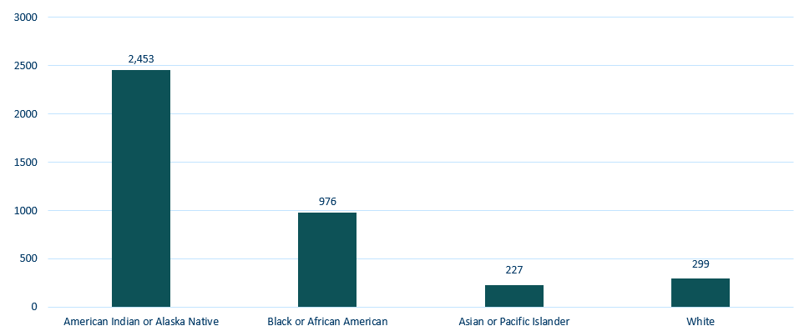
Persons Living with HCV in Minnesota by Race rates (per 100,000 persons*), 2023
*Rates calculated using 2020 U.S. Census ACS data
Excludes persons with multiple races or unknown race, n=10,234
Notes:
Data:
American Indian or Alaska Native: 2,453
Black or African American: 976
Asian or Pacific Islander: 227
White: 299

Slide 65
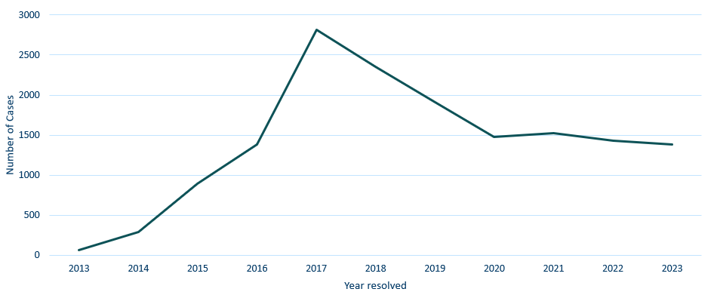
Resolved Hepatitis C, 2023
 | Series 1
2013 | 65
2014 | 289
2015 | 893
2016 | 1385
2017 | 2813
2018 | 2356
2019 | 1912
2020 | 1481
2021 | 1525
2022 | 1428
2023 | 1383

Slide 66
MN Community Collaboration on Viral Hepatitis ECHO
Project ECHO is an online learning community designed to expand access to care for vulnerable populations.
Project goals for this ECHO include:
  Eliminate HCV by facilitating collaboration between clinicians that treat viral hepatitis and community partners, such as community health clinics, addiction treatment centers, syringe service programs, and homeless shelters.
  Identify and remove barriers to testing, linkage to care, and treatment for HCV and other infectious diseases.
  Advance culturally competent care with a special focus on those most impacted by HCV, including American Indian and unhoused persons.
Sessions are held the first and third Tuesday of each month from 12:05pm – 1:05pm and are led by Hennepin Healthcare
To learn more, visit www.hennepinhealthcare.org/project-echo

Slide 67
Testing/Vaccination Recommendations
Hepatitis B
Test all adults 18 and older at least once in their lifetime using a triple panel test.
Test all pregnant persons during each pregnancy.
Vaccinate all individuals, birth through 59 years.
Vaccinate adults aged 60 years or older with risk factors for hepatitis B infection.
Hepatitis C
Test all adults 18 and older at least once in their lifetime.
Test all pregnant persons during each pregnancy. Test exposed infants after 2 months of age.
Collect all samples needed to diagnose hepatitis C in a single visit - HCV RNA testing should be performed automatically when the HCV antibody is reactive.

Slide 68
Thank you!
Genny Grilli, MPH
Genny.Grilli@state.mn.us
651-201-5557

Slide 69
Prevention and Grantee Updates
April 2024

Slide 70
HIV Prevention Programs and Grantees
EIS Programs for People at Greatest Risk (HIV Testing)
BIPOC MSM living in the 11-county metropolitan area
Black MSM
Latino MSM
American Indian MSM
Other BIPOC MSM
Black women living in the 11-county metropolitan area
Transgender people living in the 11-county metropolitan area
People experiencing homelessness and/or housing instability living in the 11-county metropolitan area
People at greatest risk living in Greater Minnesota
Notes:
The planning and delivery of all programs and services are based on priority populations identified through the prevention planning process.
In 2022 MDH released their most recent HIV prevention RFP (Request for Proposals) for 2023-2025.
In order to identify prioritized populations, the Minnesota Department of Health analyzed HIV surveillance data from 2016-2020 for both incidence (new) and prevalence (already diagnosed) cases, and HIV testing data from funded testing sites during the previous grant cycle. The prioritized populations were based on those analyses and approval from the Minnesota Council for HIV/AIDS Care and Prevention (MCHACP).

Slide 71
HIV Prevention Programs and Grantees Continued
HIV Prevention and Harm Reduction Services (SSP)
PWID/PWUD living in Greater Minnesota
  American Indian PWID/PWUD
  Black PWID/PWUD
  Other PWID/PWUD
PWID/PWUD living in the 11-county metropolitan area
  American Indian PWID/PWUD
  Black PWID/PWUD
  Other PWID/PWUD
PWID/PWUD experiencing homelessness or unstable housing
Prevention Programs for HIV Negative People at Greatest Risk (PrEP)
People at greatest risk living in Greater Minnesota
People at greatest risk living in the 11-county metropolitan area

Slide 72
EIS Programs for People at Greatest Risk (HIV Testing)
(51% tested must be priority population)
BIPOC MSM Metro - Black MSM
Clinic 555
African American AIDS Task Force
Red Door Clinic
Annex Teen Clinic
BIPOC MSM Metro - Latino MSM
Minnesota Community Care
Black Women Metro
Sub-Saharan Youth and Family Services
Annex Teen Clinic
Youth and AIDS Project
Clinic 555
Transgender Metro
Aliveness
Minnesota Community Care
Youth and AIDS Projects
PEH/Unstably Housed Metro
Native American Community Clinic
Face to Face
Greater Minnesota
Lutheran Social Services
Planned Parenthood
Notes:
The primary goals of the HIV Testing Programs: * Increase number of people living with HIV who know their status. * Decrease the transmission of HIV in populations at highest risk through PrEP/PEP/expedited linkage to HIV primary care and treatment * Decrease HIV stigma by promoting testing programs that include anti-stigma approaches to testing. HIV testing programs are expected to yield at least a 1% rate of newly identified HIV-positive tests annually. 51% or a little over half of individuals tested by your agency should be of your target population.

Slide 73
HIV Prevention and Harm Reduction Services (SSP)
PWID/PWUD Metro-Black
Clinic 555
NorthPoint
Red Door Clinic
Neighborhood HealthSource
PWID/PWUD Metro-Native American
Southside Harm Reduction Services
Native American Community Clinic
Clinic 555
Red Door Clinic
PWID/PWUD Metro-Other
Clinic 555
Aliveness Project
Avivo
PWID/PWUD Greater Minnesota
Harm Reduction Sisters
Rural AIDS Action Network – Duluth
Rual AIDS Action Network – St. Cloud
Fond Du Lac

Slide 74
Prevention Programs for HIV Negative People at Greatest Risk (PrEP)
Metro
Red Door
Clinic 555
Greater Minnesota
Planned Parenthood Minnesota, North Dakota, South Dakota
Lake Superior Community Health Center
Rual AIDS Action Network in partnership with The Aliveness Project
https://preplocator.org/

Slide 75


Grantee Highlights
Southside Harm Reduction Services Jack Martin & Zach Johnson
Native American Community Clinic Anna Bosch, Harm Reduction Manager

Slide 76
Partner and Care Link Services
April 2024

Slide 77
Partner and Care Link Services
Partner Services is a program that offers people diagnosed with HIV or a reportable STI referrals to medical, prevention and other services and assistance with partner notification
HIV Care Link Services assists persons living with HIV who are not in medical care to access care and other supportive services
Services are free, confidential, statewide, and participation is voluntary
Partner and Care Link Services are provided by Disease Intervention Specialists (DIS)
  Nine MDH DIS
  Embedded DIS at Hennepin Red Door Services, Ramsey County Clinic 555, Native American Community Clinic, Leech Lake Band of Ojibwe Health Division, Bois Forte Band of Chippewa Health Services

Slide 78
Disease Intervention Specialists and activities
DIS are highly trained public health professionals who conduct disease investigations and interviews to prevent and control STIs (including HIV).
In 2023, DIS conducted:
  1,582 disease investigations
  838 interviews
  Investigations and interviews for syphilis, HIV, and mpox outbreaks

Slide 79
What is the work of a DIS?
Partner Services Interview- conversations with individuals who are newly diagnosed or potentially exposed
Disease Investigation- gathering and analyzing information
Disease Intervention - stopping the chain of transmission
Partner Services - Contact tracing/Partner notification
HIV Care Link Services- Newly diagnosed and out of care for HIV treatment
Assist with outbreak detection and response
Referrals- testing, treatment, infectious disease care, case management, etc
Notes:
Threre is a lot of overlap for each of these terms and their definitions are pretty similar but generally used in different ways. I’ll explain the differences but don’t worry too much about memorizing each of these definitions as long as you walk away with an understanding of the big picture.
Partner Services Interview
Disease Investigation- information that is gathered and analyzed before during after interview for the purpose of disease intervention
Disease Intervention- two parts: identifying individuals who may be living with HIV or syphilis and not know it, and connecting those individuals with testing and treatment to stop the chain of transmission.
Partner Services/Contact tracing: Can be used interchangeably, Partner services encompasses a little bit more and is more often used with STIs and HIV. Contact tracing is now associated with COVID.
HIV Care Link Services: two parts: connecting people who are newly diagnosed to an infectious disease provider for HIV care and re-engaging individuals who have been living with HIV but are currently out of care.
Outbreak detection and response- with the information that we gather in interviews we can better understand how HIV is spreading in the state and we are often the first to observe new trends or clusters and we work with the epidemiologists to determine if there is anything there.
Its really interesting work and we get to be the connecting piece between the public/people living with HIV, syphilis or other infections, medical providers, and epidemiologists.

Slide 80
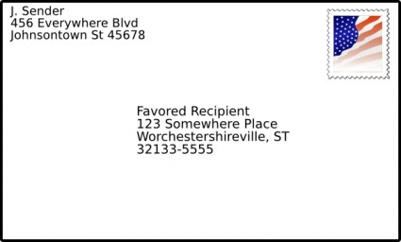



Partner Services: methods of contact, challenges & success story
Notes:
How do we contact patient dx with 900 and stds?
Phone calls
Facebook search
Sent a letter in the mail
and finally conduct a field visit

Slide 81
Questions & Answers

