Slide 1
Developmental and Social-Emotional Screening and Referral
Training Slides and Notes for Minnesota’s Public Screening Programs and Staff. Current as of June 2022
This project was supported by the Health Resources and Services Administration (HRSA) of the U.S. Department of Health and Human Services (HHS) under grant number H25MC00276 and title Early Childhood Comprehensive Systems (CISS SECCS) for grant amount $140,000. This information or content and conclusions are those of the author and should not be construed as the official position or policy of, nor should any endorsements be inferred by HRSA, HHS or the U.S. Government.

Slide 2
Land Acknowledgement
Every community owes its existence and vitality to generations from around the world who contributed their hopes, dreams, and energy to making the history that led to this moment. Some were brought here against their will, some were drawn to leave their distant homes in hope of a better life, and some have lived on this land for more generations than can be counted. Truth and acknowledgment are critical to building mutual respect and connection across all barriers of heritage and difference.
We begin this effort to acknowledge what has been buried by honoring the truth. We are standing on the ancestral lands of the Dakota people. We want to acknowledge the Dakota, the Ojibwe, the Ho Chunk, and the other nations of people who also called this place home. We pay respects to their elders past and present. Please take a moment to consider the treaties made by the Tribal nations that entitle non-Native people to live and work on traditional Native lands. Consider the many legacies of violence, displacement, migration, and settlement that bring us together here today. Please join us in uncovering such truths at any and all public events.*
*This is the acknowledgment given in the USDAC Honor Native Land Guide – edited to reflect this space by Shannon Geshick, MTAG, Executive Director Minnesota Indian Affairs Council

Slide 3
The Fine Print
These slides are intended as a resource for Minnesota public screening programs for staff training. While it may be useful to others, some information is specific to Minnesota’s early childhood system.
Content is approved by the Minnesota Departments of Education, Health and Human Services – please do not change content; however, you may eliminate slides that do not pertain to your program or your training purposes.
Refer to the Developmental and Social-Emotional Screening Training webpage (www.health.state.mn.us) for more detailed instructions, updated slides, and related handouts.
We recommend sending these out electronically in order for users to access URLS.
Do NOT copy or use the photos in these slides for other purposes or outside of this training content.
Notes:
Hyperlinks:
Training webpage - https://www.health.state.mn.us/people/childrenyouth/ctc/devscreen/training.html

Slide 4
Objectives
By the end of this training, participants should be able to:​
Identify ways to provide family-centered, equitable, culturally responsive, and high-quality screening services.​
Identify recommended, standardized screening instruments for their program.​
Explain next steps when a concern is identified, including talking with families, referral, and follow through.​
Identify local partners with whom they can coordinate to help support healthy child development and family well-being.​
Notes:
[Programs may want to revise the objectives to meet their needs.]

Slide 5
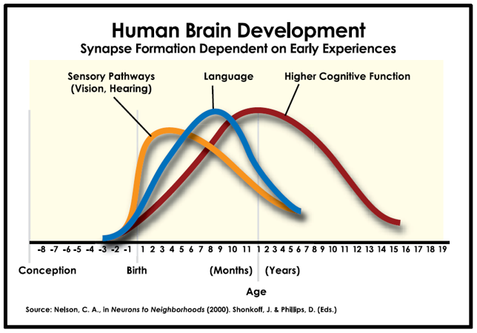
Early Childhood Brain Development​
Center on the Developing Child, Harvard University (developingchild.harvard.edu​)
Notes:
The time during pregnancy and the child’s first 3 years of life is perhaps the most crucial time of development. This graph shows how skills begin to build before we can see them evidenced by the child, and how each developmental skill builds on previous skills. Brain development begins in the womb and continues rapidly in the first few months of life. It’s easy to see here how early intervention is so important for vision and hearing problems – if we don’t catch these issues early, they impact later development in a way that we can’t “take back”. Even though it may be harder to physically see, the impact of early social-emotional development is equally important. As staff in one of Minnesota’s screening programs, your role is so important to help support families in their child’s development, and to identify any concerns early so that they can get evaluated and treated.
More information on the science of early child brain development is available from the Harvard Center on the Developing Child

Slide 6
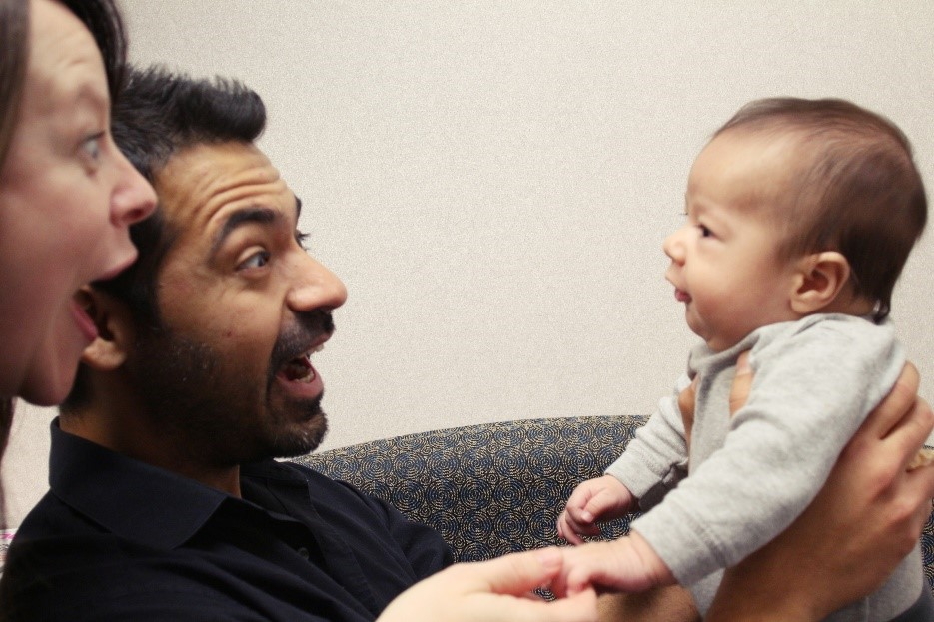
The Importance of Early Intervention​
In the first 3 years of life, the child’s brain is:
  Developing rapidly
  More sensitive
  More responsive to intervention
Notes:
As with any condition, when a developmental or social-emotional concern is found and treated early, the child is more likely to have better health and educational outcomes.
In the first 3 years of life, the child’s brain is more sensitive both to harm (for example, lead in the environment) AND to help (like early intervention services).
Universal screening programs for infants, toddlers, and young children help us make sure we identify children who might benefit from early intervention.
[For Early Childhood (preschool) Screening programs: This is why screening at 3, rather than waiting for 4 or 5 years, is so important. We can connect with children who may not have received screening earlier, and also those who may have developed something new since their previous screening at a clinic or through another program. It also helps make sure the child has enough time before kindergarten to benefit from school readiness supports and services.]

Slide 7

Child Development
Fine and gross motor
  How children move their bodies and use their hands
Communication and language
  How children understand and communicate with others
Cognitive
  How children explore, learn, think and figure out how to solve problems
Social and emotional
  How children feel, behave and relate to others
Notes:
What exactly are we looking for when we provide developmental screening? When you talk with parents about why you are screening, here are some ways you can explain what we are looking for – both skills that the child is already doing, and things that they might not be doing yet. It helps us figure out whether we should take a closer look at a certain area, provide some extra resources, and what we can do to support things that are going well.
The updated Minnesota Help Me Grow website has more information and videos for parents about developmental milestones.

Slide 8
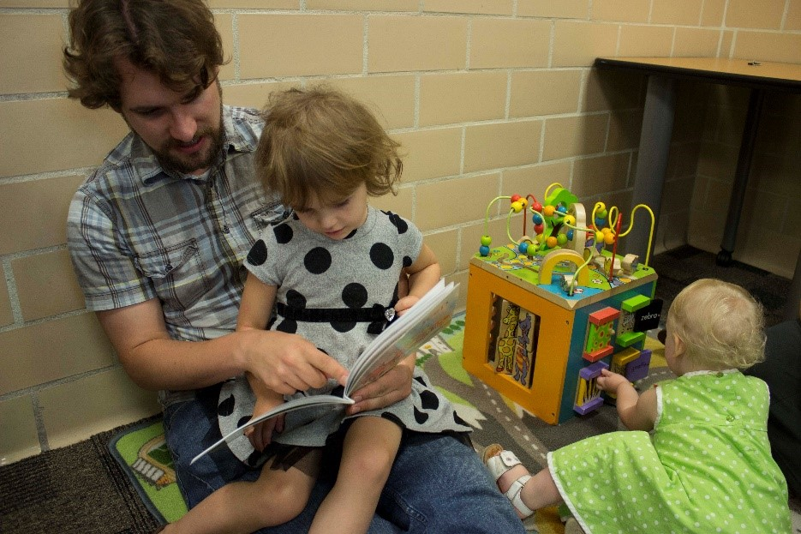
Social-Emotional Development
(Or, Infant and Early Childhood Mental Health)
All in the context of family, community and culture:
  Relationships
  Emotional regulation
  Security and exploration
Zero to Three (zerotothree.org)
Notes:
Social-emotional development is a very important part of a young child’s development and requires a separate screening instrument. Social-emotional development is also known as infant and early childhood mental health. It’s “the developing capacity of the young child to experience, regulate, and express emotions, form close and secure interpersonal relationships, and explore the environment and learn, in the context of a caregiving environment that includes family, community, and cultural expectations for young children.” Zero to Three is the leading national organization for infant and early childhood mental health. More information for both parents and professionals is available on their website.
Both parents and professionals tend to know more about and feel more comfortable with general developmental concepts like brain development, speech, and motor milestones. However, social-emotional development is the basis for a child’s later relationships, behavior, and mental health.
[Interactive activity: What do you notice about the children in this picture? What interactions do you notice between the parent and the preschooler? What about the toddler? Does she feel safe to explore in this environment with her dad nearby? When you are with a child at work, what are signs of emotional regulation? (Examples: crying and going to the parent for safety, thumb-sucking to calm themselves, saying “I’m scared”…]

Slide 9
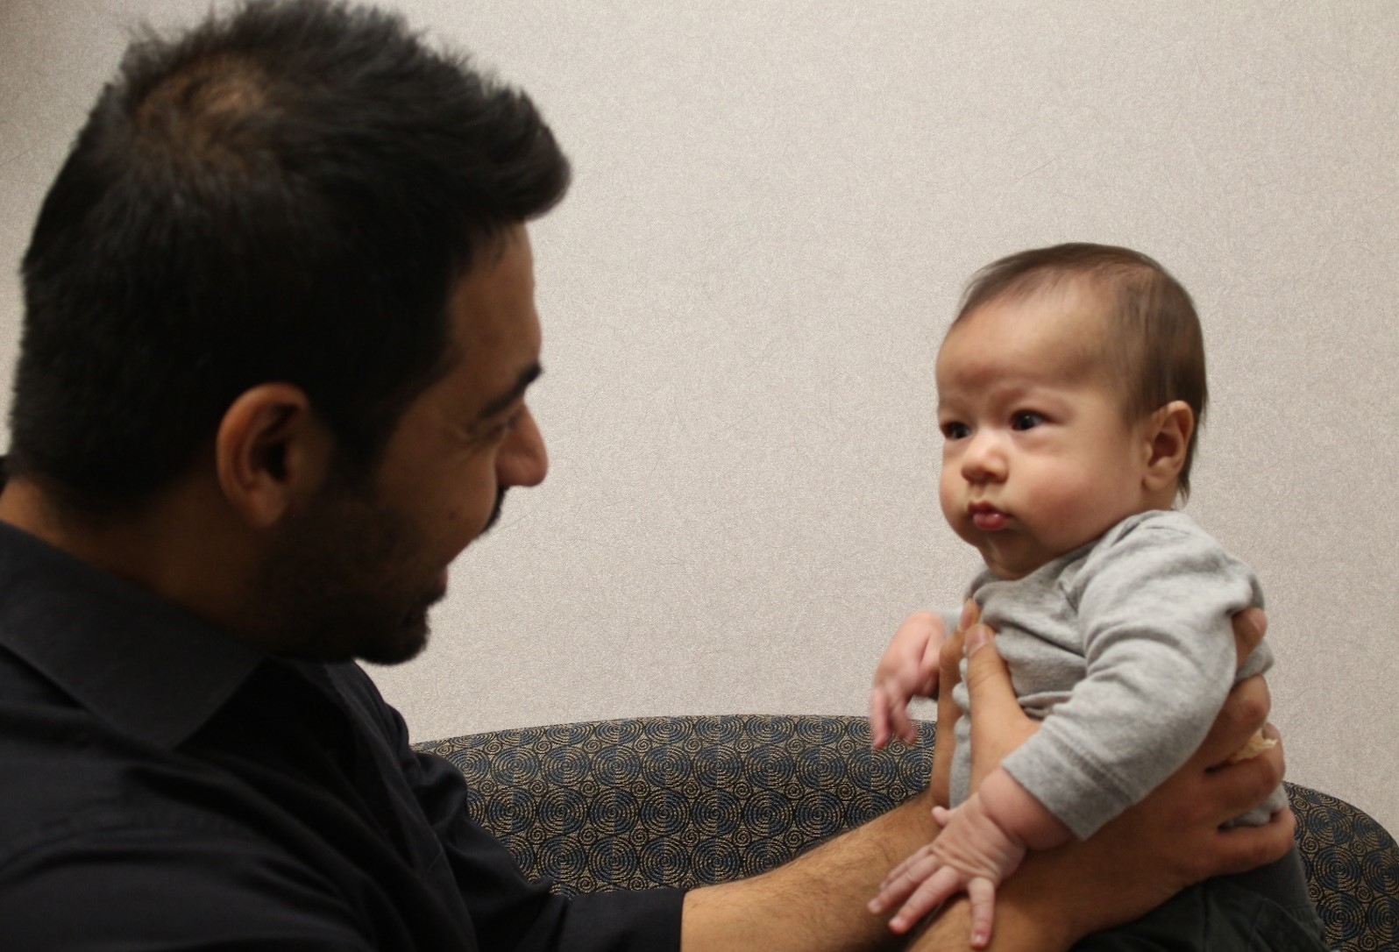
Family-Centered Care
Notes:
Development happens in the context of relationships. The child’s parent (or other primary caregiver – maybe a grandparent or foster parent) is their main partner in healthy development. The child’s relationship and interaction with that parent literally help wire healthy brain development. One of our most important jobs is to partner with parents to support them, as they support their child’s development. In a minute, we’ll take a quick look at resources for parents.
You can help support parents by doing the following as you work with them:
Recognize them as the expert on their child
Explain in plain (but not condescending) language what you would like to do and why
Always ask about parent concerns, and usually ask more than once. Parent concerns are very telling, and sometimes it takes a while for them to feel comfortable enough to share with you what they may be worried about.
After the screening process is finished, have a conversation with the parent about the results, and offer resources and referrals. Find out what fits best with the child’s and family’s needs and priorities.
When you take this approach, it helps validate the parent’s role and concerns, and helps build the trust that is needed to move to the next step if a concern is identified.

Slide 10
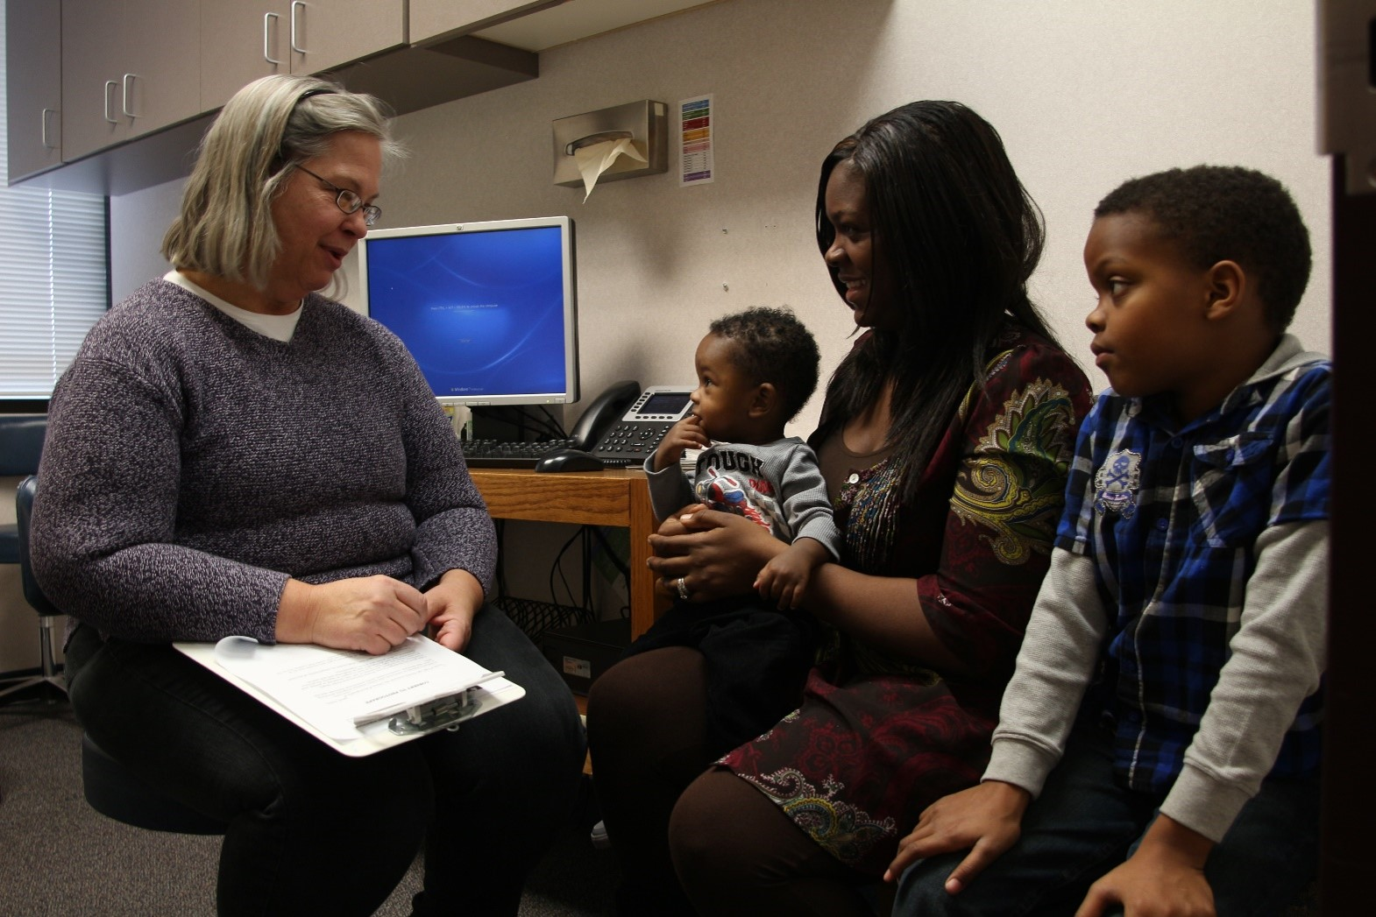
Promoting Healthy Development
Notes:
Even though we’re a program that works hard to identify concerns and make sure families get referrals and services their child needs, we’re not just focused on problems. We’re in a good position to promote healthy development.
There are some ways that you can do this even during your short visit with the family:
[Use examples of ages or situations appropriate for your screening program setting.]
Use the screening instrument as a tool to have a conversation about typical child developmental milestones at this age, and what the parent can expect over the next few months as the child continues to develop.
Model how interacting face-to-face with the infant or child helps wire their brain for healthy social and emotional development: Talk to the baby as you check him or her over: look in their eyes, talk back when they coo. Encourage the parent to keep talking, reading and playing with their baby face to face every day.
During the visit, reinforce healthy parent-child interactions by noticing and commenting on the positive ways the parent interacts with their child: “I noticed that when ____ started fussing, you smiled at him and hugged him a little closer. That seemed to really make him feel secure.”
Share resources and ideas with the parent about how they can support healthy social-emotional development. You may have some favorite take-home materials to share with parents; others will prefer to go to the web for more information. Some key resources and links are listed at the end of this module.

Slide 11
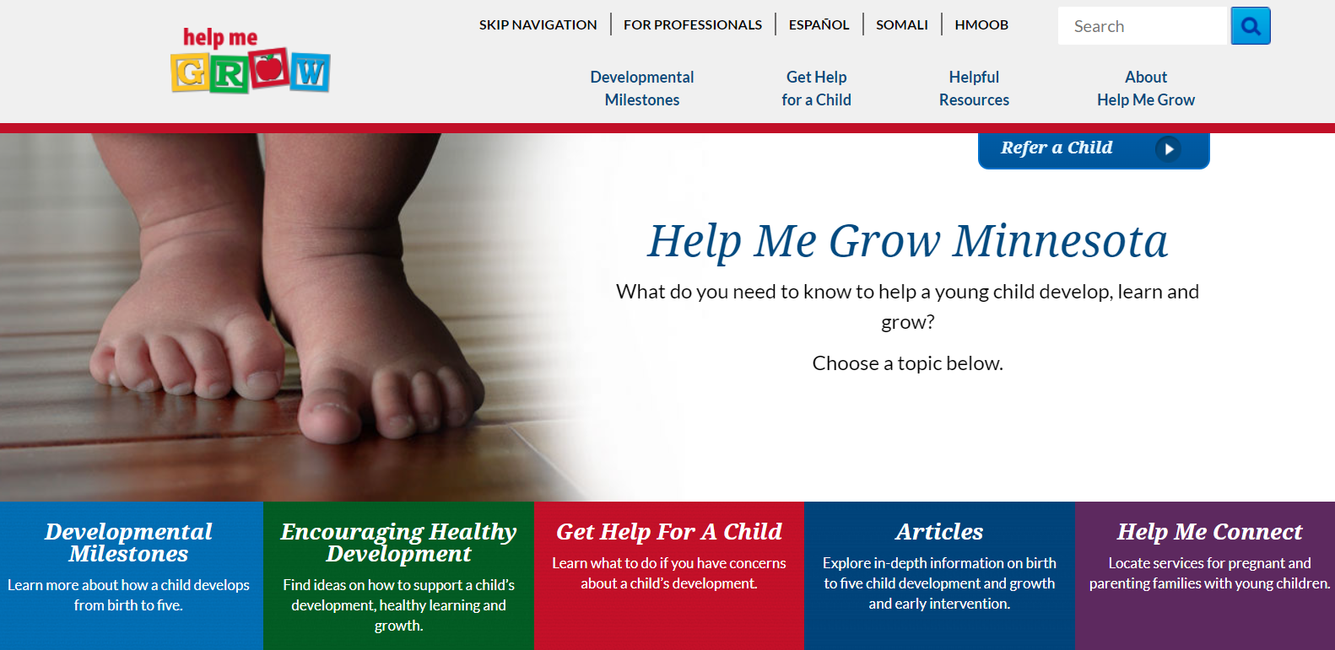
Help Me Grow
Help Me Grow MN (helpmegrowmn.org)
Notes:
Help Me Grow Minnesota’s newly updated website offers a wealth of information for families and providers about early childhood development. Parents can watch videos that show developmental milestones for different ages and learn what they can do to encourage their child’s healthy development. This website is also a point of referral for early intervention and preschool special education services in Minnesota.

Slide 12
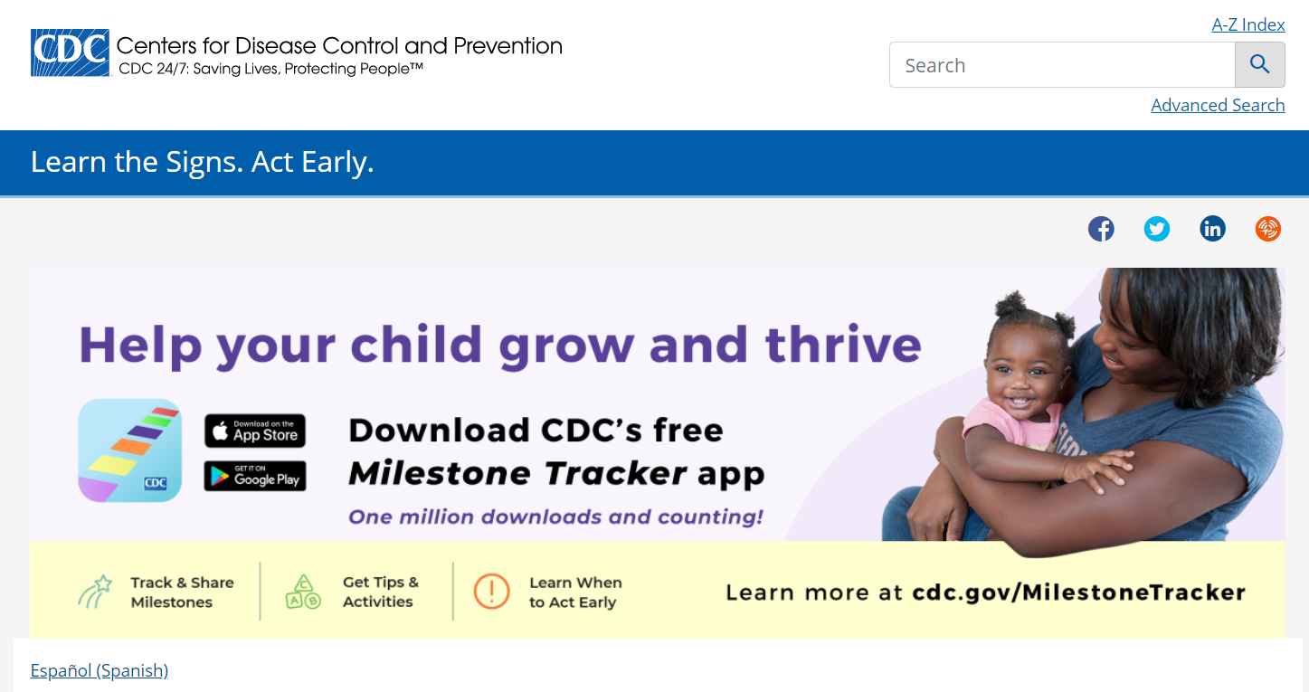
CDC’s Learn the Signs, Act Early
CDC’s Learn the Signs, Act Early (cdc.gov)
Notes:
The Centers for Disease Control and Prevention, better known as the CDC, offers both website resources and free downloadable developmental information for families and professionals.
This includes milestones, free materials, a Watch Me! Training for early care and education providers, what to do if you’re concerned about your child’s development, multimedia tools, and an autism case training.

Slide 13
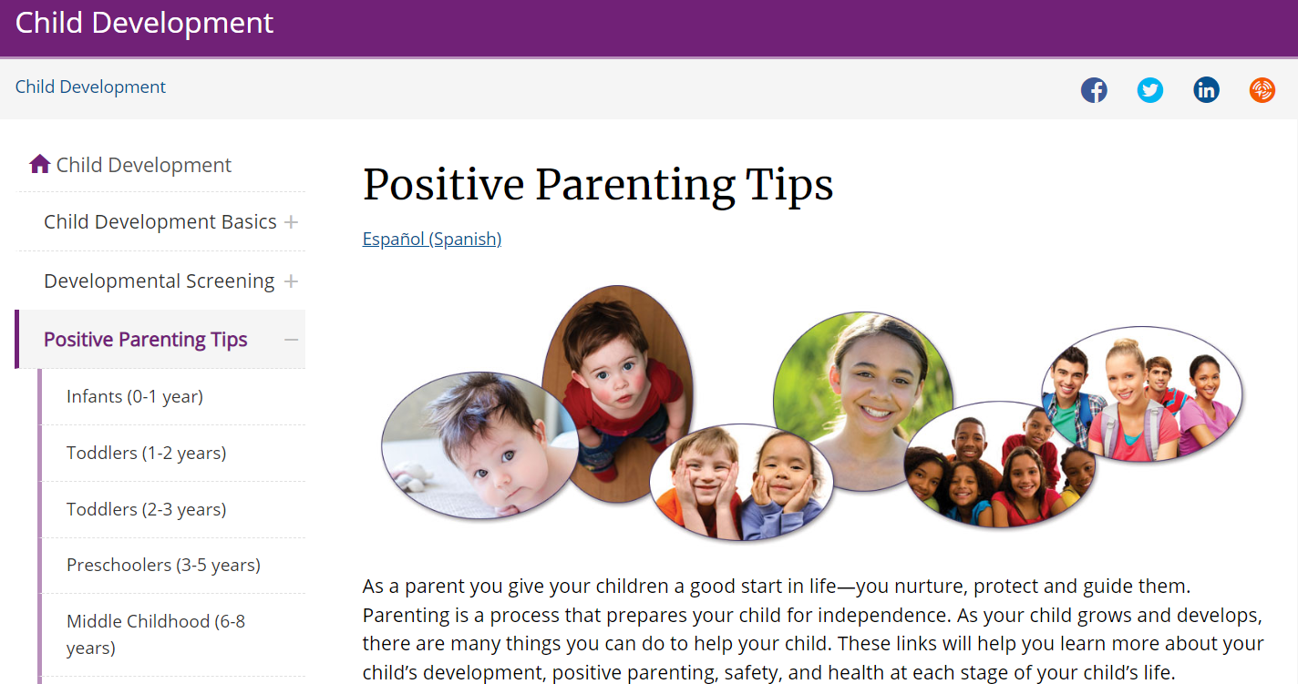
CDC Positive Parenting Tips
CDC Positive Parenting Tips (cdc.gov)
Notes:
The CDC also offers downloadable handouts on positive parent tips, for children age birth through 17 years.

Slide 14

Help Families Thrive with Help Me Connect
New online service navigator ​
Connect pregnant and parenting families with young children, birth to 8 years of age to local community services that support healthy child development and family well-being​
Search by keywords or content area (11 categories)​
Filter by location (city, county, home address)​
Create an account and save favorites​
Mobile friendly​

Slide 15
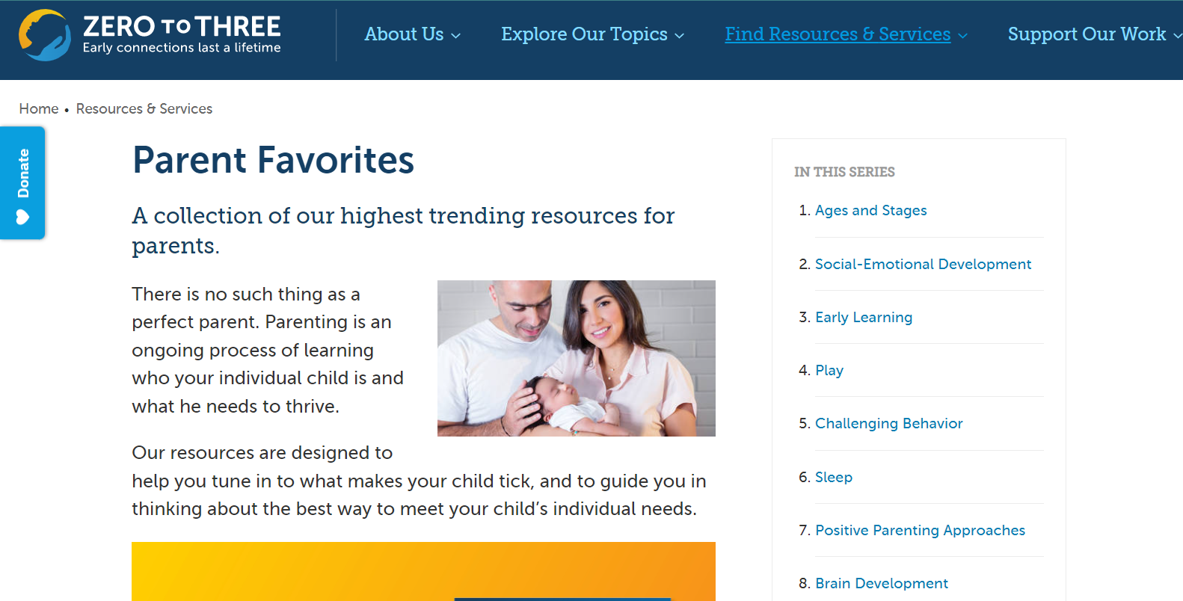
Zero to Three Parent Resources
Zero to Three Parent Resources (zerotothree.org)
Notes:
The new Zero to Three Parent Portal has information especially for parents of infants and toddlers about social-emotional development, behavior, and positive parenting.

Slide 16
Support for Parents in Your Community (slide 1 of 2)
Early Childhood Family Education (ECFE)
Head Start and Early Head Start
Cultural, faith-based and other community-based parenting groups
For children with developmental concerns or special health needs:
  Parent-to-parent networks such as Family Voices (Parent-to-Parent of Minnesota, familyvoicesofminnesota.org), PACER (pacer.org), Hands and Voices (mnhandsandvoices.org)
  Other condition-specific groups and organizations
Notes:
[Include other parent supports and resources that are available in your community.]
Hyperlinks:
Family Voices - https://familyvoicesofminnesota.org/
PACER - https://www.pacer.org/
Hands and Voices - https://www.mnhandsandvoices.org/

Slide 17
Support for Parents in Your Community (slide 2 of 2)
Family Home Visiting (health.state.mn.us)
Follow Along Program (health.state.mn.us)
Primary care/health care provider (mn.gov)
Parent Support Outreach Program (PSOP) (mn.gov)
Early Childhood Mental Health providers (mn.gov)
If families are in need of mental health services and there is a long wait time, then refer to primary health care provider and local public health home visiting.
Notes:
Hyperlinks:
Family Home Visiting – https://www.health.state.mn.us/communities/fhv/index.html
Follow Along Program – https://www.health.state.mn.us/people/childrenyouth/fap/index.html
Primary care/health car provider - https://mn.gov/dhs/people-we-serve/children-and-families/health-care/health-care-programs/programs-and-services/ctc.jsp
Parent Support Outreach Program (PSOP) - https://www.thefamilypartnership.org/programsservices/education/parent-development-and-support/parent-support-outreach-program-psop/
Early Childhood Mental Health providers - https://mn.gov/dhs/people-we-serve/people-with-disabilities/health-care/childrens-mental-health/programs-services/other-dhs-programs.jsp

Slide 18
What Can Interrupt Healthy Development?
Biological reasons
Disruptions in relationships with primary care givers
Exposure to trauma
Social/environmental stressors, racism, poverty
  Neurons to Neighborhoods (nap.nationalacademies.org)
  ACE Study (cdc.gov)
Notes:
Biological exposures:
Prenatal alcohol or drug use, lead exposure
Loss of a parent or primary care giver for any reason: death, abandonment, or inconsistent availability perhaps due to mental illness or substance use
Exposure to trauma (domestic violence, neighborhood violence, abuse or neglect)
Social or environment stressors on the child and family - like poverty, homelessness, racism, decreased access to quality child care or education or medical services
All of these can negatively affect brain development and long-term health outcomes, especially if the child doesn’t have consistent, nurturing care or environment.
Hyperlinks:
Neurons to Neighborhoods – https://nap.nationalacademies.org/catalog/9824/from-neurons-to-neighborhoods-the-science-of-early-childhood-development
ACE Study - https://www.cdc.gov/violenceprevention/aces/index.html

Slide 19
What About Trauma Questions?
We recommend that providers ask the following questions, as they are not included in the ASQ:SE.
  Has your child ever experienced anything stressful or traumatic in the past year?
  If so, what was it? When did it happen?
  Did you get any support?
  Would you like some support, I can connect you with a colleague (friend) who can support both you and your child around this stressor.

Slide 20
Long-Term Effects of Adverse Childhood Experiences (ACEs)
Notes:
[OPTIONAL SECTION]

Slide 21
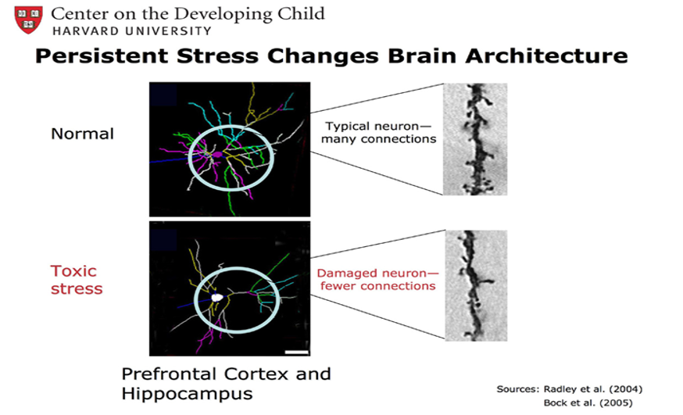
The Effects of Trauma and Adversity on the Brain

Slide 22
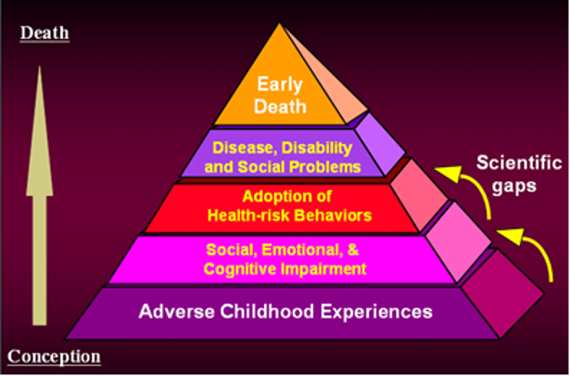
Adverse Childhood Experiences (ACEs)
ACE Study (cdc.gov)
Notes:
Research over the past decade on the long term health consequences of adverse childhood experiences (ACEs) helps us understand how crucial it is to pay attention to the experiences of our youngest children.

Slide 23
10 ACEs Studied:
Childhood abuse
  Emotional
  Physical
  Sexual
Neglect
  Emotional
  Physical
Household dysfunction:
  Witnessing domestic violence
  Alcohol or other substance abuse
  Mentally ill or suicidal household members
  Parental marital discord
  Crime in the home/ imprisonment
Notes:
Studies on ACEs – both nationally and in Minnesota – asked adults to look back on experiences they had during childhood, including exposure to verbal, physical or sexual abuse; drinking problems, drug use, or mental illness in the household; incarceration of a member of the household; parent separation or divorce; and witnessing domestic violence.

Slide 24
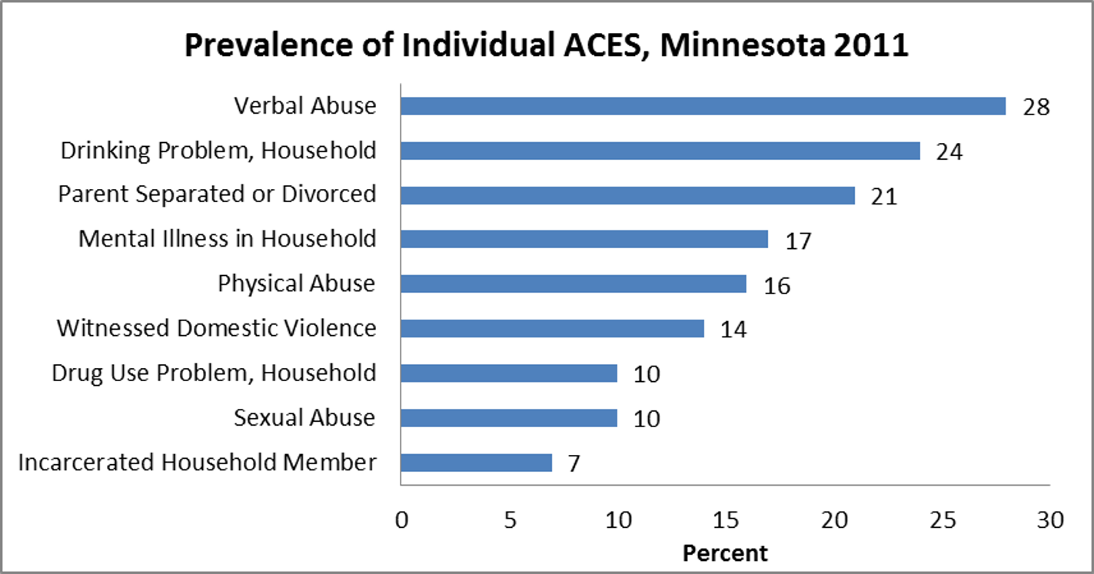
ACEs in Minnesota (BRFSS 2011)
Notes:
Data in Minnesota was similar to national data: almost a third of respondents reported exposure to at least one ACE.

Slide 25
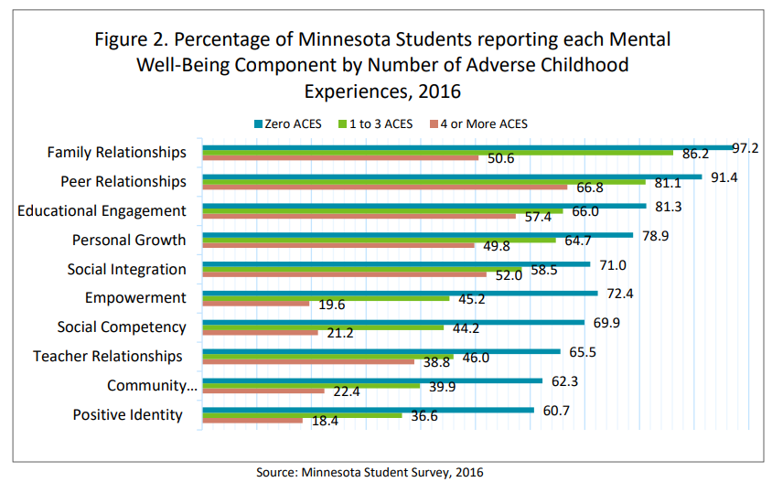
Minnesota Students With More ACEs Have Less Opportunities to Thrive
Notes:
Studies showed that exposure to ACEs has long-term health, mental health, and behavioral health consequences. Those adults who reported exposure to greater numbers of ACEs also reported significantly increased rates of asthma and other physical health conditions, depression, anxiety, drinking and smoking.
Work by Jack Shankoff and others showed that simply paying attention to ACEs – asking about exposure, listening and caring – helps provide immediate relief. Additionally, pediatric clinicians are in a position to help prevent, identify, and mitigate some adverse childhood experiences early – before health consequences set in.
[NOTE: behavioral health includes substance abuse]

Slide 26
Standardized Screening

Slide 27

What Is Screening?
Quick and simple check of child health and development – for all children
  Uses standardized tools
  Identifies child strengths and skills
  Identifies more subtle concerns
Not a diagnosis!
  Not the same thing as assessment or evaluation
Answers the question, “Does this child need more comprehensive evaluation?”
Notes:
The goal of screening is to identify as early in a child’s life as possible any developmental or social-emotional concerns, and to help the family connect to meaningful services and supports that help the child do better in their health, education, and social interactions.
Standardized screening is designed to help us identify developmental or social-emotional concerns – especially more mild concerns that might not be obvious even to professionals.
Standardized screening instruments have been tested on thousands of children to make sure they are accurate in identifying real concerns, and reliable in different situations.
Screening is universal: all children should be screened, not just ones that we’re concerned about.
The purpose of screening is both to show child’s developmental progress, AND to pick up on hints that a child may need a closer look with more comprehensive evaluation. Screening does not diagnose.

Slide 28
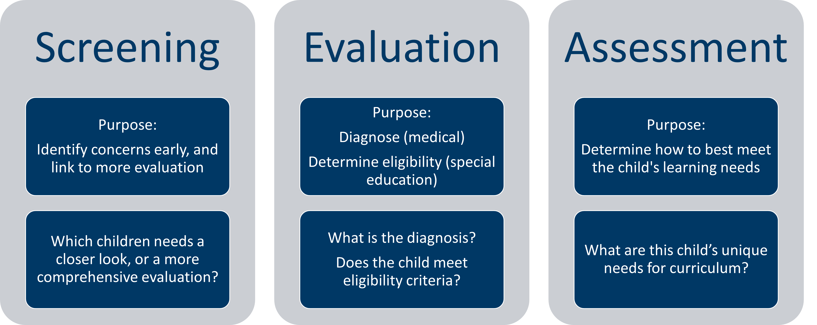
How Is Screening Different From Evaluation and Assessment?
Notes:
[OPTIONAL: Programs should be clear about definitions that are pertinent in their setting.]
Screening, evaluation and assessment mean different things. Screening is a BRIEF, standardized approach that is designed to identify developmental concerns early. It is used for a whole program population (NOT just those with concerns), at routine age intervals, as children get older. It answers the question, “Which children need a more comprehensive evaluation?”
Evaluation is a more in-depth, comprehensive look at a child when concerns are raised during screening. In the medical setting, it answers the question, “What is the diagnosis?” In the educational setting, it is used to determine if a child is eligible for early intervention or preschool special education services.
Assessment is different still. It is an ongoing or recurring process to decide what an individual child’s learning or curriculum needs are.

Slide 29

Talking to Parents About Screening
Normalize screening: just like hearing, vision, height & weight
Do call it a tool or a “snapshot” in time to see how the child is growing & developing
Don’t use words like test, fail, or any diagnosis words
Ask parent about their concerns and to give their best, honest answers
Notes:
If we explain screening well ahead of time, parents have an easier time with it, and we get more helpful information. Some parents may be nervous about screening – like it’s a test, or that we will be judging how good of a parent they are. These tips can help calm these worries, and help parents understand how important their role is, as “expert” on their child.

Slide 30
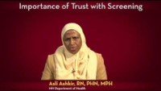
Presenting Screening to Refugee or Immigrant Families
Importance of Trust with Screening (youtube.com)
Notes:
For families who are less familiar with preventive health and developmental screenings, trust is a huge factor, along with explaining the purpose of screening.
In this video, Asli talks about this, in relation to the Somali population. [CLICK ON PHOTO TO LINK TO THE YOUTUBE VIDEO: https://www.youtube.com/watch?v=bBvwOmG72Hs&list=PLqPfFYYbtBZjkeFkeVwUKz-iciPB8HpPi&index=9 ]
[DISCUSSION: Some potential questions for group discussion:
What are ways we can establish a trusting relationship with families in our setting/program?
Besides trust, what are other issues that Asli raises for us to pay attention to in our approach with families?]

Slide 31
Successful Screening for Culturally & Linguistically Diverse Families
Learn more about the cultures and languages in the community you serve
Hire staff who are representative of the families being served
Use professional interpreters, with a little extra training
Provide additional support for access, screening process, and follow-up as needed
Notes:
[QUESTIONS TO CONSIDER DISCUSSING: How do we address these challenges?]
What cultural or ethnic groups do we serve? How do our screening rates or ages screened differ by race?
How easy is it for a parent to request an appointment or ask a question if English is not their preferred language?
How closely does our staff match the population we serve?
If it’s not a close match, what could we do to address that? (examples: paraprofessional staff, volunteers, community/cultural liaisons, interpreters, other ways?)
Are we using the best screening instrument(s) for the population we serve? Are there particular questions or items that are problematic?
What are ways that you’ve been successful in trusting and effective screening relationships, even across cultures and languages?

Slide 32
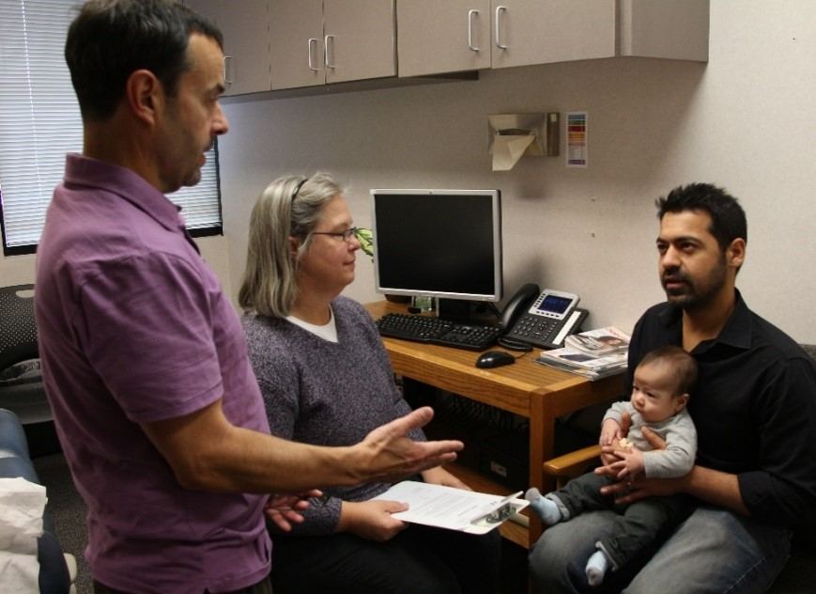
Working With Interpreters
Effectively determine if an interpreter is needed
Provide a professional interpreter whenever possible
Educate the interpreter
It’s okay to explain or re-frame questions
Notes:
Provide a professional interpreter; do not try to screen without or use family members (children or adults).
How do you decide if an interpreter is needed?
Less effective: Do you need an interpreter?
More effective: In what language are you most comfortable talking about your child’s health and development? (This is closer to the level of language they will need to use to talk with you about their child’s development.)
Take a few minutes ahead of time to explain the tools you are using; ask them not to provide answers for the parent; request direct translation; and give them permission to raise concerns (like if something isn’t culturally appropriate, or something else they notice).
[If desired: Refer to Minneapolis Public Schools interpreter handout as an example – handout and next slide.]

Slide 33
Guide for Interpreters
Early Childhood Screening Guidelines for Interpreters (education.mn.gov)
Training Video: Early Childhood Screening and Interpreters (education.mn.gov)
Notes:
[Optional – refer to handout – used with permission. Consider developing something similar for your program.]
Hyperlinks:
Early Childhood Screening Guidelines for Interpreters - https://education.mn.gov/mdeprod/groups/educ/documents/basic/bwrl/mdg3/~edisp/mde087018.pdf
Training Video: Early Childhood Screening and Interpreters –
https://education.mn.gov/MDE/VideoNew/?group=Communications&id=mde033429 This 20 minute video was made with input from the Taskforce, MDE specialists in Equity, Community Engagement, Multi Language Learners and educational interpreters in Minnesota.

Slide 34
Screening Instruments

Slide 35
Recommended Screening Instruments
Minnesota has a list of recommended instruments (health.state.mn.us) that have been reviewed for validity, reliability, and practicality.
Different screening programs (health.state.mn.us) have different requirements for which instrument to use.
Programs are responsible for making sure that they are using the most current, recommended instrument(s) for their program.
Notes:
All public screening programs in Minnesota should refer the website of the Minnesota Interagency Developmental Screening Task Force for information about recommended screening instruments. Many other resources are also available on this website.
[REVIEW WHAT INSTRUMENTS ARE USED IN YOUR PROGRAM. For example:
For Early Childhood Screening, state statute requires an observational developmental screening instrument, but also a parent report instrument – different ECS programs use different developmental tools, but most programs use the Ages and Stages Questionnaires: Social-Emotional (ASQ:SE-2) to meet that 2nd requirement.
Follow Along Program uses ASQ-3 and ASQ:SE (or ASQ:SE-2).
MIECHV family home visiting programs report on ASQ-3 and ASQ:SE screening.
Clinics that provide Child and Teen Checkups usually use the ASQ-3 or PEDS parent report developmental screening instruments, for practical reasons.]
Hyperlinks:
Recommended Instruments – https://www.health.state.mn.us/people/childrenyouth/ctc/devscreen/instruments.html
Screening Programs - https://www.health.state.mn.us/people/childrenyouth/ctc/devscreen/programs.html

Slide 36
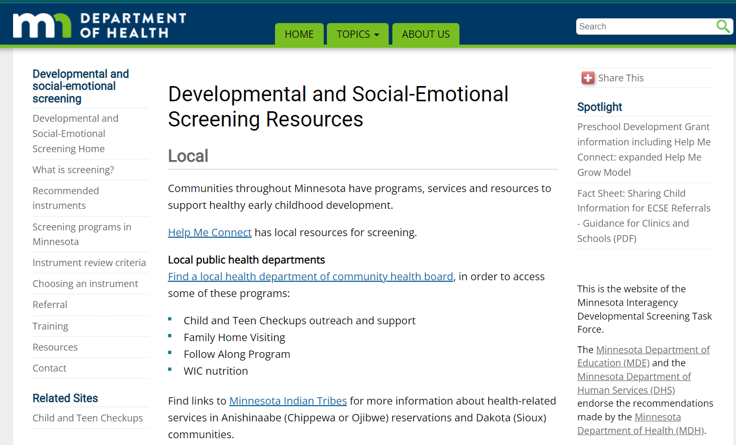
Developmental and Social-Emotional Screening for Young Children (0-5 Years) n Minnesota
Developmental and Social-Emotional Screening for Young Children (0-5 Years) in Minnesota (health.state.mn.us)
Notes:
This is a screen shot of the website where the Minnesota Interagency Developmental Screening Task Force posts recommended instruments and other information for public screening programs for ages birth through 5 years. [Direct link to webpage, if you would like to explore it with your training group: https://www.health.state.mn.us/people/childrenyouth/ctc/devscreen/index.html]
Left navigation panel: point out “Recommended Instruments”, “Referral”, and “Resources”.
The Resources page (shown here) has links to help you find local programs that support healthy early childhood development, as well as links to state and national resources.

Slide 37
Choosing a Screening Tool
What type of screening is required or allowed for your program?
What staff qualifications does the tool require?
What instrument best meets your population’s needs?
Refer to Choosing an Instrument (health.state.mn.us) on the developmental screening website.
Notes:
What type of screening is required or allowed for your program?
Developmental and social-emotional screening require separate instruments.
Parent report (answered by a parent or primary caregiver) vs. observational instruments (administered by a staff person or professional)
What staff qualifications does the tool require?
Refer to the screening instrument manual.
What instrument best meets your population’s needs?
Age range
Validated for a diverse population
Is it translated into needed language(s)? Is it validated in those languages? Are there different cut-off scores?
Hyperlinks:
Choosing an Instrument - https://www.health.state.mn.us/people/childrenyouth/ctc/devscreen/selection.html

Slide 38
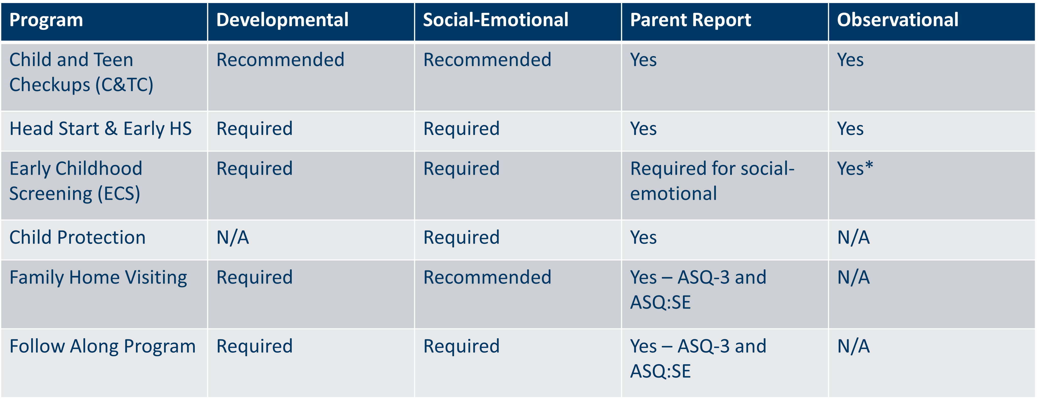
Program Requirements
Notes:
[optional slide – to compare requirements across programs]
There are many public screening programs in Minnesota: Child and Teen Checkups, Head Start and Early Head Start, Early Childhood Screening, Child Protection, Family Home Visiting, and the Follow Along Program. Each of these programs has specific screening recommendations or requirements.
This is helpful to know in order to choose an instrument, but also means there may be more opportunities for children to be screened, and opportunities for different programs to coordinate to decrease duplication of services.
* Note for ECS, during COVID-19, a parent report tool of cognitive, speech/language, fine and gross motor development may be used for distance screening. Observational tool is used during in-person or hybrid learning model.

Slide 39
What Makes a Good, Standardized Screening Instrument? (Review Criteria)
Instrument purpose
Developmental domains
Sensitivity/specificity, validity
Reliability
Recent standardization
Additional considerations:
  Practicality
  Population and age span targeted by the instrument
  Cultural, ethnic, and linguistic sensitivity
  Minimum expertise of screeners
  Cost
Notes:
[OPTIONAL: Even if your program’s tool is pre-determined, staff may like to know that the MN Interagency Developmental Screening Task Force uses certain criteria to select high quality instruments recommended for public screening programs.]
Instrument purpose: Does the tool accurately screen for conditions we are trying to address?
Developmental domains: Instruments for Minnesota’s screening programs should at least cover the following areas:
Gross motor
Fine motor
Language/communication
Cognitive
Social-emotional (separate instrument)
Sensitivity/specificity, validity: Is the tool ACCURATE? (it actually finds what we are looking for)
Reliability: Is the tool RELIABLE, from one time to the next, or from one administrator to the next?
Recent standardization: Was the tool developed and tested within the last 10-15 years?
Additional considerations:
Practicality: How long does it take to complete?
Population and age span targeted by the instrument: Has it been validated on a diverse population, at the ages that matter for our programs?
Cultural, ethnic, and linguistic sensitivity: Has the tool been translated into other languages? If so, was that translation validated in that population? (Note: this is a big challenge – some tools have been validated in Spanish, but very few in other languages.)
Minimum expertise of screeners: What kind of staff person can administer and interpret the tool?
Cost

Slide 40
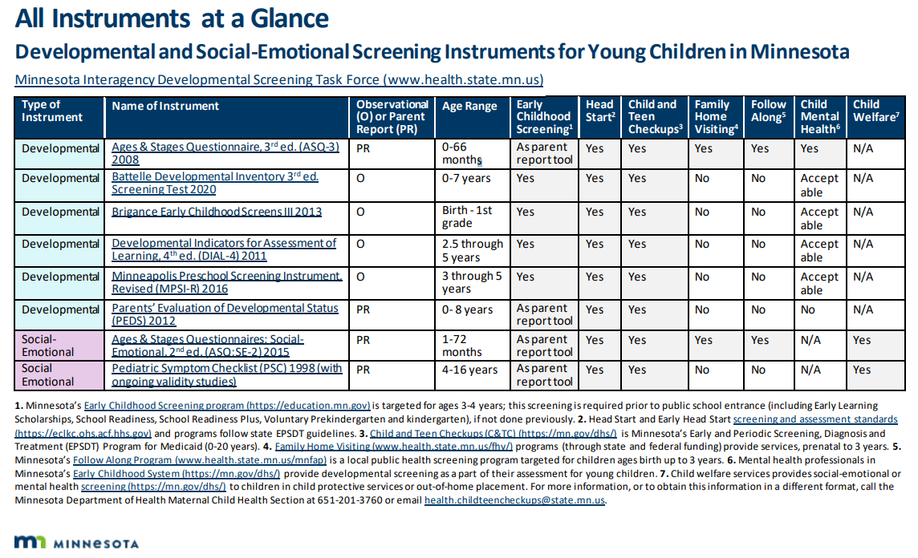
Currently Recommended Instruments
Currently Recommended Instruments (health.state.mn.us)
Notes:
[OPTIONAL – Shows currently recommended instruments.]
Light blue are developmental screening tools.
Purple are social-emotional screening tools.
The columns show whether these recommended tools are appropriate for different age groups and different programs in Minnesota.

Slide 41
Observational Developmental Screening Instruments
Require a child to perform certain developmental tasks, observed by a professional
Allow for direct observation of development that may not be recognized by parent/caregiver (such as a speech concern)
May be particularly useful if the parent/caregiver has limited ability give a report of development
Are currently required for Early Childhood Screening programs

Slide 42
Parent-Report Developmental Screening Instruments
Perform as well or better than observational tools
Help focus visits on issues important to families
Create teachable moments
Respect parents as experts
Capture milestones even if child cannot “perform” them at the screening visit
References:
  Minnesota Child Improvement Partnership. Healthy Development through Primary Care Project, 2008.
  Developmental Surveillance and Screening Policy Implementation Project, AAP, June 2006.
Notes:
[OPTIONAL: Some screening providers question the validity of parent-report instruments; this is to address that concern.]
Many professionals wonder if we can we rely on parent-completed instruments. Research shows that parent report instruments perform as well or better than tools that rely on professionals making real-time observations of skills at a specific time and location. Parents or caregivers spend the most time with their child and can most often capture many more subtle behaviors in their children. Other benefits of using a parent-report instrument:
You can identify both how the child is doing with development, and what the parent’s concerns are.
You can more quickly focus your visit on what concerns the parent (and what they are most motivated to act on.)
Parents feel respected as the expert on their child.
Parents have the chance to learn about child development during the screening process – use the screening instrument as a teaching tool, and a tool to start a conversation about concerns.
Regardless of what instrument you use, an essential part of screening is asking parents about any concerns they have about their child, and following up on those concerns.

Slide 43

What’s in the ASQ-3?
(Ages and Stages Questionnaires: 3)
If possible, give to parents ahead of time.
A tool to check the child's development.
Covers: Communication, Gross motor, Fine motor, Problem solving. Personal-social
Response options: yes, sometimes, not yet
Written at the 4-6th grade level
Unscored section- open ended questions
Parent concerns are very predictive- any concerns require follow-up
Notes:
[OPTIONAL: There is often confusion about the ASQ-3 versus the ASQ:SE. ]
Both are parent-report instruments.
The ASQ-3 covers general development, including the areas listed here.
The ASQ:SE covers specific areas of social-emotional development.
The 2nd edition just came out in fall of 2015, and is called the ASQ:SE-2. Programs who use the ASQ:SE should transition to the 2nd edition no later than July 1, 2017.

Slide 44

What’s in the ASQ:SE-2?
(Ages and Stages Questionnaires: Social-Emotional, 2nd edition)
Data and cut-off scores based on sample size of more than 14,000 diverse children
Age range: 1 to 72 months of age
Has a monitoring zone (similar to ASQ-3)
Scoring and interpretation is similar to ASQ:SE
Screening Items specific to autism
Refined Spanish translation
Notes:
[OPTIONAL – for programs that use the ASQ:SE, this slide outlines the main changes in the 2nd edition (ASQ:SE-2). According to the publishers, people who are familiar with using the original ASQ:SE should not need special training to use the ASQ:SE-2.]

Slide 45
Making Meaning Out of Screening

Slide 46
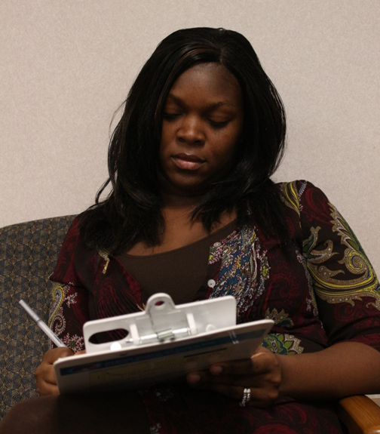
Interpreting Screening Results
Clarify any missing or concerning responses
Interpret results in context
Consider:
  Opportunity
  Health or developmental factors
  Family and cultural factors
No screening tool is perfect
Notes:
Even though using a standardized screening tool is much more effective than not, no screening instrument is 100% accurate. Any concerning result requires action
Ask parent/caregiver for clarification about missed or concerning answers
Screening must be interpreted in the context of the child and family’s experience, culture, and everything else you know about the child.
Consider the following:
Opportunity – give the child an opportunity to try a new skill if it hasn’t been offered before.
Health and developmental factors, such as recent illness or hospitalization; history of vision, hearing or other factors that could affect development. Screen again when those issues have been addressed.
Family and cultural factors – including family or cultural expectations around parenting, discipline

Slide 47
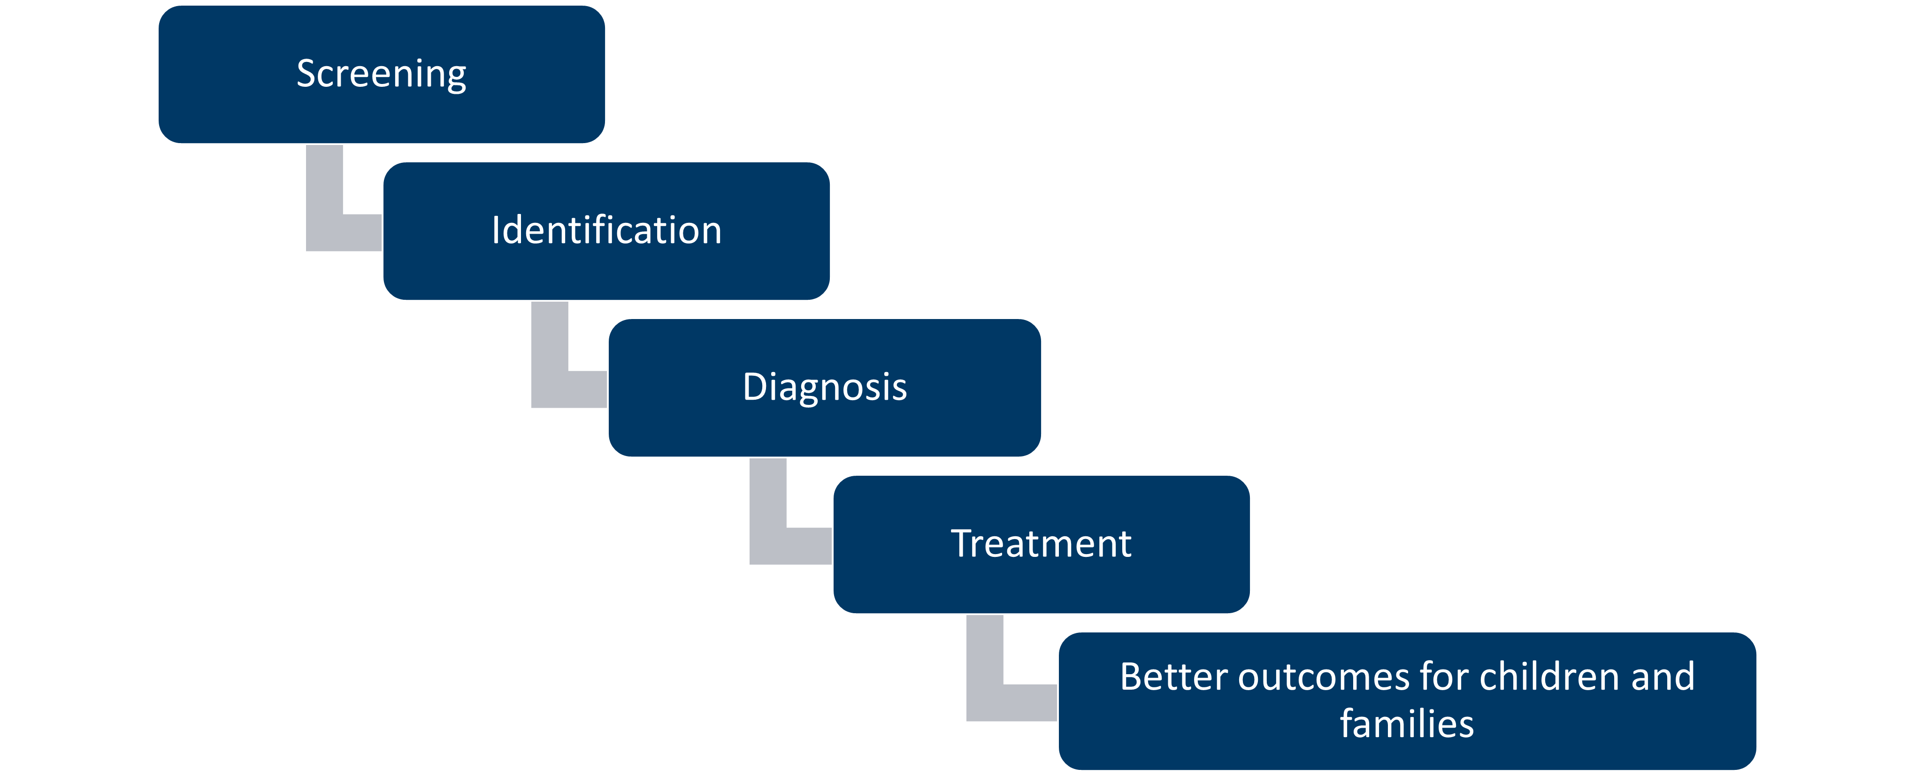
Process Following Screening

Slide 48
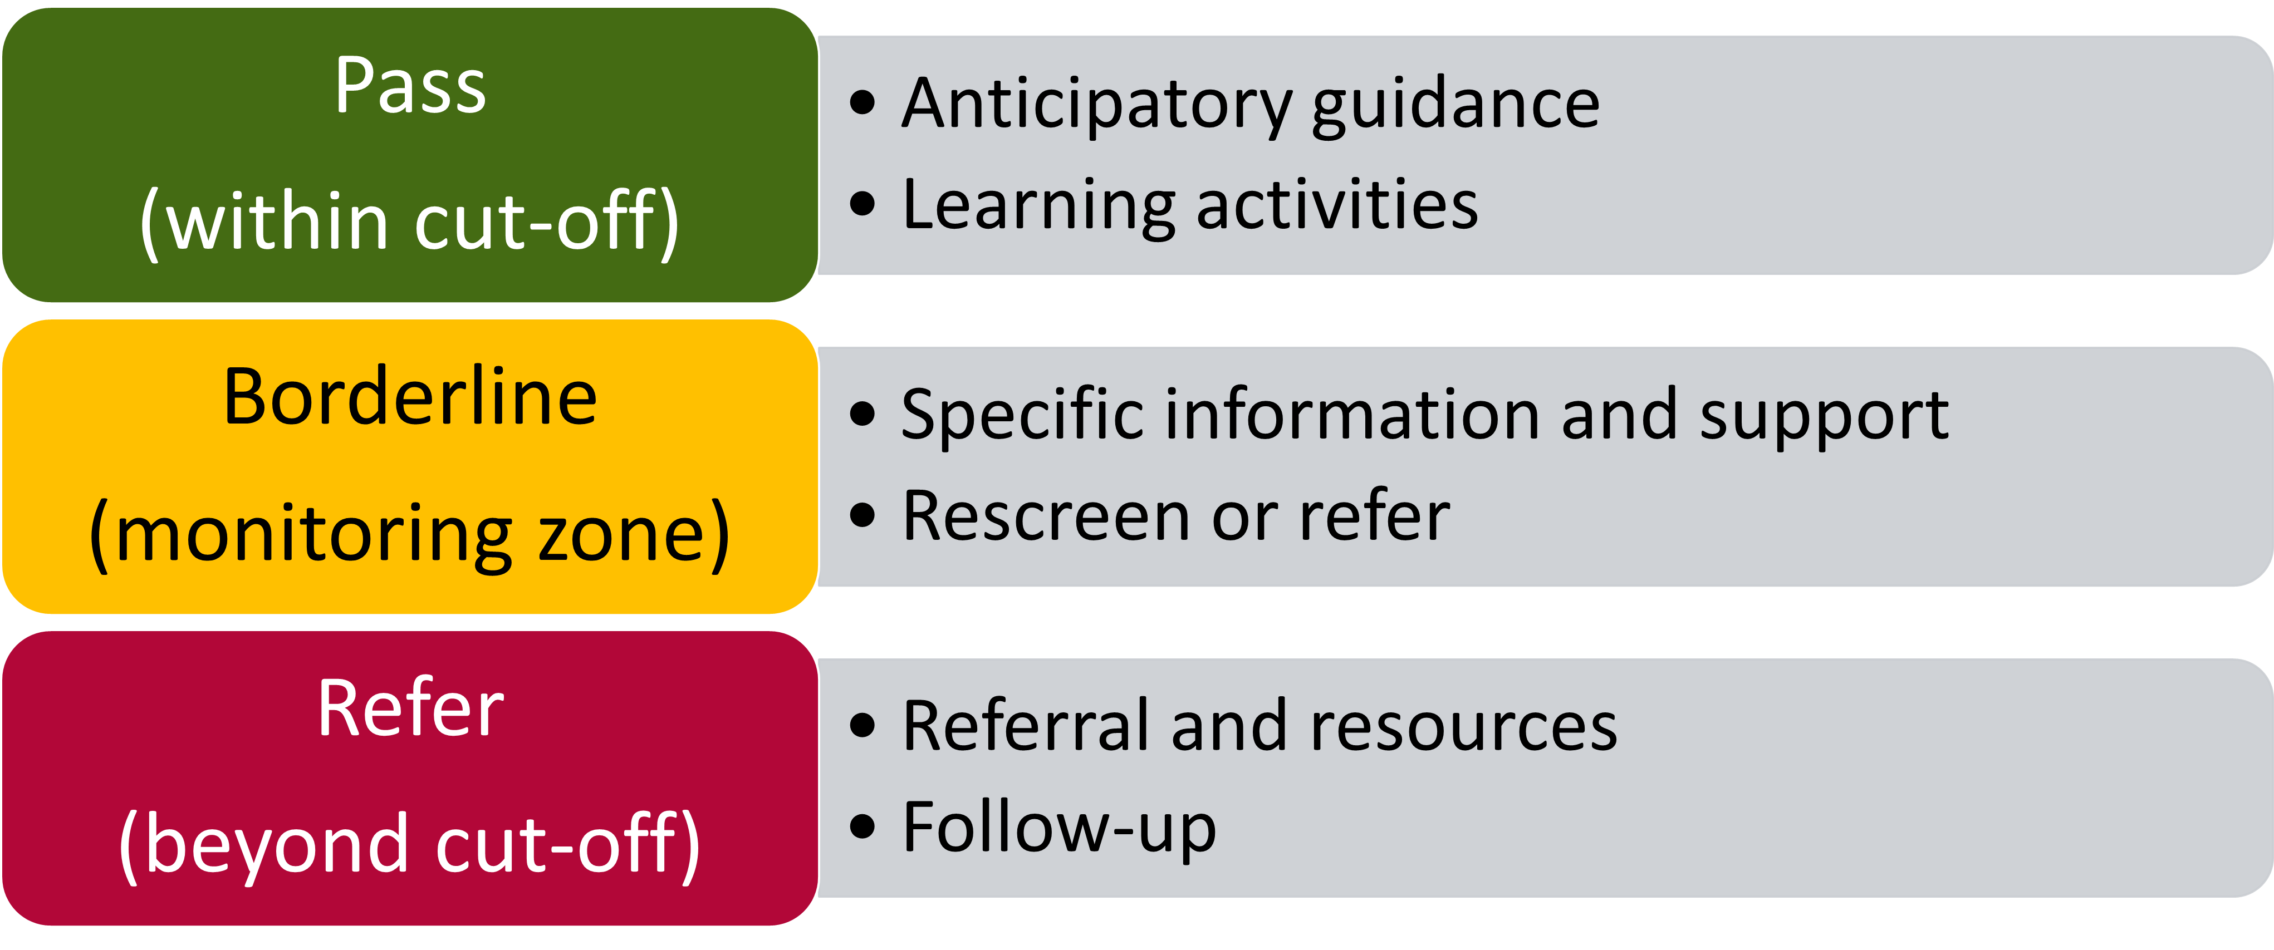
Results and Action
Notes:
If screening results are within cut-off range (“pass” or typical development), this is our opportunity to provide education about what to expect next in the child’s development, and give ideas about how the parent or caregiver can support healthy development at home.
If screening results are borderline or in the monitoring zone, more information is needed. Talk more with the family to see if there are programs or other things that could support the child’s healthy development, and follow up sooner rather than later with the family to re-screen the child.
If the child’s screening results are beyond cut-off (concerning), more information is needed. Discuss the concerns with the family and develop a plan together for next steps. We’ll talk in a minute about what those next steps might be.
Remember, even if screening results are “normal”, if either the parent or you have a concern about the child’s development, they may still need a referral for a more comprehensive evaluation or supportive services.

Slide 49
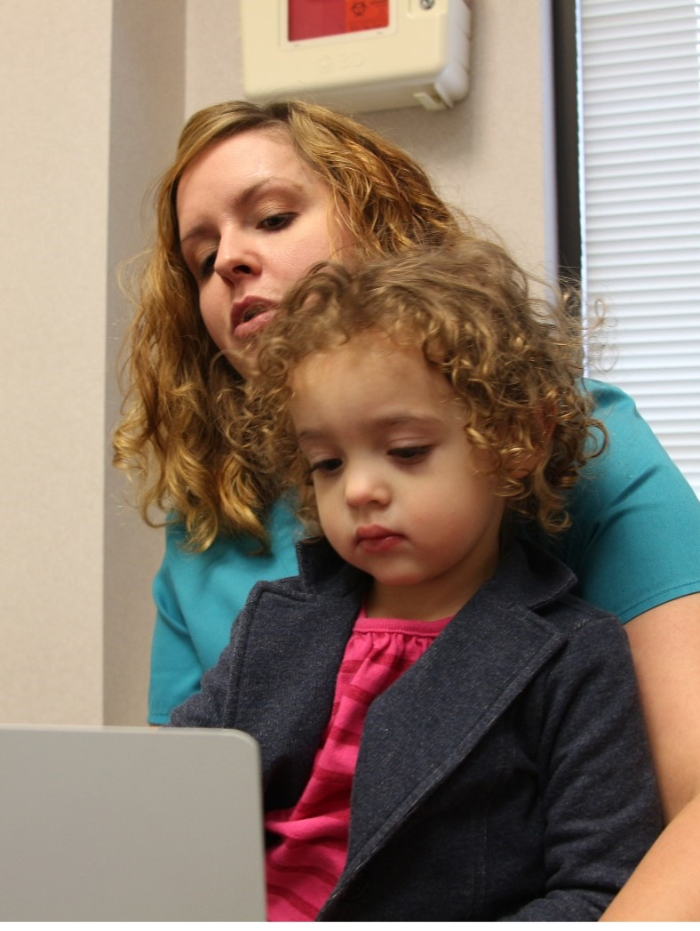
Talking About Screening Results – What Not to Say:
She failed her screening.
I’m worried she might have autism.
Let’s just wait and see if she grows out of it.
Here’s the number for Help Me Grow. You should call to see if she can get special education.
Notes:
There are some ways NOT to approach screening results with parents.
Do not use the word “fail”: Screening is not a test. Screening helps us both see what is going well for a child, and it helps us find areas where we might want to take a closer look.
Don’t use any diagnosis words: Screening is not a diagnosis. If there is an area of concern, more information is needed.
Take the “wait and see” approach

Slide 50
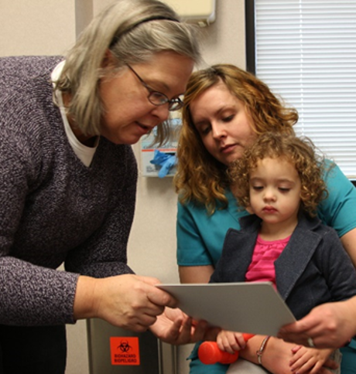
Talking About Screening Results – A Better Way
The screening showed that she’s doing ____ very well. However, it looks like she isn’t doing ____ yet like most other children her age.
What have you noticed about this?
The screening is just a quick check. We can take a closer look at what might be going on and find some helpful resources.
Would it be okay if I shared some ideas with you?
Notes:
DO use screening as a tool to start conversation. Give specific examples of the child’s strengths, and any areas of concern.
The screening showed that she’s doing ____ very well. However, it looks like she isn’t doing ____ yet like most other children her age.
DO address parent concerns and learn more about what they think.
What do you think? What have you noticed about this?
DO offer to provide recommendations for next steps. Use family-centered decision making principles to develop a plan together.

Slide 51
Referrals: When Concerns Are Identified

Slide 52
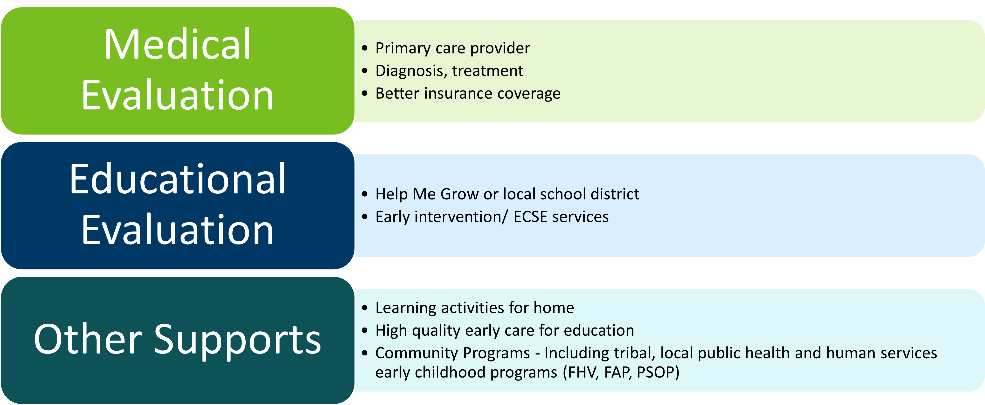
Developmental Concerns: DUAL Referral
(motor, cognitive, communication concerns)
Notes:
Whenever general developmental concerns are identified, the family should be offered a DUAL referral (to both, simultaneously):
To the child’s primary care clinic for MEDICAL evaluation to determine possible cause and treatment. This can also result in better health insurance for the child.
To the child’s local school district for EDUCATIONAL evaluation to see whether the child is eligible for early intervention services that are free to the family.
We’ll talk more in a minute about why both of these referrals are important.
In every community, there are programs that may help support the child’s healthy development and the family’s well-being. This might include things like high quality child care or Head Start, Early Childhood Family Education (ECFE), evidence-based family home visiting, or other supportive services.

Slide 53
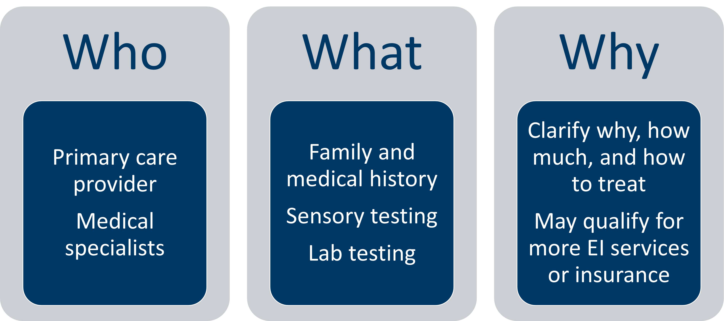
Medical Evaluation
Notes:
A child with developmental concerns should always be referred for more evaluation by their primary health care provider or helped to connect to a clinic if they don’t have one.
The health care clinician will provide a comprehensive medical evaluation to help see if there really is a delay, and if so, how much of a delay. They can help see why the delay may be happening. Medical evaluation will include a careful health and family history and physical exam, and may include testing for hearing, vision, lead exposure, thyroid problems or other conditions. Untreated chronic health conditions like asthma, allergies, or under-nutrition can result in developmental or behavioral problems. The primary care provider may decide to refer the child to medical specialists such as an audiologist, ophthalmologist, developmental pediatrician, geneticist for more evaluation.
A medical diagnosis may mean that the child qualifies for more early childhood special education services and may help the child qualify for better health insurance or social services.

Slide 54
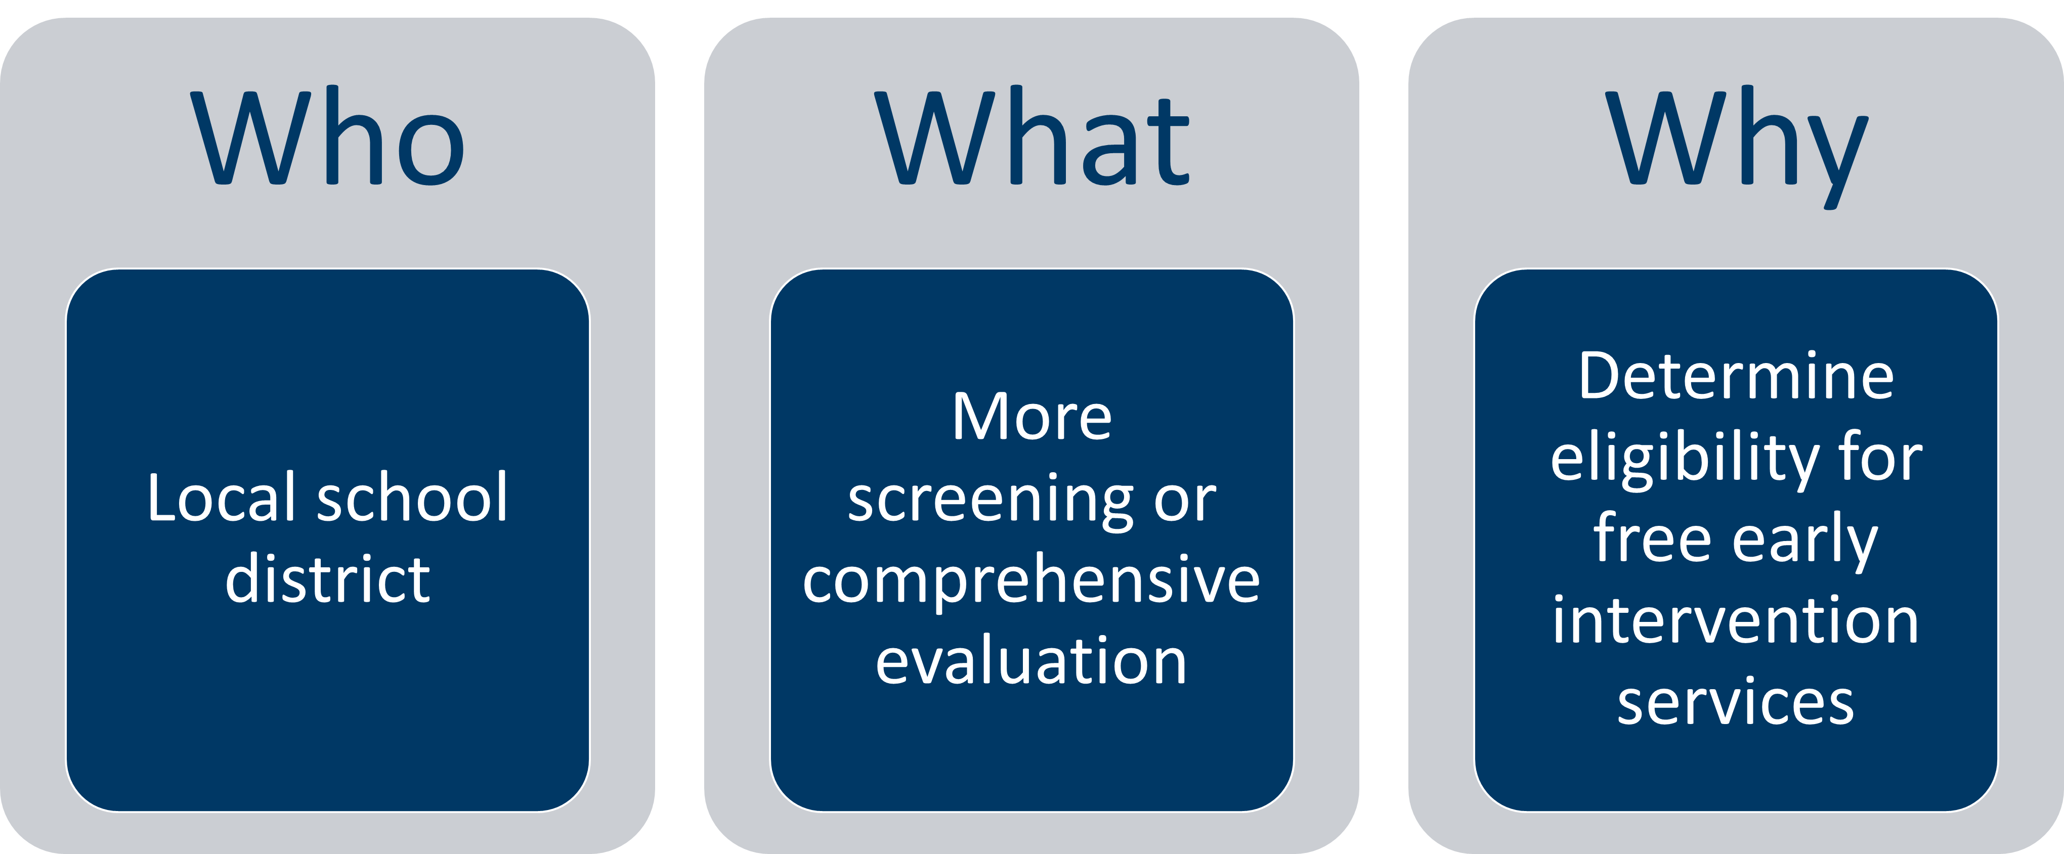
Educational Evaluation
Notes:
While the primary care provider is responsible for medical diagnosis and treatment, it’s essential to ALSO refer the child right away for an educational evaluation. In Minnesota, the local school districts provide Infant and Toddler Intervention and Preschool Special Education Services. The school district will contact the family and offer more screening or comprehensive evaluation to see if the child is eligible for free early intervention services.

Slide 55
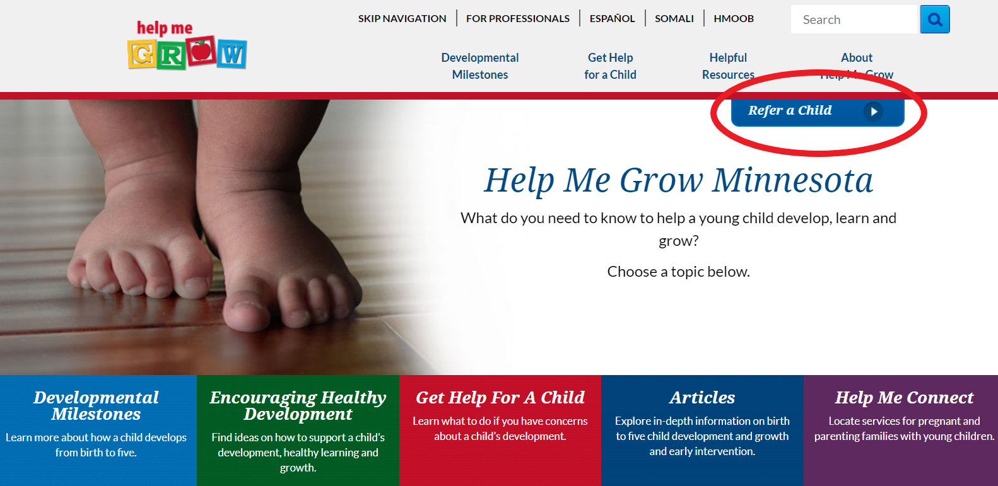
How to Make a Referral for Educational Evaluation in Minnesota
Call the school district directly, or
1-866-693-GROW (4769) or Help Me Grow MN (helpmegrowmn.org)
Notes:
To referral a child to for an educational evaluation to see if they are eligible for services, you can either refer them directly to the local school district by phone, fax or secure electronic means,
Or refer them via the statewide Help Me Grow website or toll-free phone number.
Click on the “Refer a Child” button to make the referral. [Optional: brief website demo]

Slide 56
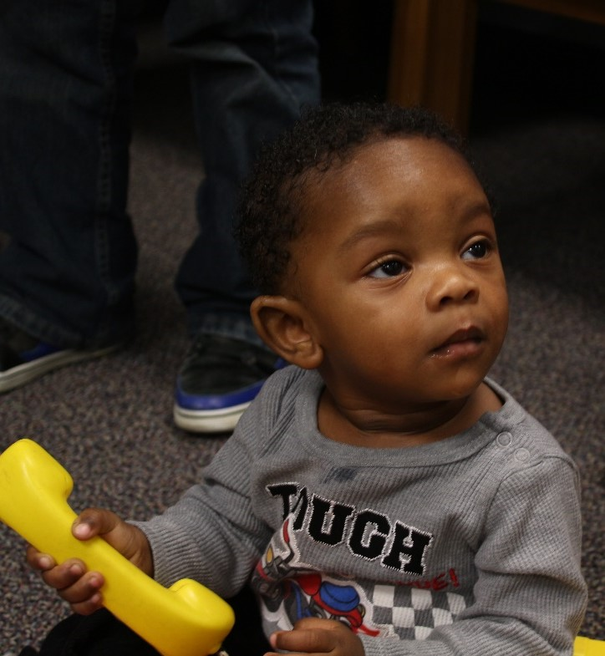
Refer EARLY for Educational Evaluation
Top reasons to refer before 3 years of age:
  Earlier intervention is more effective
  Easier to qualify for services
  Services are year-round
  Services provided in child’s “natural environment”
Beginning at age 3:
  Must demonstrate an educational need
  Services provided in early childhood classroom or center-based setting
Notes:
Referral to Help Me Grow is important, at any age before kindergarten – the sooner, the better! This gives the child more time to benefit from early childhood special education services, if they qualify.
There are some differences between Infant and Toddler Intervention services for 0-2 years and Preschool Special Education for 3-5 years.
Top reasons to refer before 3 years of age:
Earlier intervention is more effective, as we’ve talked about
Easier to qualify for ECSE services – the threshold to qualify for services under 3 years of age is lower
Services are year-round
Services provided in child’s “natural environment” – meaning in the child’s home or daycare
While referral at any age is important, there are some important changes once the child turns 3 years old. Beginning at age 3, :
The child must show an educational need, not just a developmental delay or concern. It is harder to qualify for early childhood special education services.
Services are usually provided in integrated preschool setting, rather than at home or daycare.

Slide 57
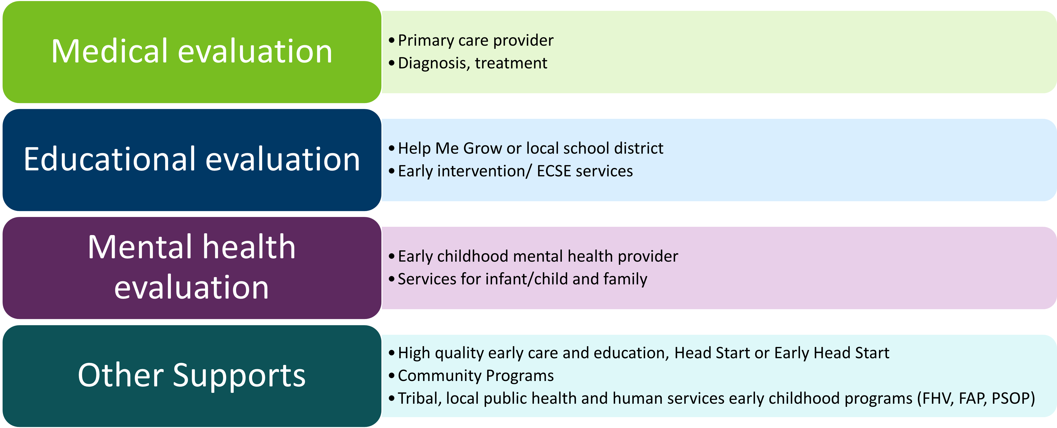
Social-Emotional Concerns: TRIPLE Referral
Notes:
Just like with developmental concerns, social-emotional concerns are most easy and effective to treat when we identify and act early.
For this reason, a child with social-emotional concerns should be also referred for medical and educational evaluation.
An additional important referral to make is to a local mental health provider that has special skills and training in working with the youngest children (birth to 5 years) and their families.

Slide 58
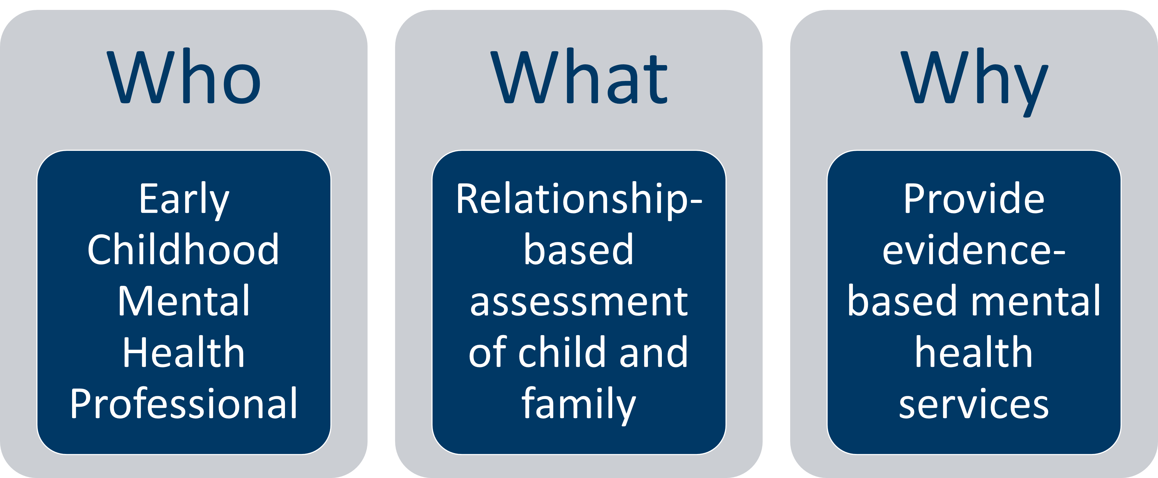
Mental Health Evaluation
Notes:
Early Childhood Mental Health professionals are specially trained to work with parents and caregivers when an infant, toddler, or young child shows behavioral or other social-emotional delays or concerns. They also recognize and support the mental health of the parent. These professionals have specialized training in evidence-based assessment and treatment of a broad range of social-emotional concerns. Their work supports the relationship between the parents and infant or young child, and their services support positive parenting. As with any developmental concern, it’s best to refer for mental health services sooner, rather than waiting until behaviors or relationships are at a point of crisis.

Slide 59
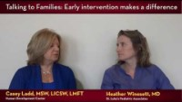
Talking With Parents of Young Children About Mental Health Referral
Talking to Families: Early Intervention Makes a Difference (youtube.com)
Notes:
VIDEO [click on photo for hyperlink to video; or use direct link: https://www.youtube.com/watch?v=CNeYRFuZAbA&list=PLqPfFYYbtBZh-wSpPl3-JDyOywMUUEXWY&index=7]
Casey Ladd, an early childhood mental health professional, talks about how important it is to intervene early for social-emotional concerns

Slide 60
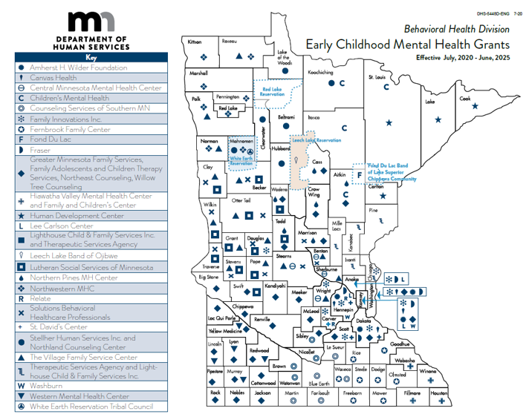
Early Childhood Mental Health Services in Minnesota
Early Childhood Mental Health System of Care (mn.gov)
Notes:
Minnesota is fortunate to have mental health professionals that specialize working with families of infants, toddlers and young children. These professionals have special training to provide evidence-based mental health services that work with parents and caregivers to support parenting and healthy development.
[HANDOUT: map and contact information for early childhood mental health providers/grantees.]
The Minnesota Department of Human Services supports early childhood mental health grantees in all counties and some tribes. Other local agencies may be available as well in your area – get to know your local resources.
Hyperlink:
https://mn.gov/dhs/partners-and-providers/policies-procedures/childrens-mental-health/early-childhood-mh-system-care/

Slide 61
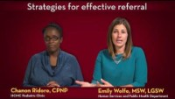
Effective Referrals
Offer options
Develop plan together
Prioritize based on family’s needs
Active referral: get the process started together
Warm handoff: help make initial connection, let families know what to expect, introduce them if possible
Notes:
[optional video: 2:16 minutes. CLICK ON PHOTO TO OPEN LINK TO YOUTUBE VIDEO. Direct link: https://www.youtube.com/watch?v=SZNgyfCGRsw&list=PLqPfFYYbtBZgdBhtKrxFAgsQPQgSIntNz&index=5]
Emily Wolfe is a social worker. She describes the family-centered approach she takes to talking about referrals. In this case, she is talking about referral for social-emotional concerns, but the same principles may apply to other types of referrals as well.
[LEARNING STRATEGY: Delete text from slide. Watch video together and ask participants to identify strategies for effective referral.]

Slide 62
Follow-Through
Family-centered decision-making:
  What is highest priority for the family?
  What works for them?
  Teach back
Follow through
  Families often do not follow through the 1st time – more than half of the time!
  Follow up by phone, mail, text or with a future visit
  Engage other professionals that have a trusted relationship with the family, with their permission
  Tips: care coordinator, tickler file, Excel spread sheet…
Notes:
[Training recommendation: Group discussion]
How do we put families at the center of how our screening and referral process works? How could we improve? [This can also be a good time to recognize that “family” means different things to different people – talk about how you learn from the child’s caregiver about the important people in that child’s life – who help with decisions, child care, and daily logistics like getting to appointments.]
Once we’ve developed a follow-up plan with the family, we can use the “teach back” method to ensure understanding and unearth any remaining questions or concerns. Ask the parent/caregiver to explain in their own words what they understand to be the next step. This is the same information they can share at home with other important adults in the child’s life.
What are expectations for follow-up in our program, when concerns are identified and a referral is made? How can we do a better job of making sure families are supported to get to the next step?

Slide 63
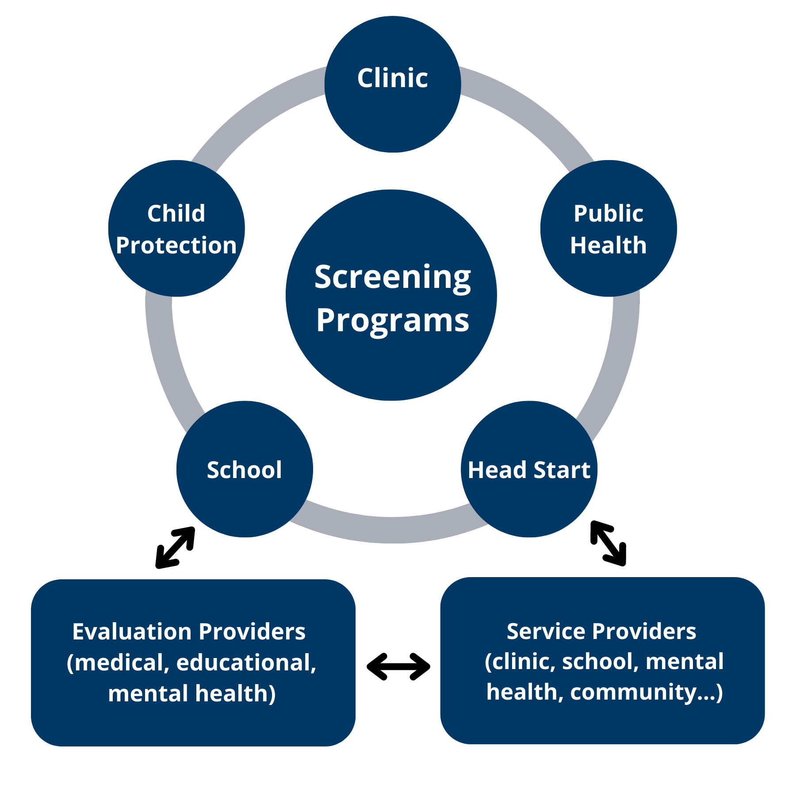
Closing the Loop
Family needs
Parent consent
Who needs to know
What information
Notes:
[Point out the child and family in the middle of a complex system]
The child will have better outcomes, and the family will have a smoother and less frustrating process, if we coordinate with other programs who are serving or will be working with the family.
Questions:
Where else does the child receive screening, besides our program? How can we best coordinate with them?
What information do other providers need after referral to do their job well, and meet the needs of the family?
Note: explain to the family why sharing information is helpful to decrease duplication (repeated screening) and improve the services their child can get; make sure to follow federal and state privacy laws and obtain signed consent when it’s required. [an example of when consent is needed is provided on the next slide]
Screening results: clinics, schools and mental health providers can use screening results to inform their evaluation (and they don’t have to duplicate screening)
Other information about the child and family that may help inform the evaluation (e.g. homelessness, pertinent health or social history)

Slide 64
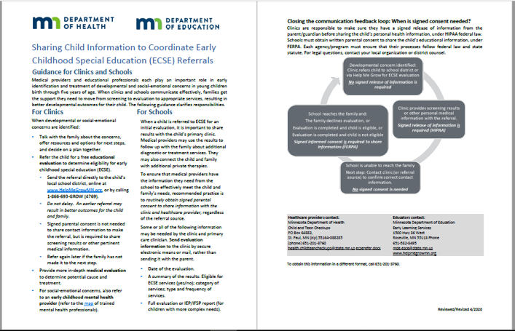
Example of Why and How to Share Information
Fact sheet for clinics and schools: Sharing Child Information to Coordinate ECSE Referrals (health.state.mn.us)
Notes:
This fact sheet was developed by MDH and MDE to clarify the importance of sharing information and coordinating care between clinics and early childhood special education programs when it comes to early childhood screening and evaluation. It clarifies HIPAA and FERPA requirements for sharing information.
This can serve as an example for other programs as well. Contact information is available on the back side of the fact sheet, for questions.
Hyperlinks:
Sharing Child Information to Coordinate ECSE Referrals - https://www.health.state.mn.us/docs/people/childrenyouth/ctc/devscreen/ecserefer.pdf

Slide 65
Community Supports for Healthy Development
County and tribal public health programs:
  Follow Along Program
  Family Home Visiting
School district and community education programs:
  Early Childhood Family Education (ECFE)
  Various pre-K and school readiness programs
Head Start and Early Head Start
Child Care Aware of Minnesota
Other community family support programs
Refer to Developmental and Social-Emotional Screening Resources (health.state.mn.us)
Notes:
Many families will benefit from the non-clinical programs in the community that support them as parents, and that promote their child’s healthy development.
Most communities have these types of programs available through the county, school district, or other community-based programs:
The Follow Along Program is available in most counties and some tribes in Minnesota. Public health nurses or other staff send out Ages and Stages developmental and social-emotional questionnaires and follow up with families when there is a concern.
Family Home Visiting is an evidence-based program of intensive home visiting by nurses or other trained personnel offered by many counties and tribes,, usually starting prenatally and continuing until the child is 2-3 years old. This program is good to consider especially for young or first-time parents, or for families where there are significant risk factors for the family or the child’s development.
Early Childhood Family Education, or ECFE, is a program available through community education for parents and children 0-5 years old. These parent groups are facilitated by child development professionals, and are designed to support positive parenting, healthy child development, and school readiness.
Early Head Start for infants and toddlers is available in many communities, and includes high quality early care and education, along strong family engagement and support.
Various types of voluntary and district pre-K programs are available, as well as School Readiness programs.
For more information about finding these programs in your area of the state, go to this website: http://www.health.state.mn.us/divs/cfh/topic/devscreening/resources.cfm.
Parents can also find high quality child care in their area by going to www.parentaware.org.

Slide 66
Developmental and Social-Emotional Resources
Refer to Developmental and Social-Emotional Screening Resources (health.state.mn.us) for more information about these programs:
  Help me Connect
  Child and Teen Checkups
  WIC
  Early Childhood Screening
  Help Me Grow
  Learn the Signs. Act Early.
  Positive Parenting Tips
Notes:
Hyperlinks:
Resources - https://www.health.state.mn.us/people/childrenyouth/ctc/devscreen/resources.html

Slide 67
Our Program Referral Resources
Create your program specific contact list of:
  Medical evaluation and treatment
  Educational evaluation and services
  Mental health evaluation and services
  Other local programs that support healthy development
  Materials and resources for families
  Methods to follow-up with families
Notes:
[Optional discussion: Review your program’s resources and process for referral for the following:]
Medical evaluation and treatment – if a child is not already connected to a primary healthcare provider, what are some local clinics that provide high quality pediatric care?
Educational evaluation and services – how do we make the referral for ECSE evaluation? [for example, Help Me Grow online, directly to ECSE staff in our building, other…]
Mental health evaluation and services – who are the local early childhood mental health agencies and professionals? Have we met them? Can we set up a time to meet, and develop a referral process?
Other local programs that support healthy development – especially if a child doesn’t qualify for ECSE services, what are other programs we can recommend? [e.g. quality child care, Head Start/Early Head Start, Follow Along Program, Family Home Visiting, local parenting support groups…]
Materials and resources for families – What resources do we offer to parents to support healthy development at home?
Methods to follow-up with families – How do we/can we ensure that families make it to the next step when concerns are identified?

Slide 68
Virtual Screening Tips
Know your options for questionnaire delivery and completion (online platform or phone).
Prepare parents for the screening ahead of time.
Before screening, take time to introduce and review the questionnaire.
Assist families with gathering and adapting materials.
Schedule two phone or video conferences: one to go through the questionnaire, one to discuss results and next steps.
Follow a step-by-step guide for virtual screenings.
Learn more about how to work effectively with parents during virtual screenings.
Virtual Screening Tips (agesandstages.com)
Notes:
During COVID-19 your program may be offering more screening using a virtual method. Here are some helpful tips.
Hyperlinks:
Virtual Screening Tips - https://agesandstages.com/free-resources/articles/tips-and-resources-for-virtual-asq-screenings/

Slide 69
9 Best Practices for Using an Interpreter for ASQ Completion
A translated questionnaire is not a substitute for an interpreter.
Use an interpreter, not a translator.
Know the qualities of a good interpreter.
Prepare the interpreter with a questionnaire preview.
Try to identify items that are not culturally appropriate.
Get off to a smooth start.
Take your time during administration.
Give the family a summary at the end.
Keep a record of culture-related notes.
9 Best Practices for Using an Interpreter for ASQ Completion (agesandstages.com)
Notes:
Hyperlinks:
( Best Practices for Using an Interpreter for ASQ Completion - https://agesandstages.com/free-resources/articles/best-practices-for-using-an-interpreter-for-asq-completion/

Slide 70
Remote Interpreting
Remote interpreting (atanet.org)
Communication has moved to online platforms
Options: phone, video, video conferencing, remote simultaneous interpreting
Planning and equipment recommendations
Tips for before, during and after the session
Notes:
Although this link was created for educational setting, health care settings may benefit from reviewing these same best practices. This is one in a series of guidance documents.
file:///C:/Users/mchresand/AppData/Local/Microsoft/Windows/INetCache/Content.Outlook/WXITSQ5K/Best%20practices%20for%20remote%20interpreting%20in%20Education%20(002).pdf
or
http://www.iteworkgroup.org/ Interpreting and Translation in Education Workgroup.

Slide 71
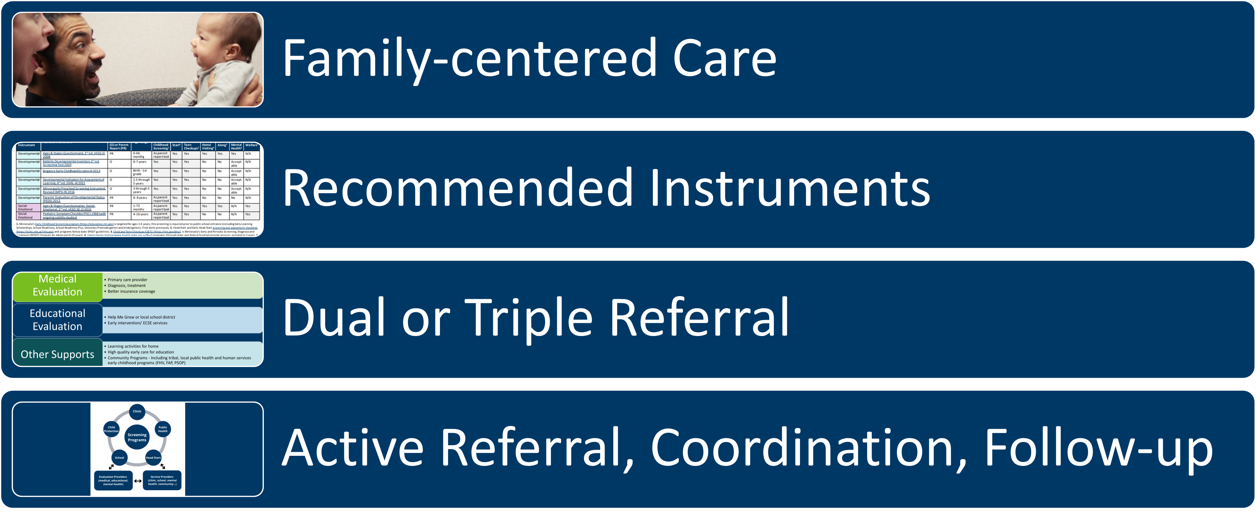
Take-Home Points
Notes:
Summarize the most important points of the training. [Discussion suggestion: ask attendees to elaborate on each of these.]
Family-centered care means recognizing parents/caregivers as children’s most important partner in healthy development; building our services and processes around what works for families; listening first to parent/family concerns; and partnering with families to develop a plan when concerns are identified.
Minnesota recommends specific developmental and social-emotional screening instruments that are sensitive, specific, valid, reliable, and practical. Recommended instruments should be used in all of Minnesota’s public screening programs. These instruments are listed online, along with more detailed information.
When developmental concerns are identified, make a dual referral (refer the child for both medical and educational evaluation). When social-emotional concerns are identified, make a triple referral (for medical, educational, and mental health evaluation). [Review referral resources and processes for your specific program.]
Make an active referral by sending referral and related information directly rather than asking the parent to call or bring the information. Coordinate and communicate with the program to which the child is being referred, with appropriate parent/guardian permission. Follow-up to make sure the family was able to make it to the next step.

Slide 72
Thank You!
Firstname Lastname
firstname.lastname@state.mn.us
555-555-5555

